Slide 1
Finding
the Building Maker
David Leslie, RWC
NU-FAM

Slide 3
Shocking Truth:
80% of new construction litigation involves water intrusion!
Notes:
Considering that there are so many trades working on one building and few people know how to manage Terminations, Transitions, and Penetration, it is no wonder that 80% of litigation involves water intrusion. That is like say 8 out of 10 cars in the new car lot will not run!!

Slide 4
Purpose of Buildings:
Keeping the Outside Out
and the Inside In!

Slide 5
Learning Objectives:
1: We will examine the 90%/1% to develop an understanding of why continuity is needed in the construction process to create continuity in the building.
2: We will study the process of Design-Bid-Build (DBB) compared to the Power vs. Knowledge graph to uncover the root causes making continuity in the process virtually impossible.
3: We will delve into the concept of the Building Maker and gain insight into why the method can change our industry for the better.
4: We will investigate the steppingstones that can move our industry from leak-ridden legal quagmires of buildings produced with DBB, to the streamlined performance-based building delivered by a Building Maker.

Slide 6
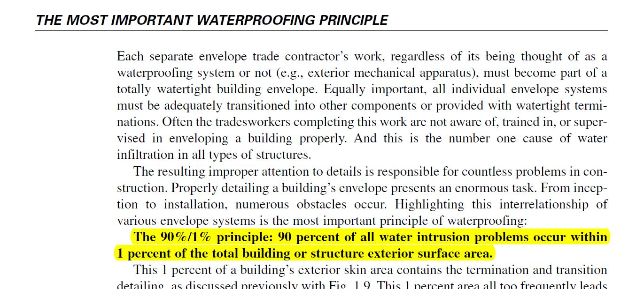
Michael T. Kubal –
Construction Waterproofing Handbook
Notes:
Michael was a waterproofer who was great a stopping leaks. For years, people said he needed to write a book and he did. In that book, he has two principle and the first and most important is the 90%/1% principle. 90% of all water intrusion comes from less than 1% of the building surface.

Slide 7
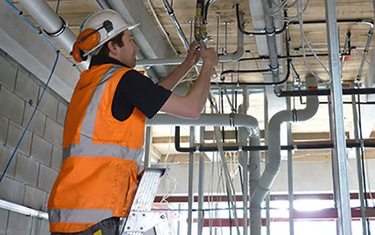
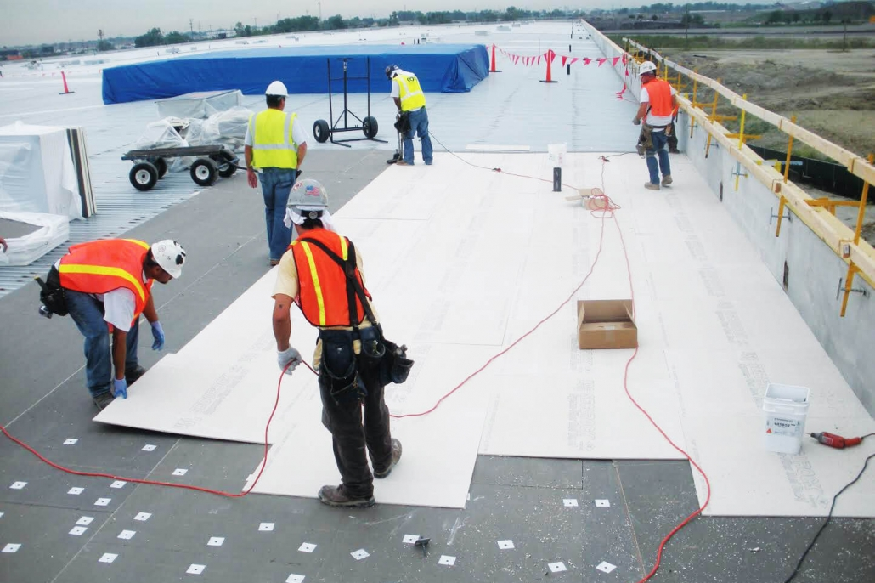
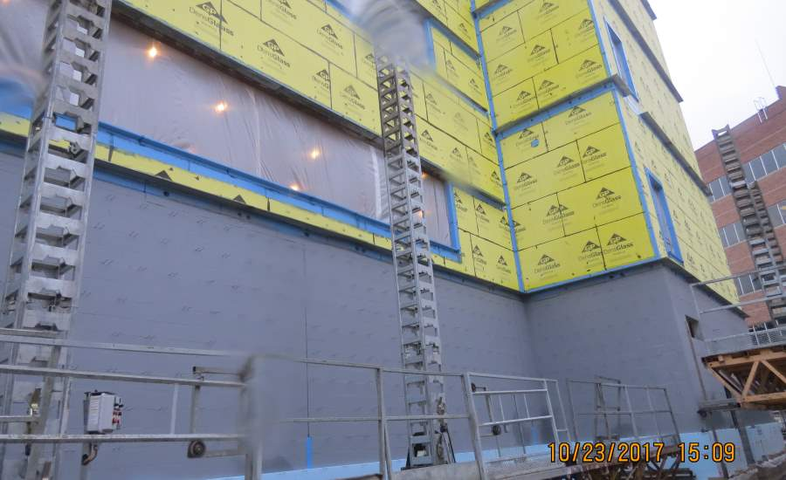
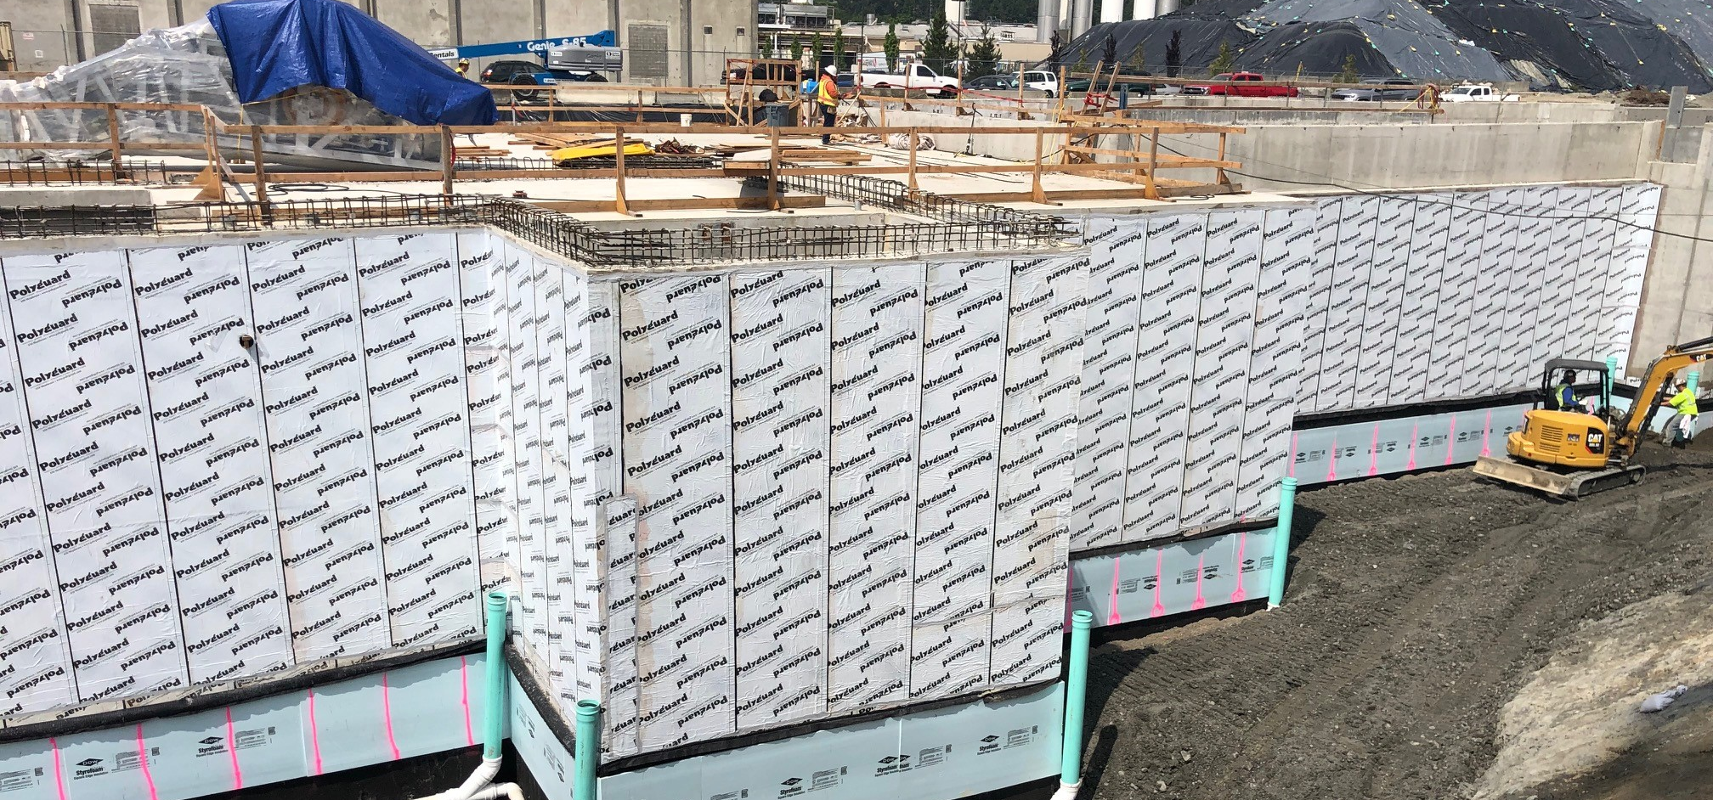
Notes:
We know that know the 90% of leaks occur in less than 1% of the building surface or in three places: Terminations, Transitions, and Penetrations. In construction today the waterproof, the air barrier installer, the glazer, and the roofer are all different contractors. So, the 1% being Terminations, Transitions, and Penetrations is where these installers systems meet, and no one takes ownership.

Slide 8
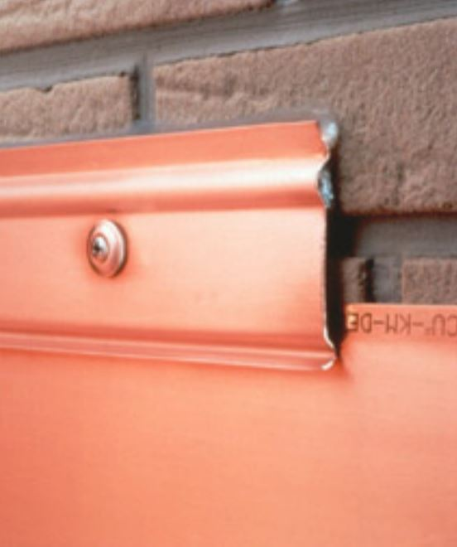
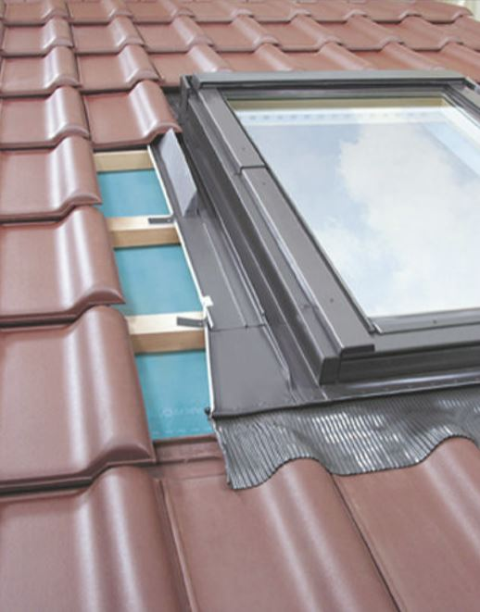
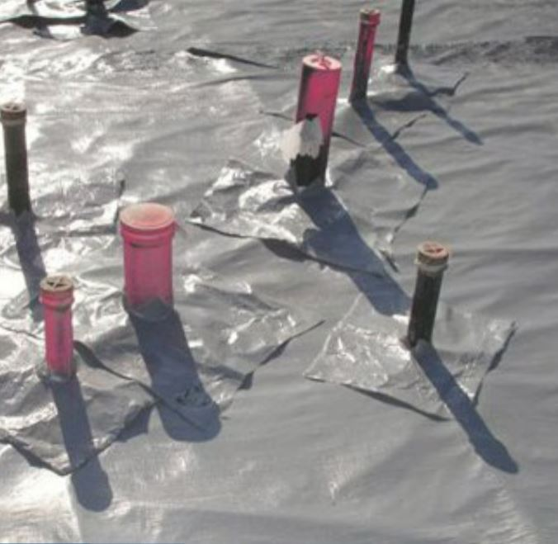
The 1% is:
Terminations
Transitions
Penetrations

Slide 9
Design
Bid
Build
(DBB)

Slide 10
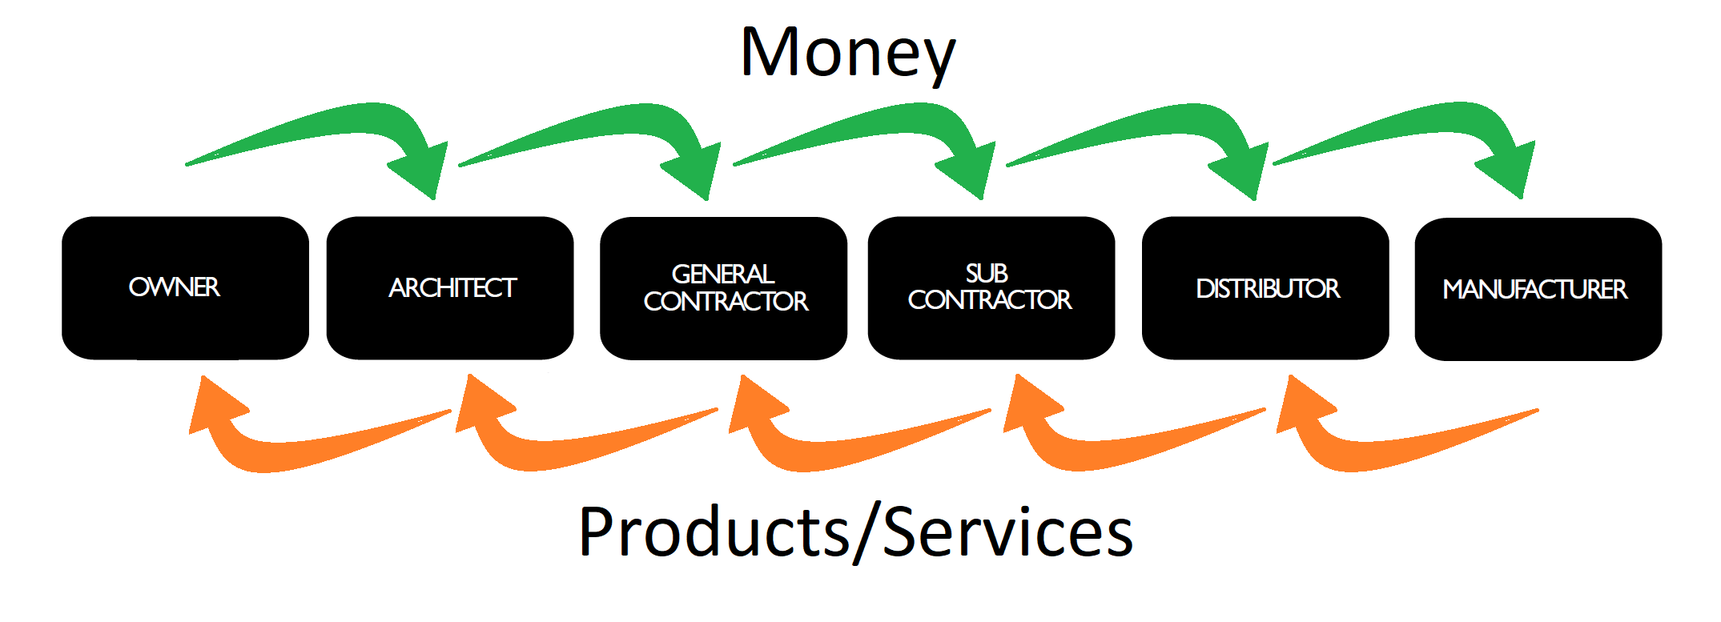
Design
Bid
Build
(DBB)

Slide 11
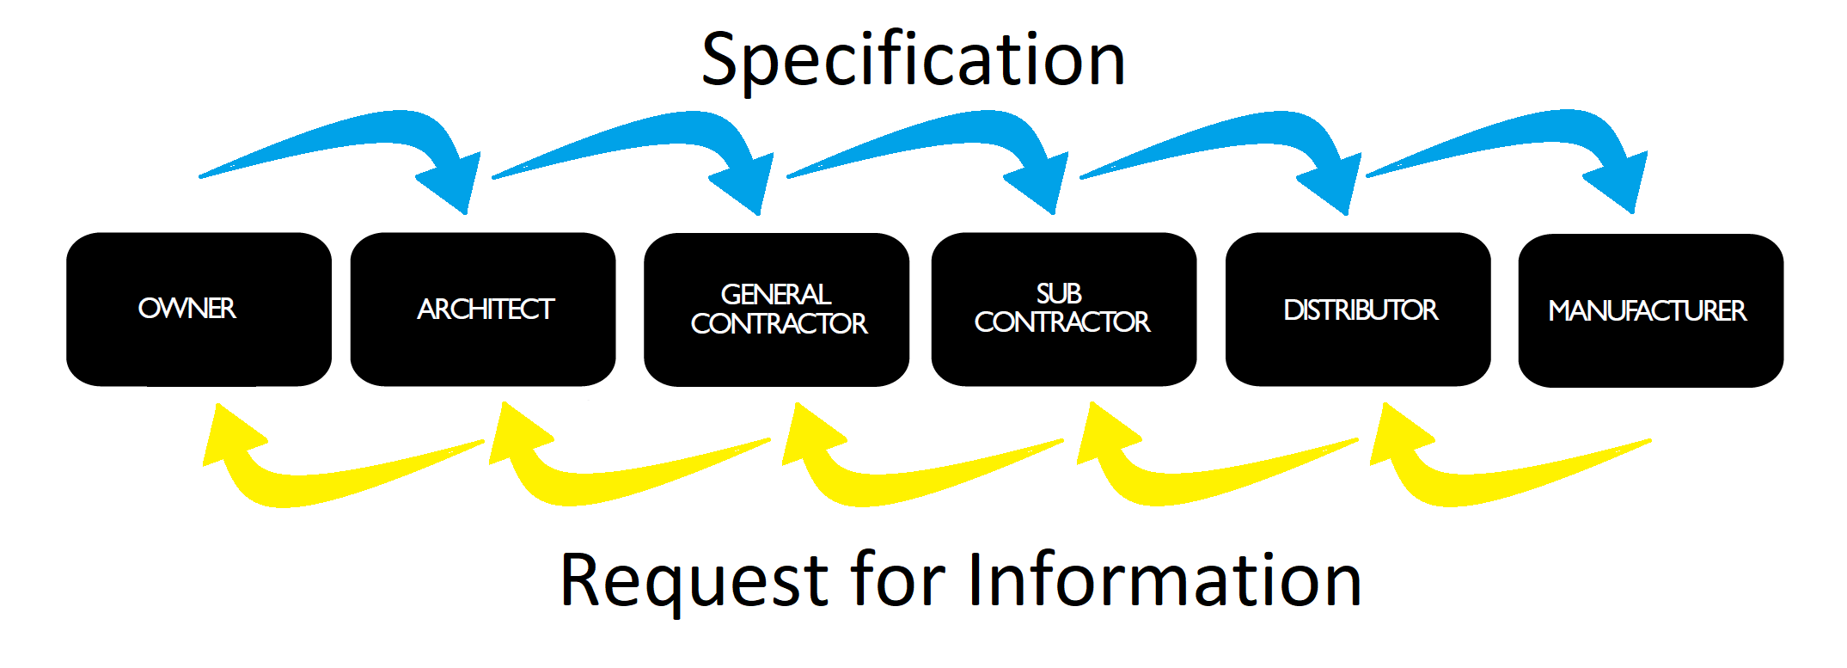
Design
Bid
Build
(DBB)

Slide 12
Fact:
You cannot have continuity in the building,
if You do not have continuity in the process.

Slide 13
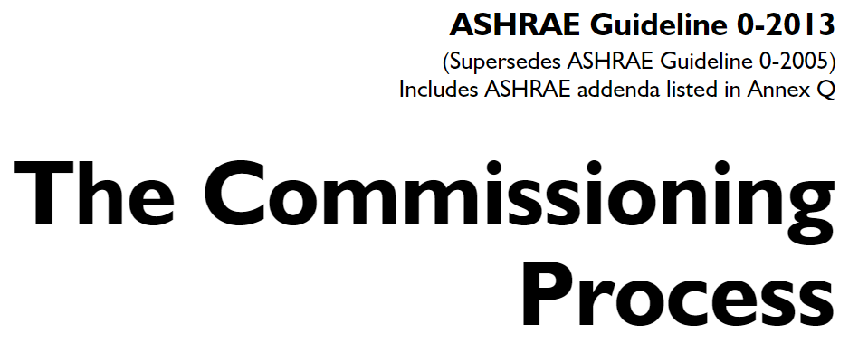
ASHREA 90.1

Slide 14
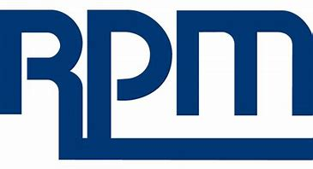
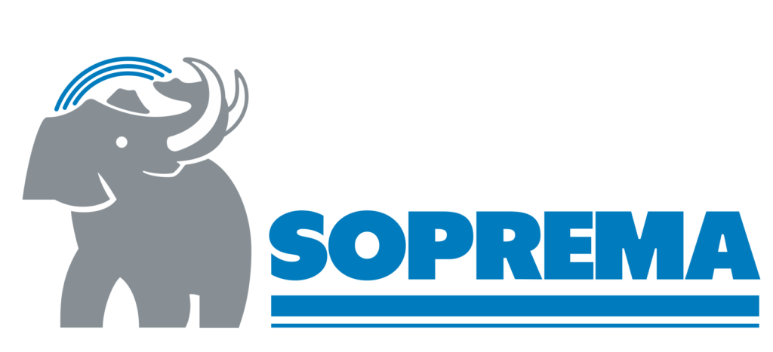

Slide 16
Reason for Constructing Buildings:
Providing for our family!

Slide 17
Understanding Motives:
Who are you?
Who is your customer?
How do you make money?

Slide 18
Stakeholders
Primary Motivation

Slide 19
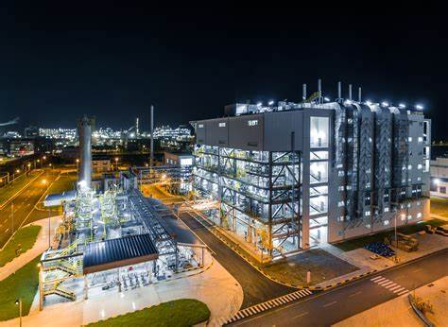
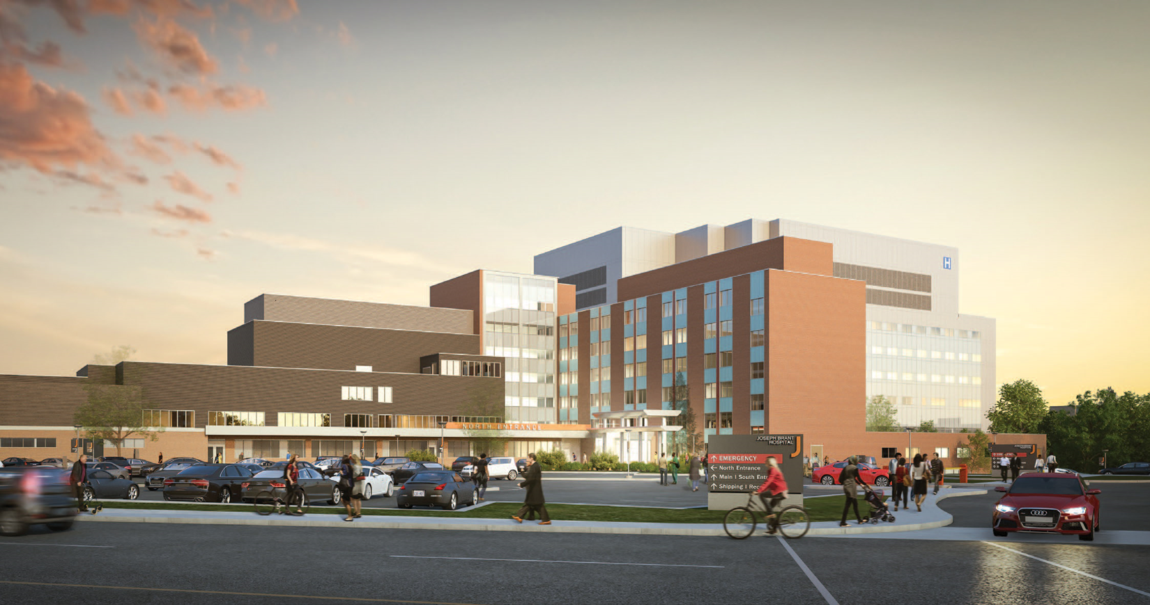
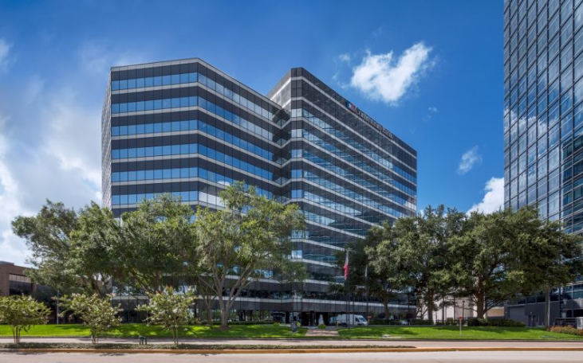
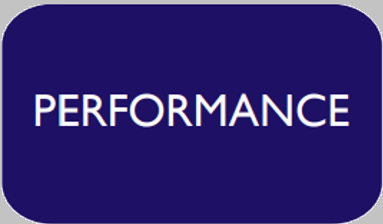
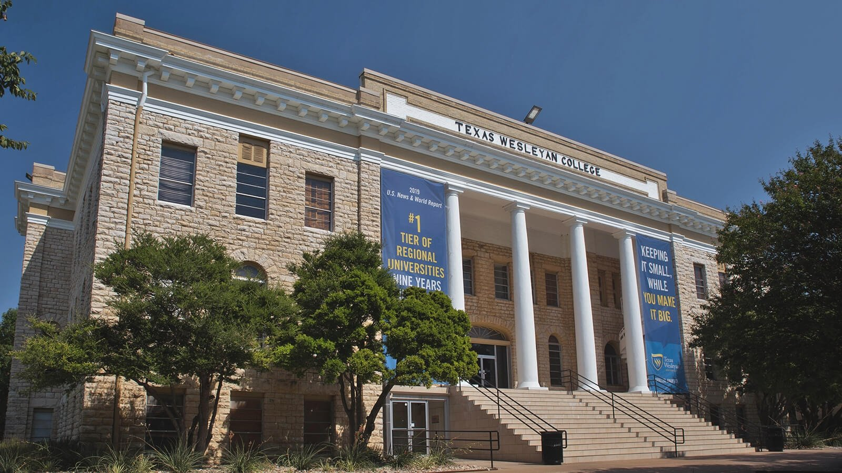

Slide 20
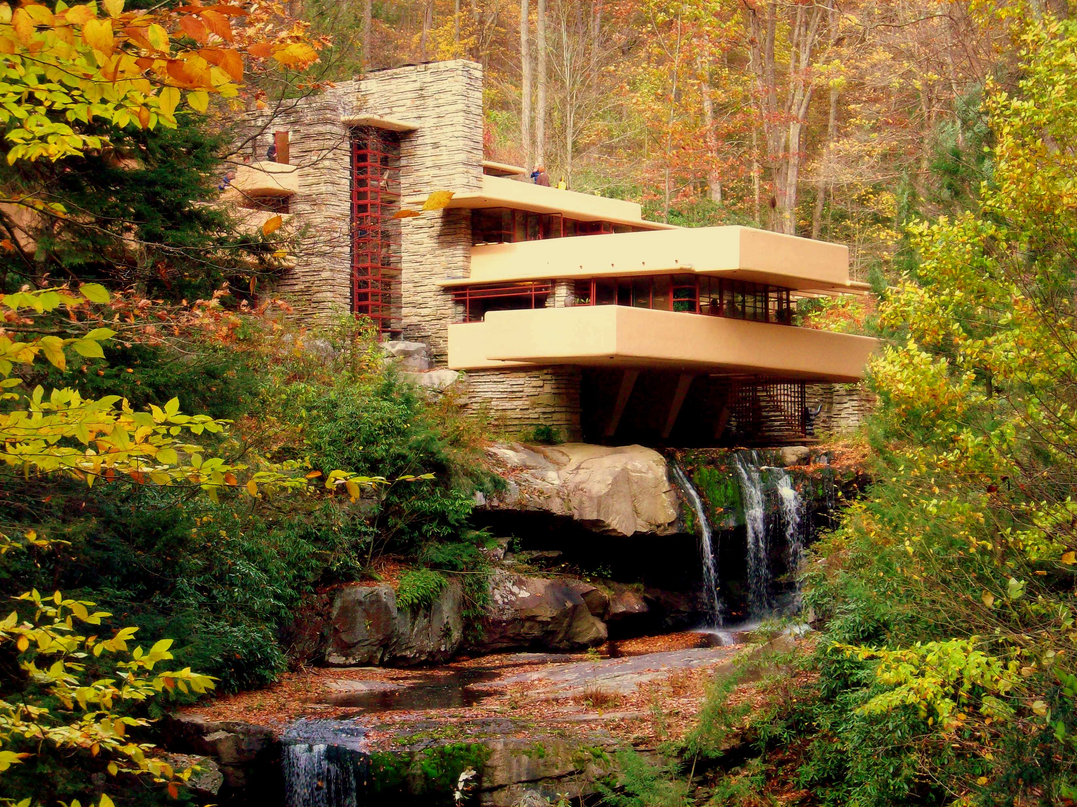
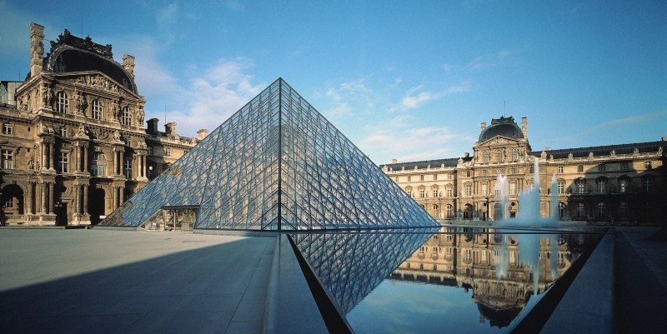
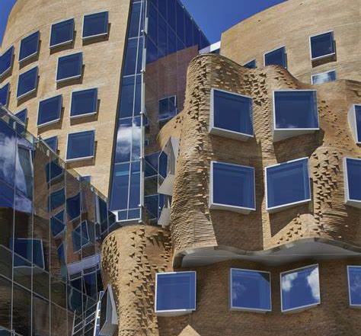
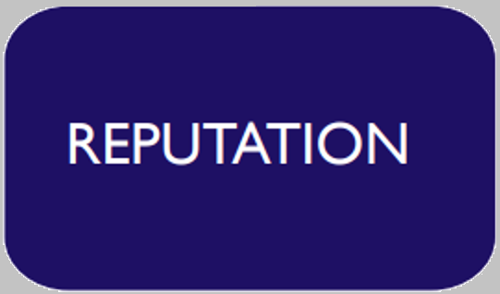
Notes:
Frank Lloyd Wright – Failing Water, Frank Gehry - Dr Chau Chak Wing building, I. M. Pei -Entrance to the Le Grand Louvre in Paris

Slide 21
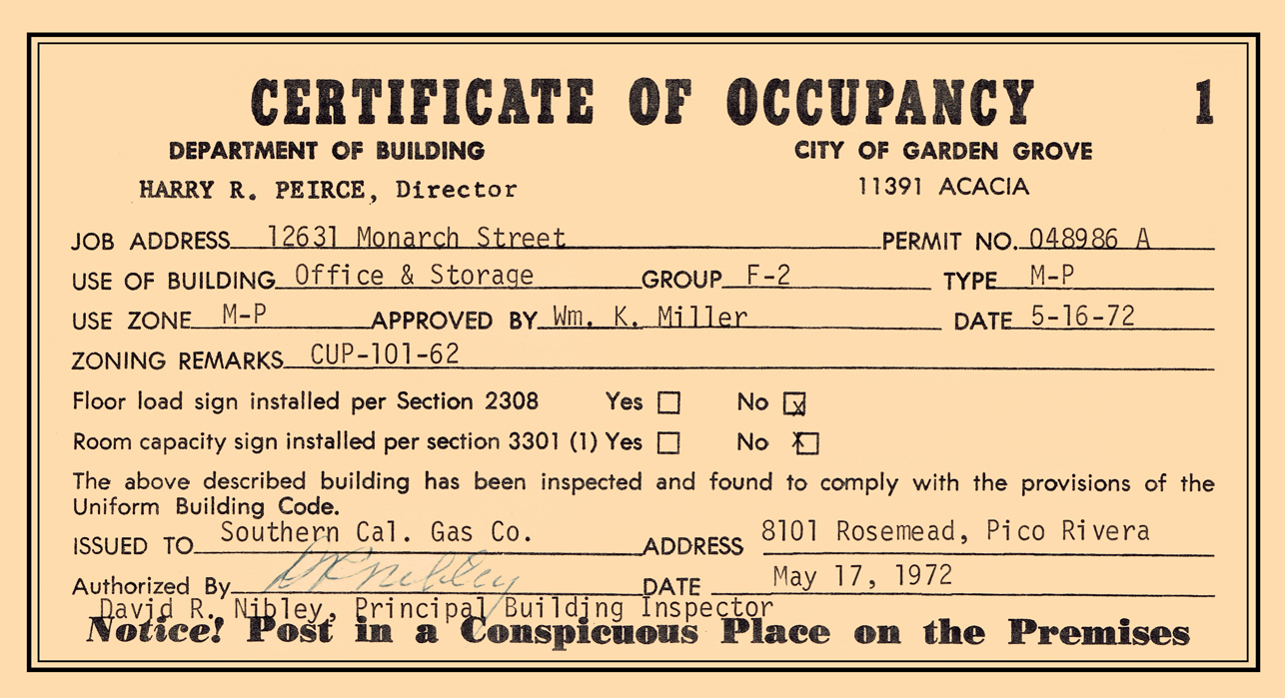
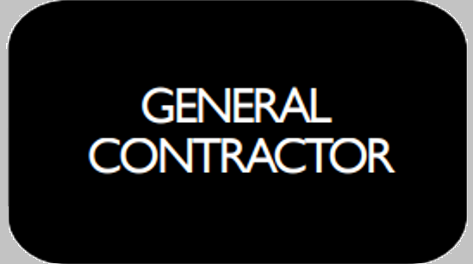
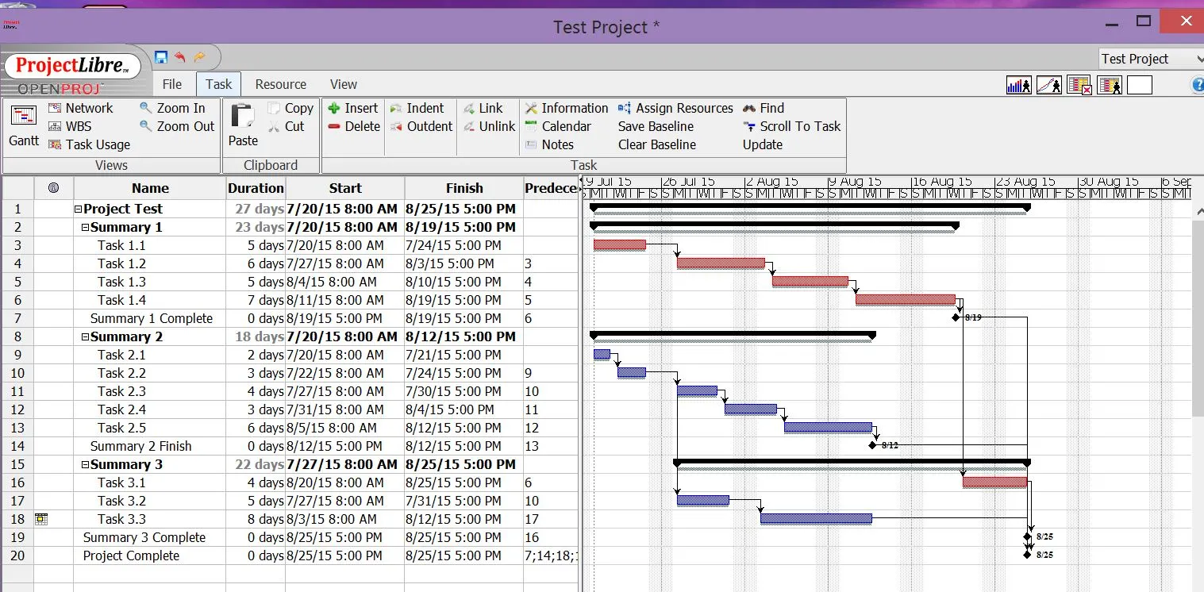
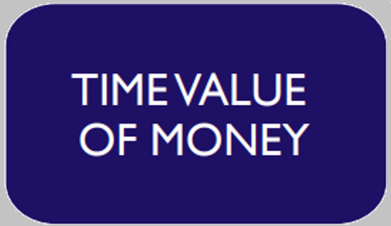

Slide 22
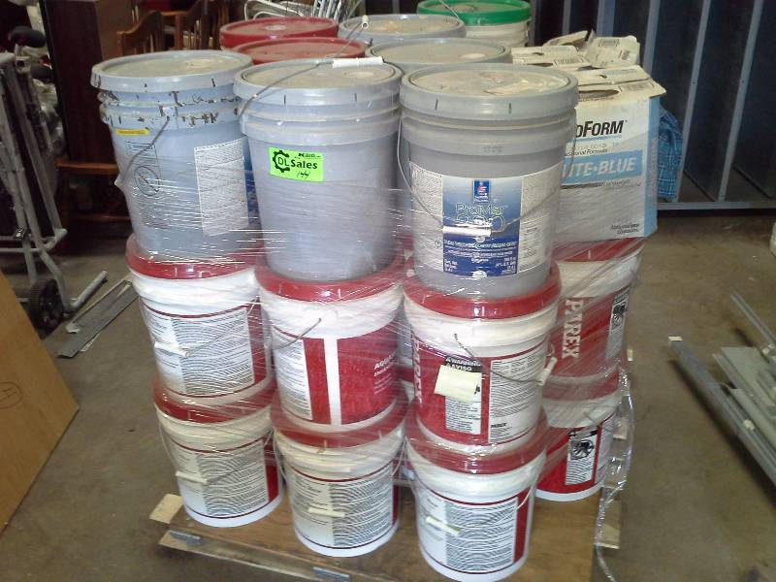
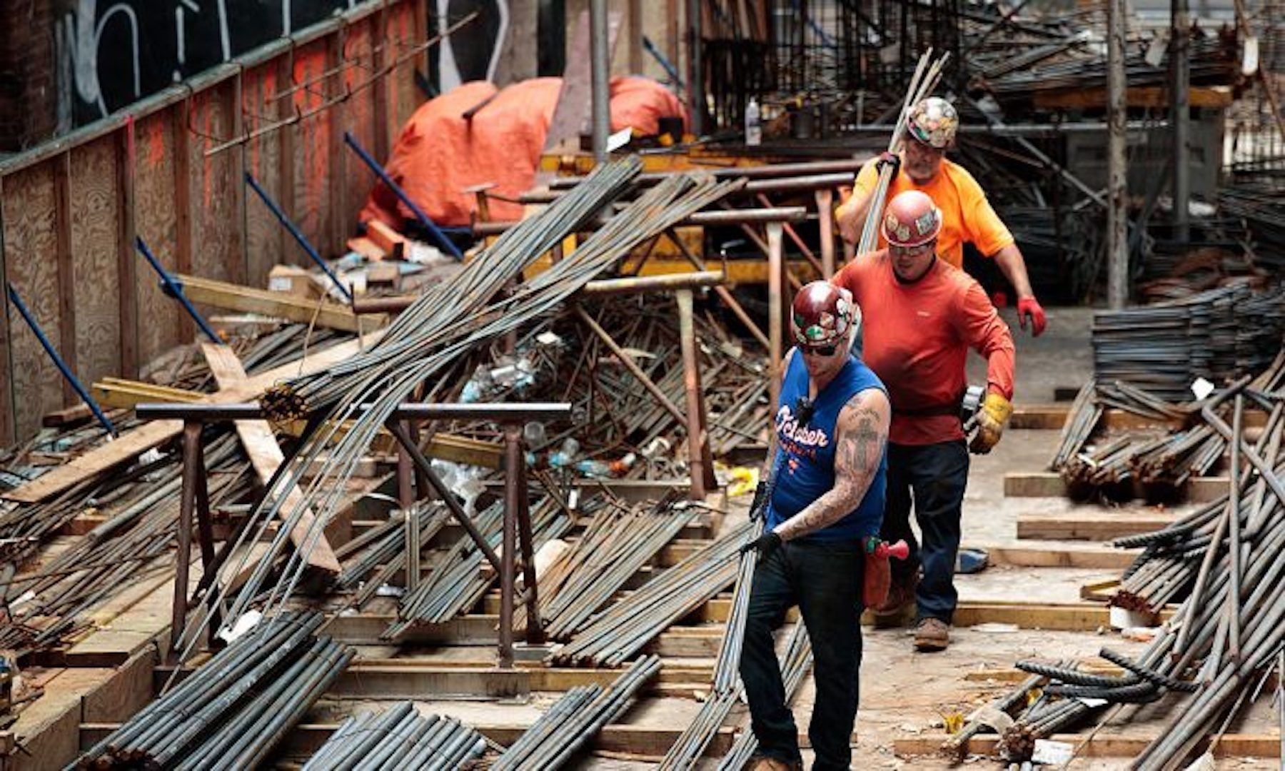
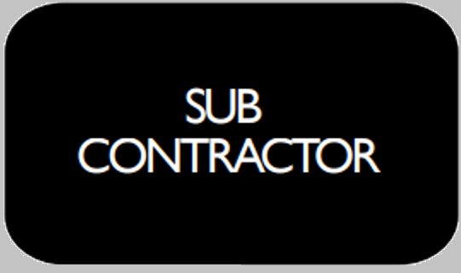
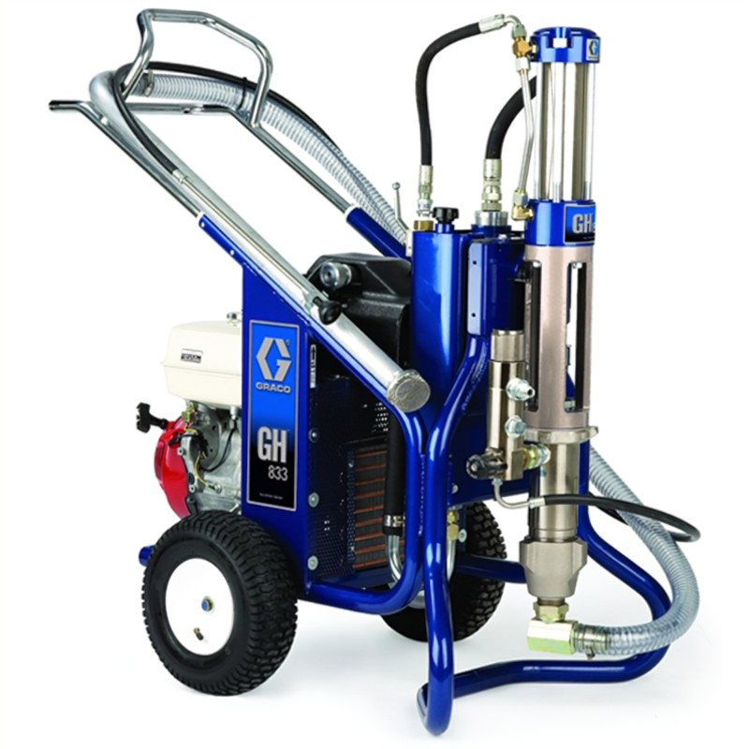
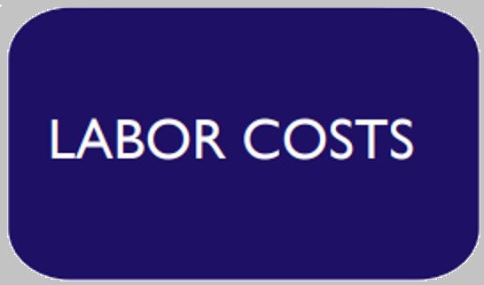

Slide 23
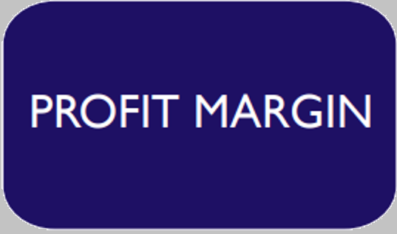
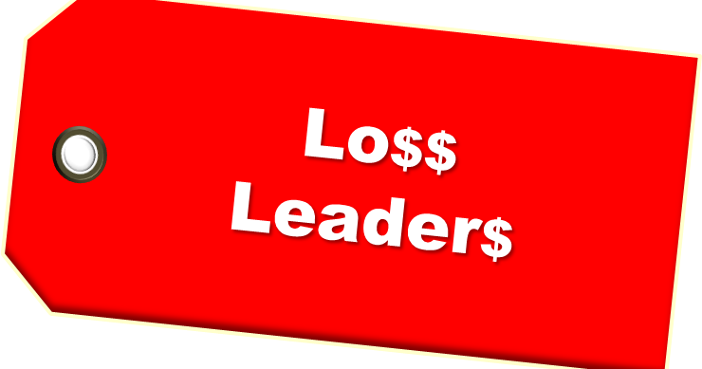

Slide 24
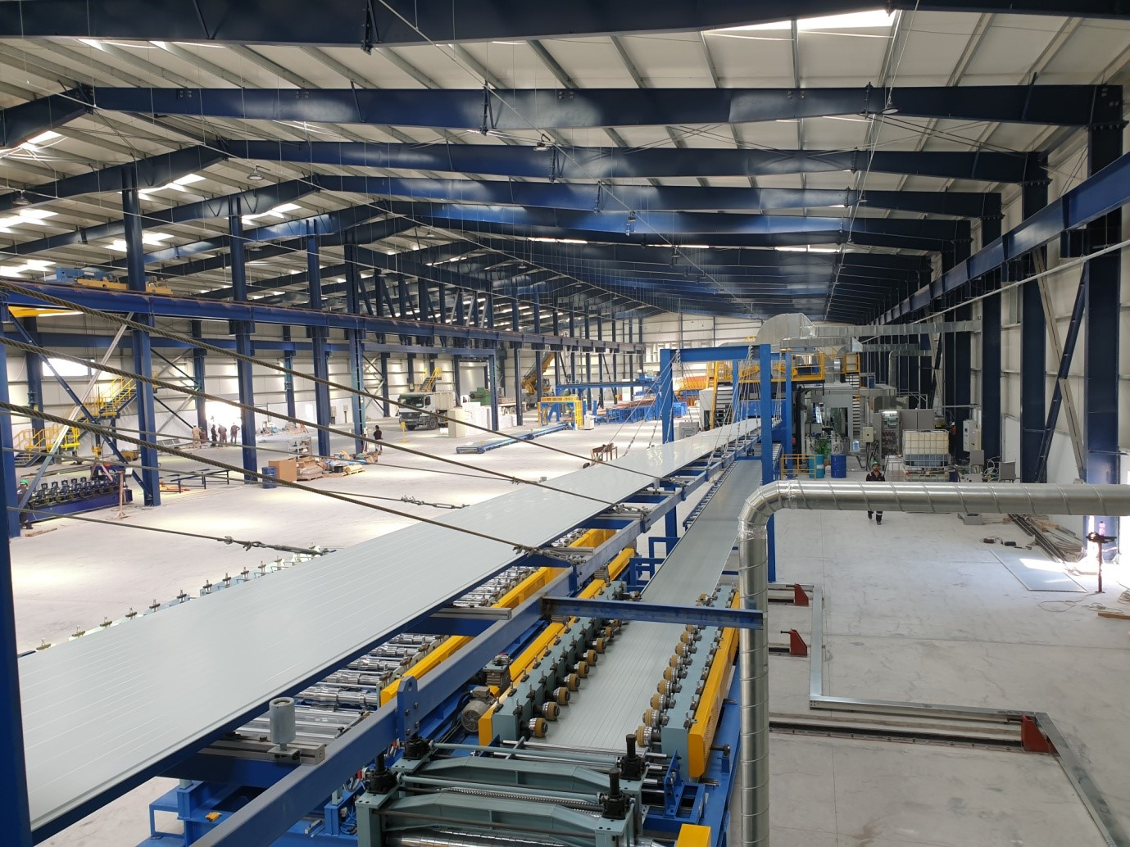
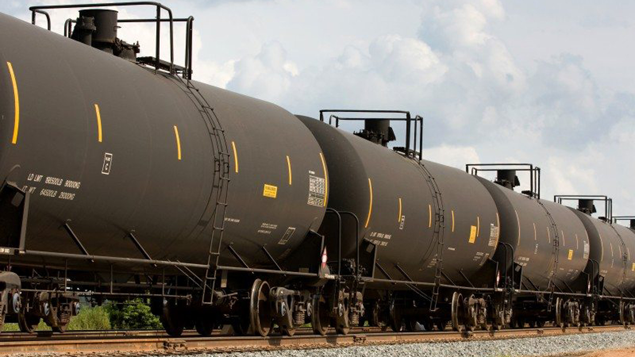
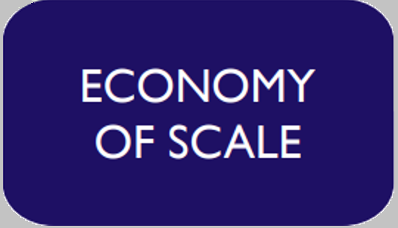
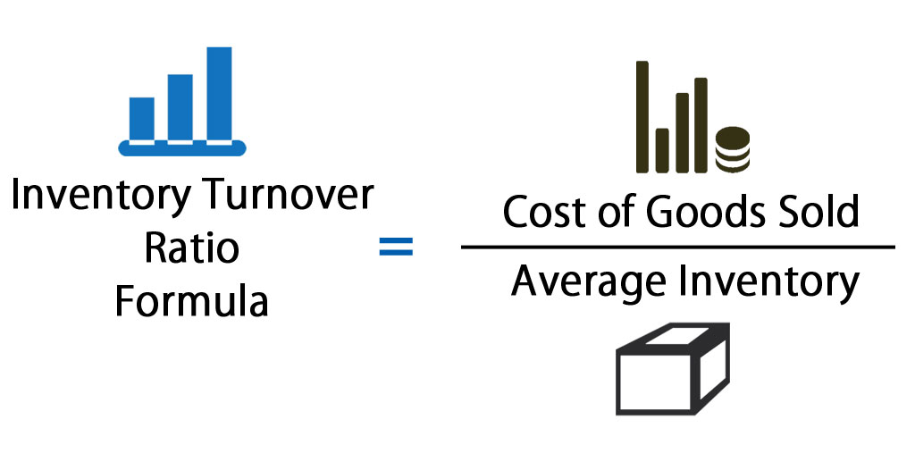

Slide 25
Success with DBB =
Get to the next job FASTER!

Slide 26
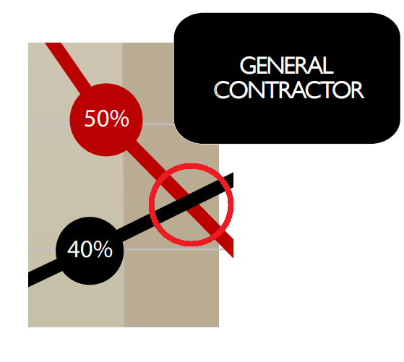
How often does one Owner build a new building?

Slide 27
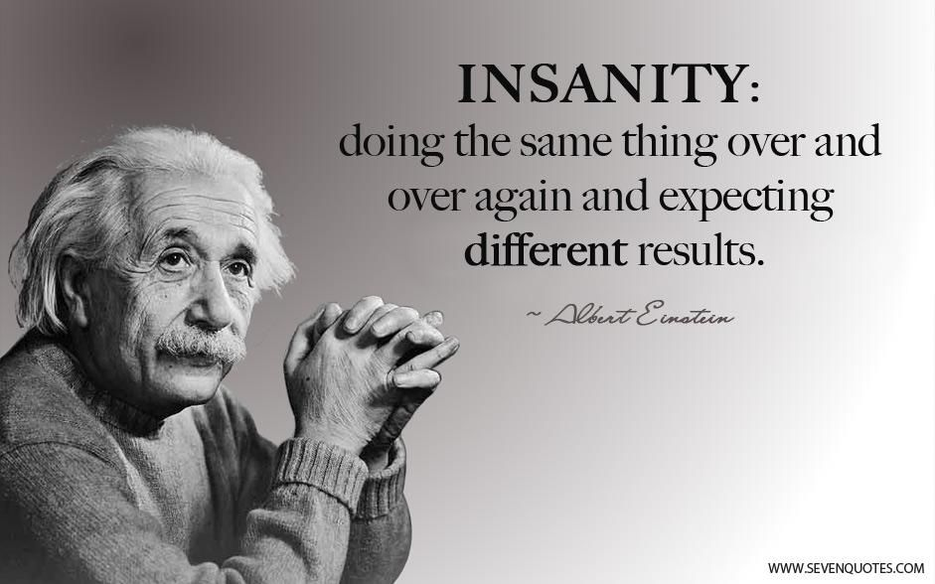

Slide 28
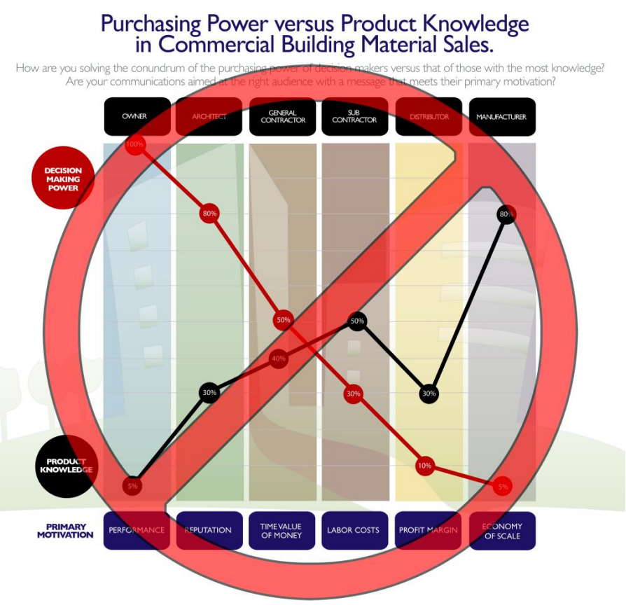

Slide 29
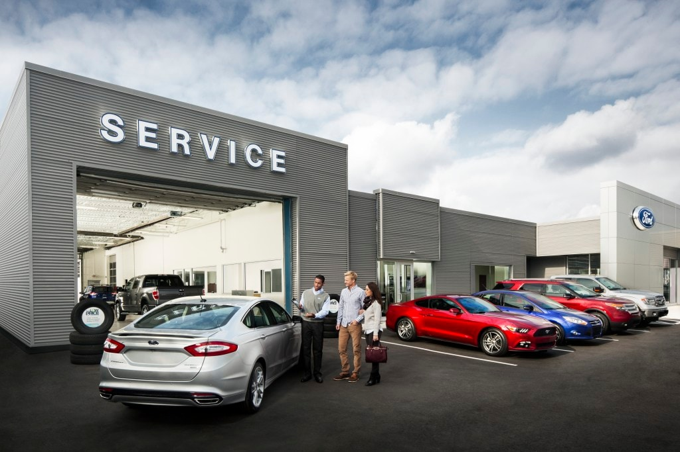
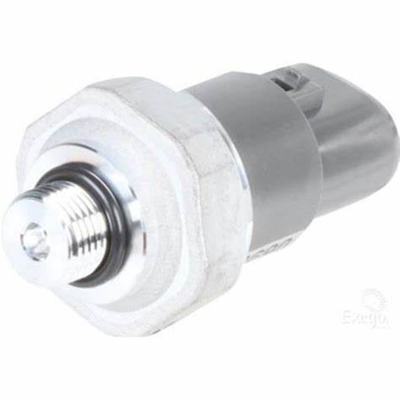
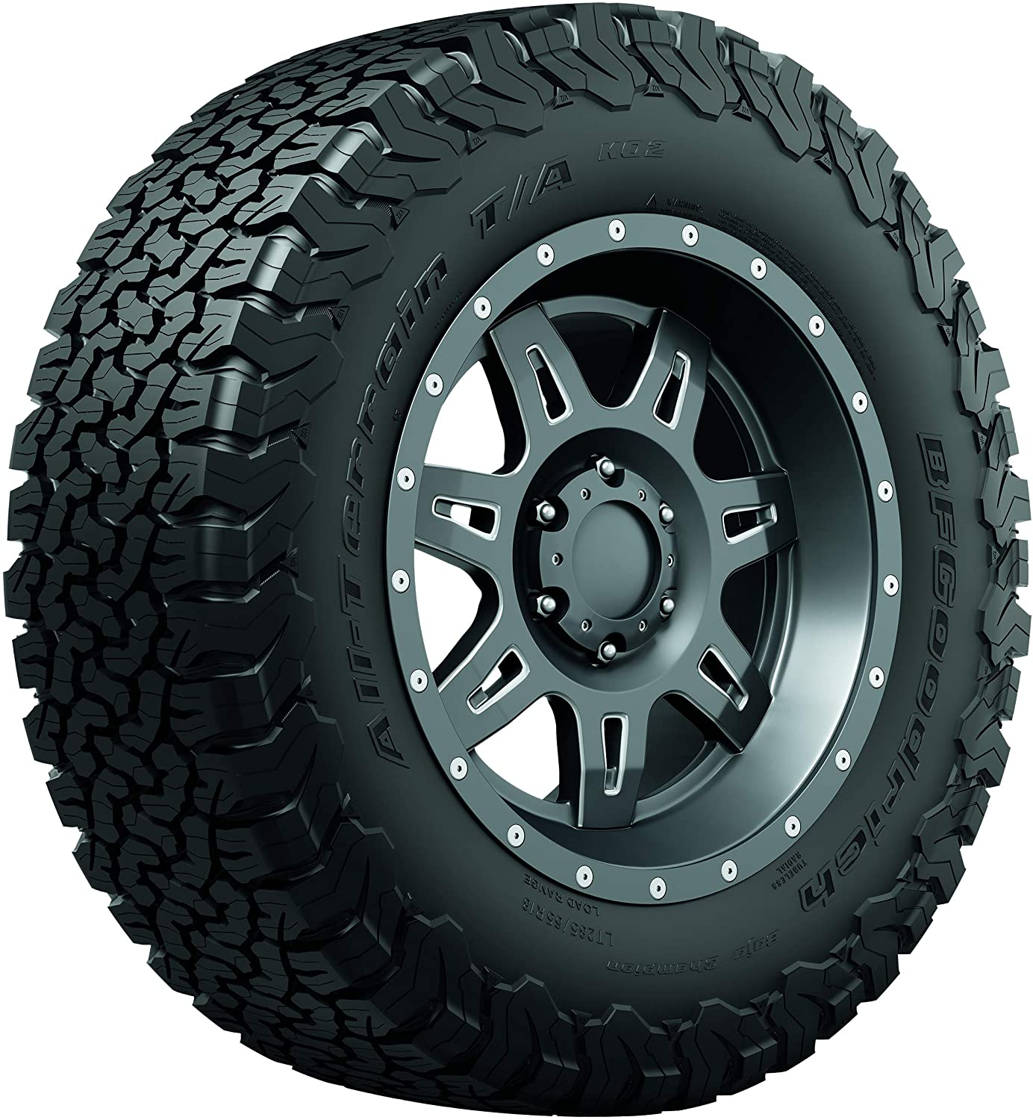
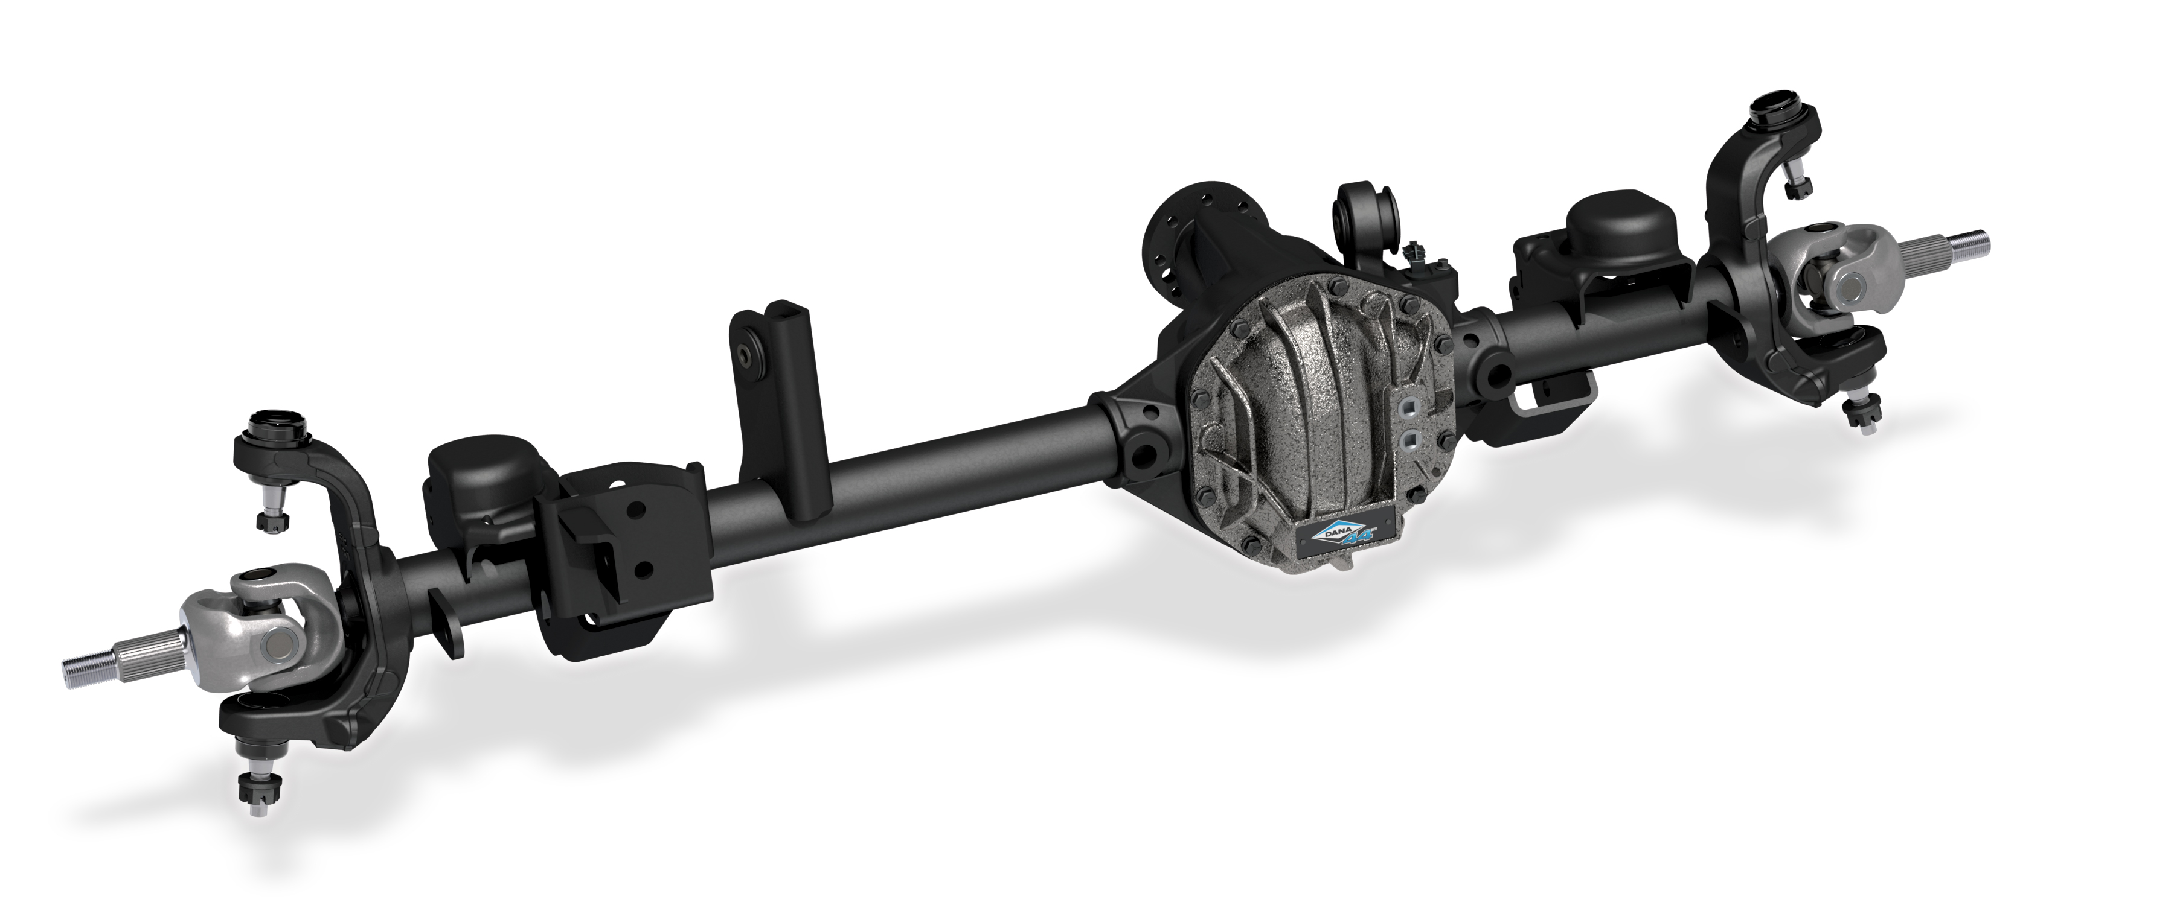

Slide 30
Building Maker

Slide 31
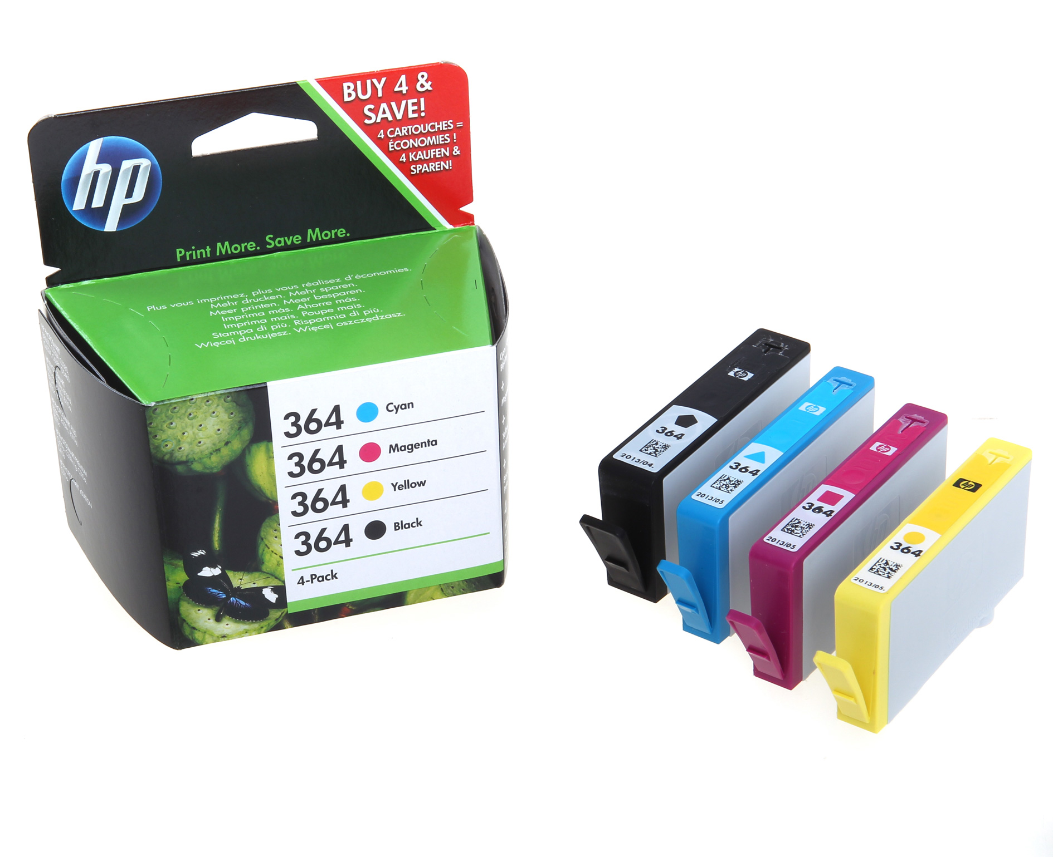
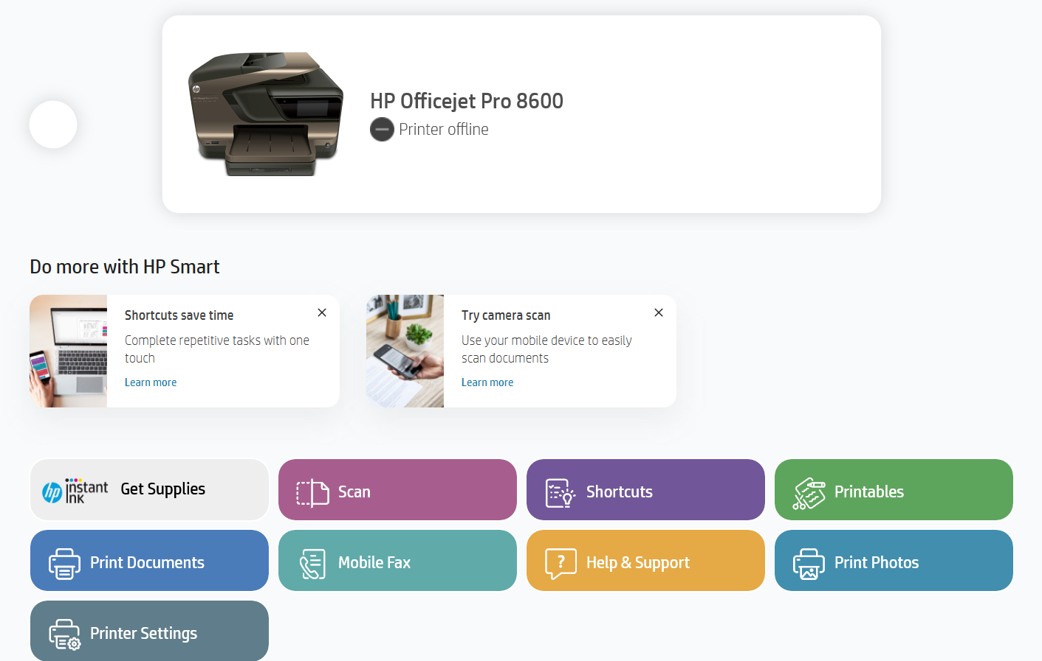
The future of Buildings!

Slide 32
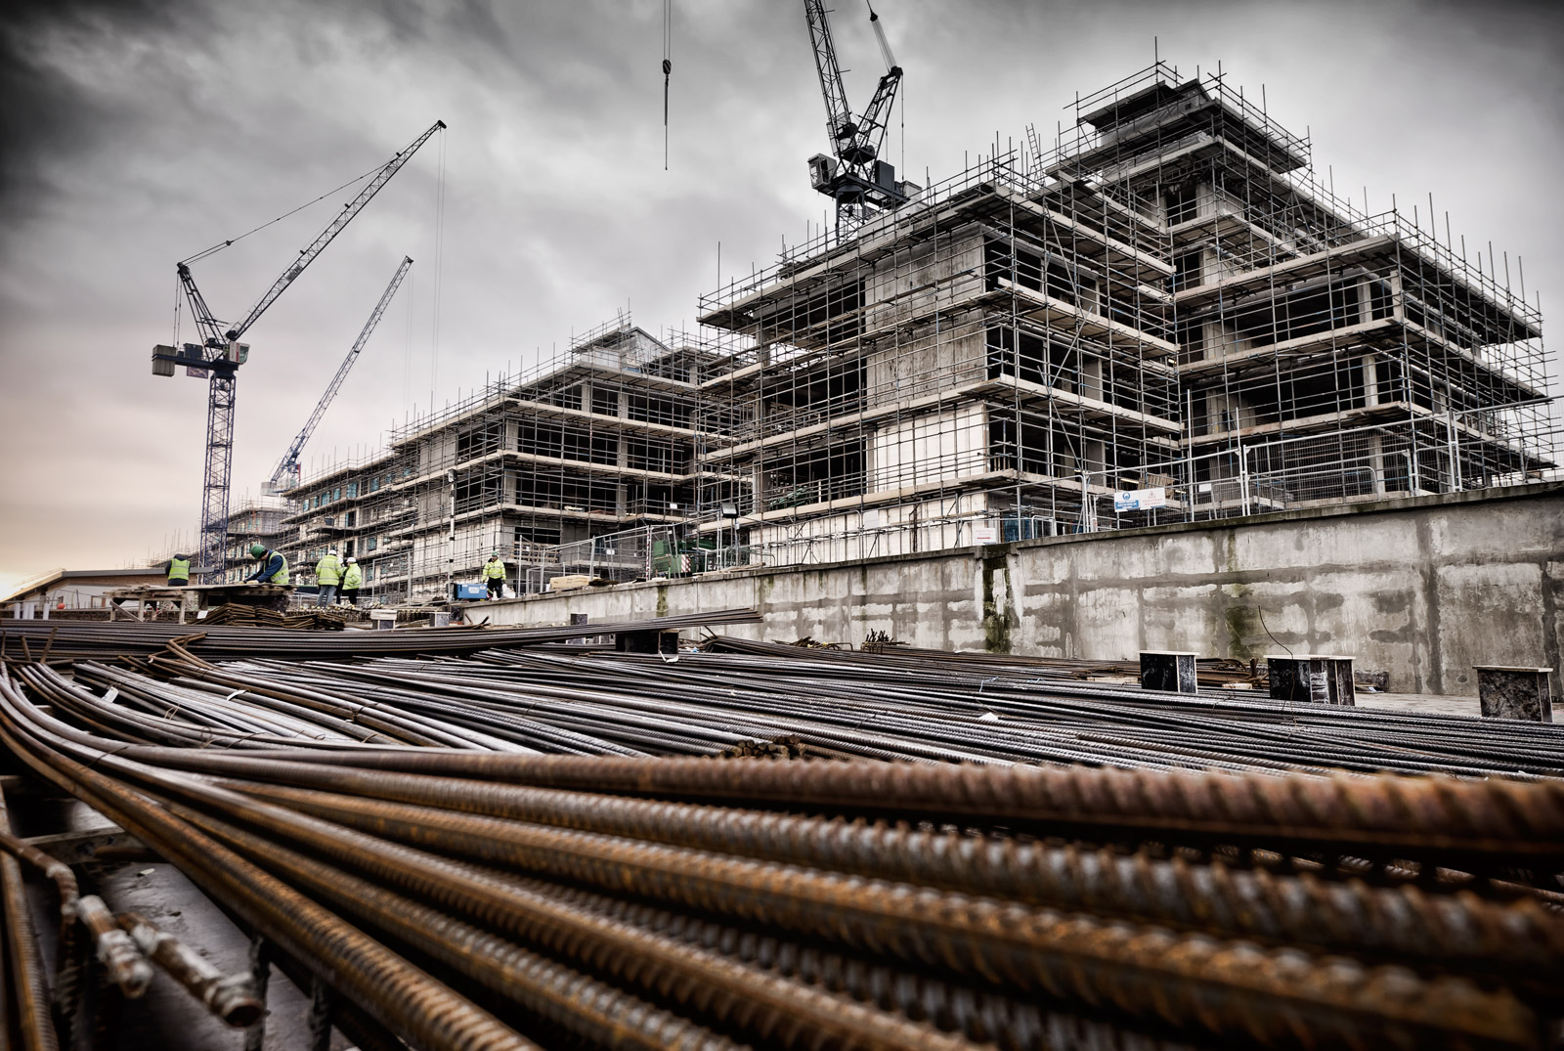
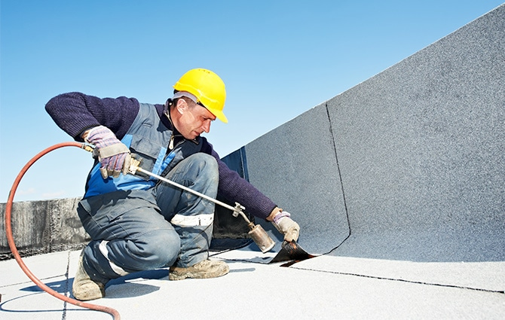
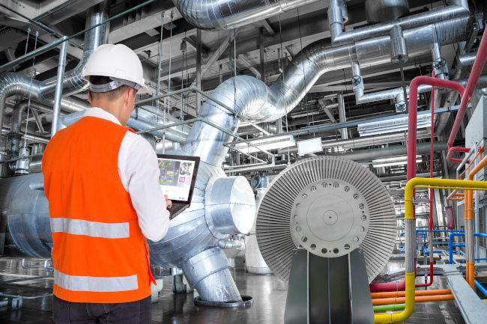
Maintenance!

Slide 33
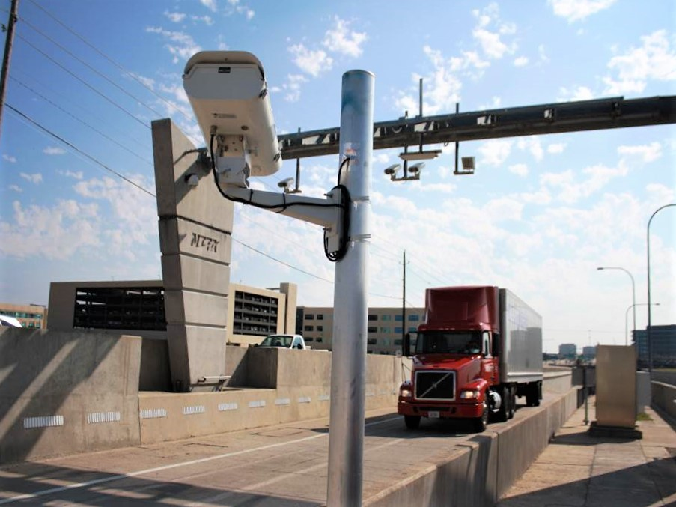
Public
Private
Partnership
(PPP)

Slide 34
Design
Build
Maintain
+
(DBM+)

Slide 35
Success with DBM+ =
RELATIONSHIP!

Slide 36
Why is the + Important?
Short Pencil is better than a long memory!

Slide 37
Building Maker
Built to Last!
Properly Maintained!
Better Living and Better World!

Slide 38
The Fatal Funnel:
Non-revenue generating space
Reduction in Maintenance Funds
Inefficient building and systems
Mold and sick building syndrome
Expensive emergency repairs
Devaluation of the property
Notes:
The two revenue sources are connected and when they start the downward spiral becomes the Fatale Funnel:
Non-revenue generating space
Mold and sick building syndrome
Expensive emergency repairs
Devaluation due to poor maintenance

Slide 39
Call to Action:
Early Adopters

Slide 40
This should have never happened or happen again!

Slide 41
Flashlight Fix:
The batteries have tape on the contacts.
How do I know?
I assembled them!

Slide 42
David Leslie, RWC
President
www.nu-fam.com
dl@nu-fam.com
469-449-3393

