Slide 1
You can’t know where you are going without knowing where you have been.
Presented by
David Leslie, RWC
This presentation is protected by US and International Copyright laws. Reproduction, distribution, display and use of the presentation without written permission of the Provider is prohibited.
©2023, NUFAM, LLC.
Notes:
Intro:
David Leslie – President of National United Facilities Asset Management
David is a Registered Waterproofing Consultant with over 30 years of experience working with he Building Envelope
He is a published author, public speaker, expert witness and holder of multiple patent applications.

Slide 2
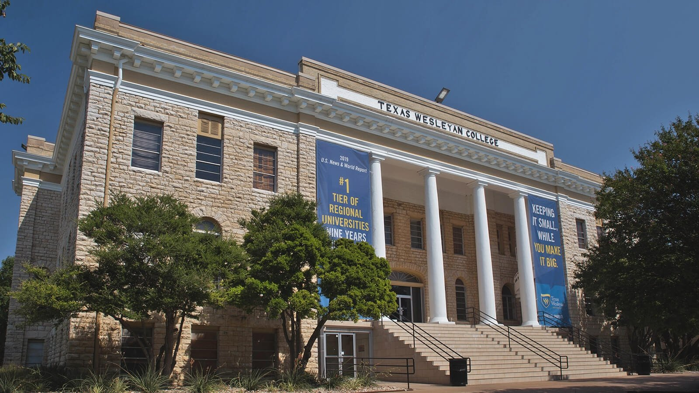
Shelter Human Activity…
Notes:
The primary purpose of a building is to shelter human activities.

Slide 3
Purpose:
Keeping the Outside Out
and the Inside In.
Reason:
To make a living.
Notes:
The Building Envelope is the part of the composition of a building that gives it the ability to meet its purpose which is: Keeping the outside environment out and the inside environment in to provide shelter.

Slide 4
Three Ps of Continuity:
Principle
Process
Property
CONTINUITY
Notes:
Continuity is the critical element to achieve success when managing any asset. To attain Continual Asset Optimizations, continuity must be applied to the Three Ps:

Slide 5
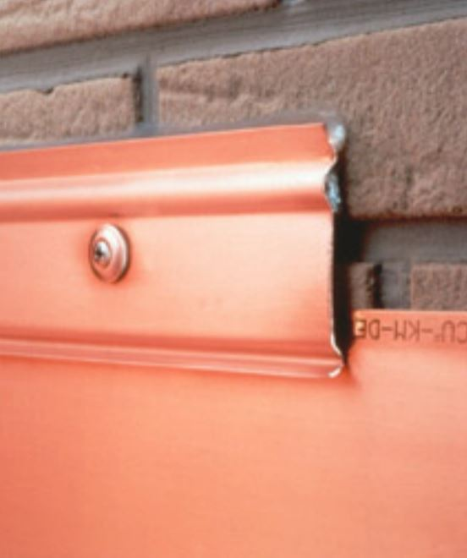
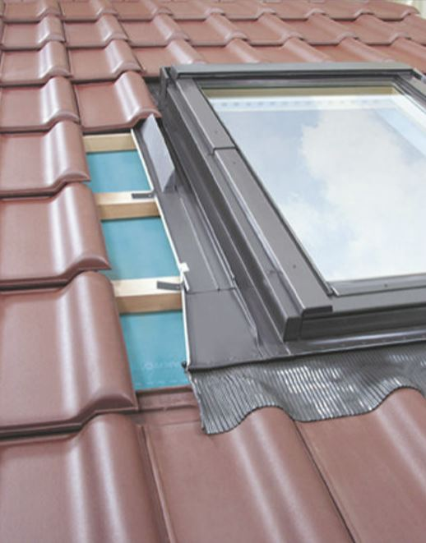
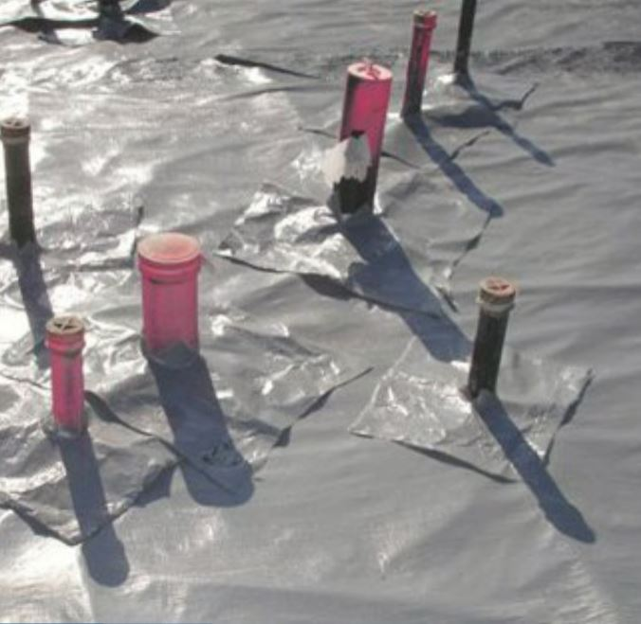
Principle:
The set of truths that apply to the subject being managed.
Terminations
Transitions
Michael T. Kubal –
Construction Waterproofing Handbook
Penetrations
Notes:
Considering that there are so many trades working on one building and few people know how to manage Terminations, Transitions, and Penetration, it is no wonder that 80% of litigation involves water intrusion. That is like say 8 out of 10 cars in the new car lot will not run!!

Slide 6
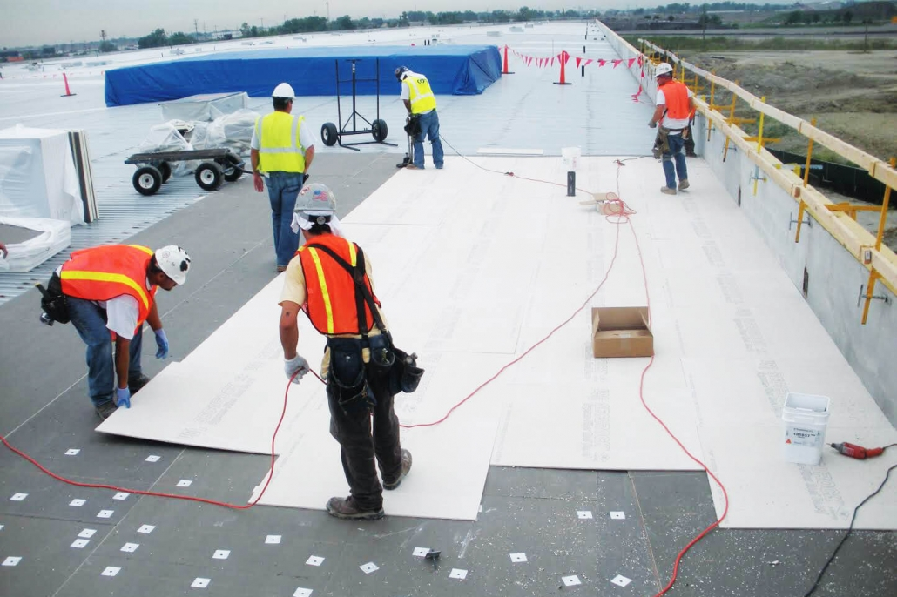
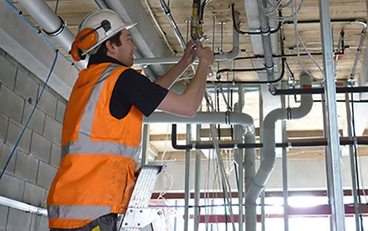
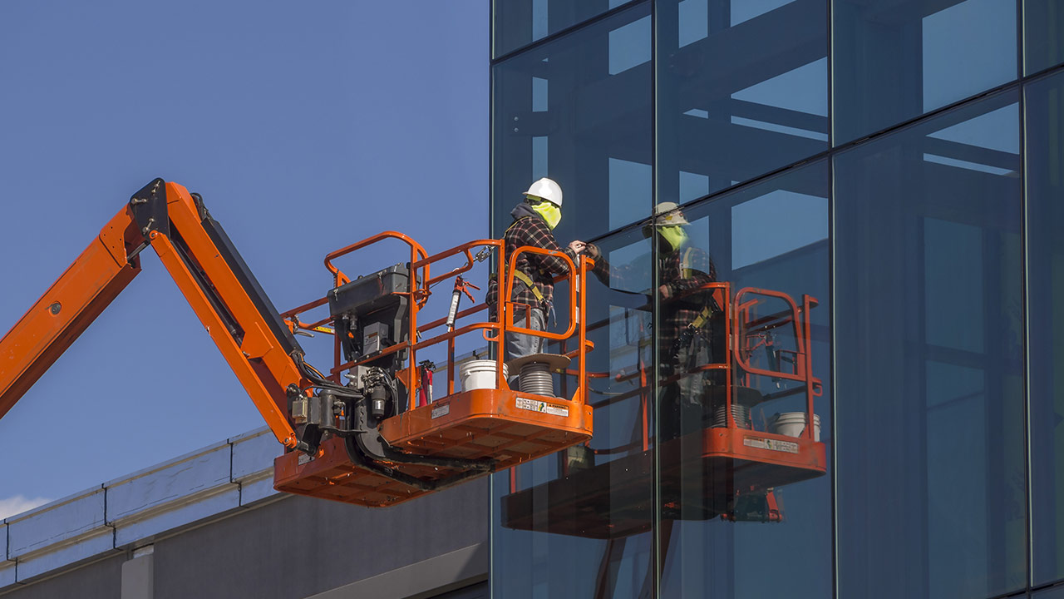
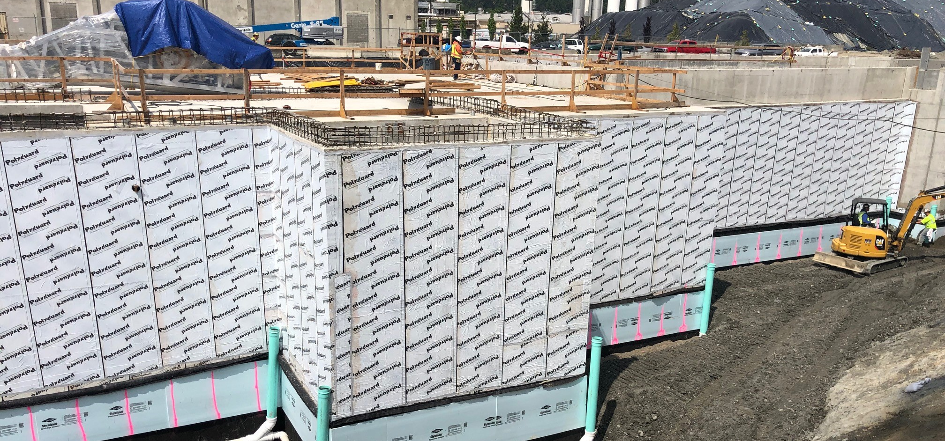
Process:
The set of activities that apply to the subject being managed.
Notes:
Considering that there are so many trades working on one building and few people know how to manage Terminations, Transitions, and Penetration, it is no wonder that 80% of litigation involves water intrusion. That is like say 8 out of 10 cars in the new car lot will not run!!

Slide 7
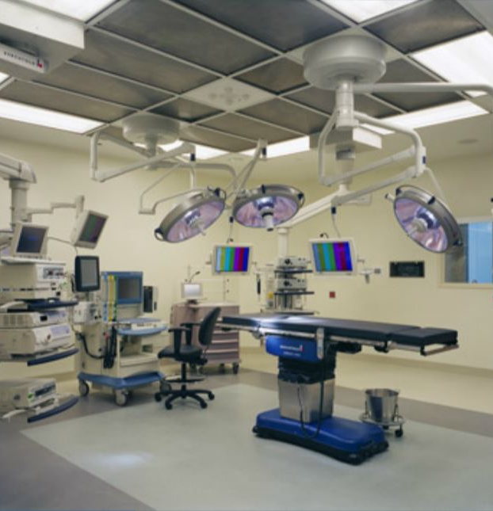
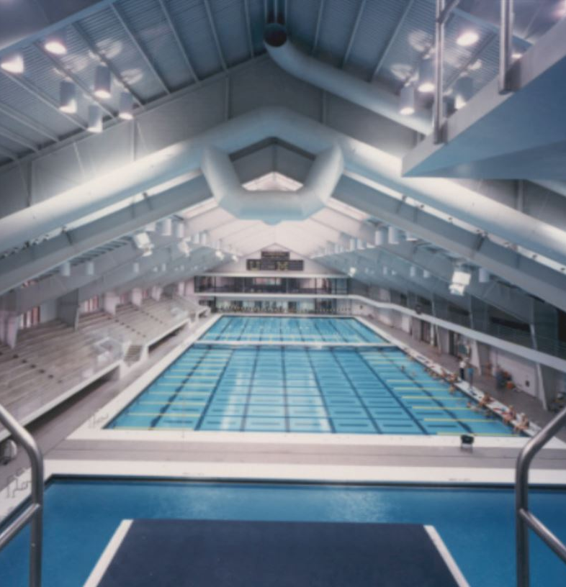
Property:
The set of characteristics that apply to the subject being managed.
Notes:
Considering that there are so many trades working on one building and few people know how to manage Terminations, Transitions, and Penetration, it is no wonder that 80% of litigation involves water intrusion. That is like say 8 out of 10 cars in the new car lot will not run!!

Slide 8
Applying The Three Ps of Continuity :
There must be Continuity in the understanding and application of the Principles.
There must be Continuity in the communication and coordination of the Processes.
There must be Continuity in addressing and maintaining the components of the Properties.
Notes:
The three Ps need Continuity

Slide 9
You can’t know where you are going without knowing where you have been.
Learning Objectives:
Understanding why history is forgotten.
Understanding how to capture history in a format that it accessible and useful.
Understanding how to utilize history not to just avoid repeating it, but to improve the future.

Slide 10
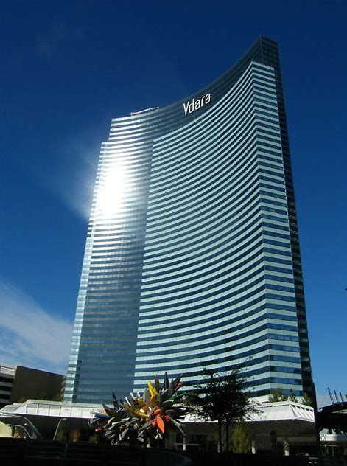
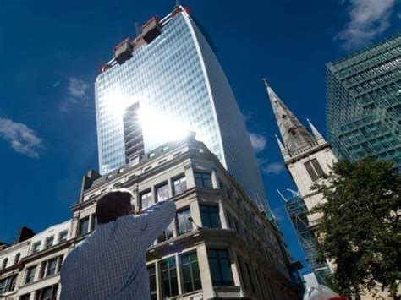
George Santaya said: "Those who cannot remember the past are condemned to repeat it."
Notes:
20 Fenchurch Street, London: Designed by Rafael Viñoly and completed in 2014, the parabolic shape of this 38-story London office complex reflects a huge swath of sunlight onto a small area at street level for several hours each day, resulting in storefront temperatures exceeding 200°F. An automobile was partially melted, and a reporter fried an egg on the sidewalk. The thermal behavior caused locals to nickname the building “the Fryscraper.”
Failure to do so was especially galling in this case, due to Viñoly’s involvement with the similarly sizzling Vdara Hotel design in Las Vegas only 6 years prior to the Fryscraper.

Slide 11
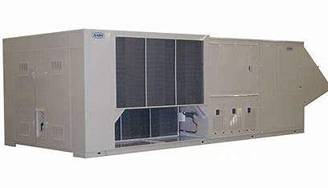
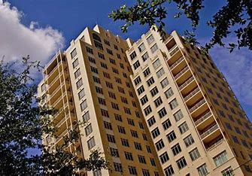
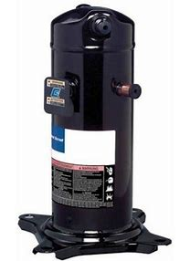
Principle, Process, or Property
8-Year Period
Replace 5 Compressors
15-Year EUL

Slide 12
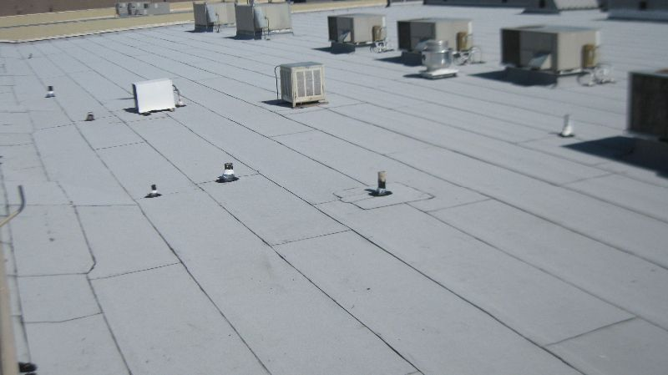
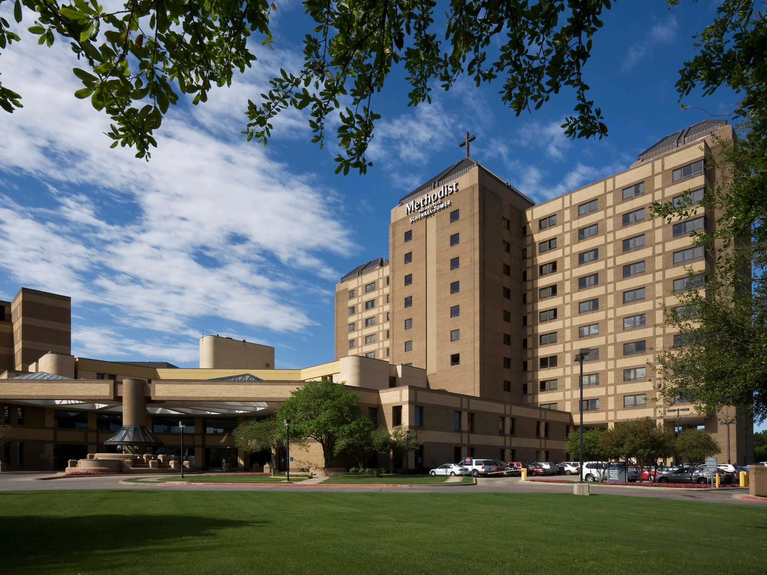
Principle, Process, or Property
9-Year Period
Taking Replacement Bids
Under Warranty

Slide 13
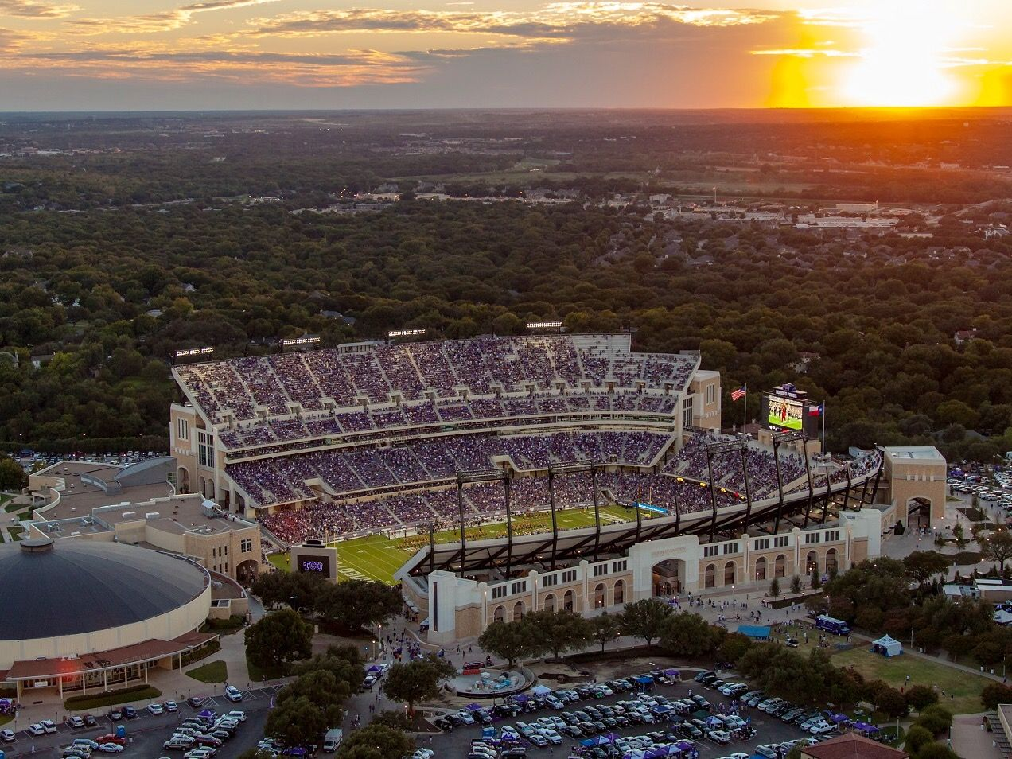
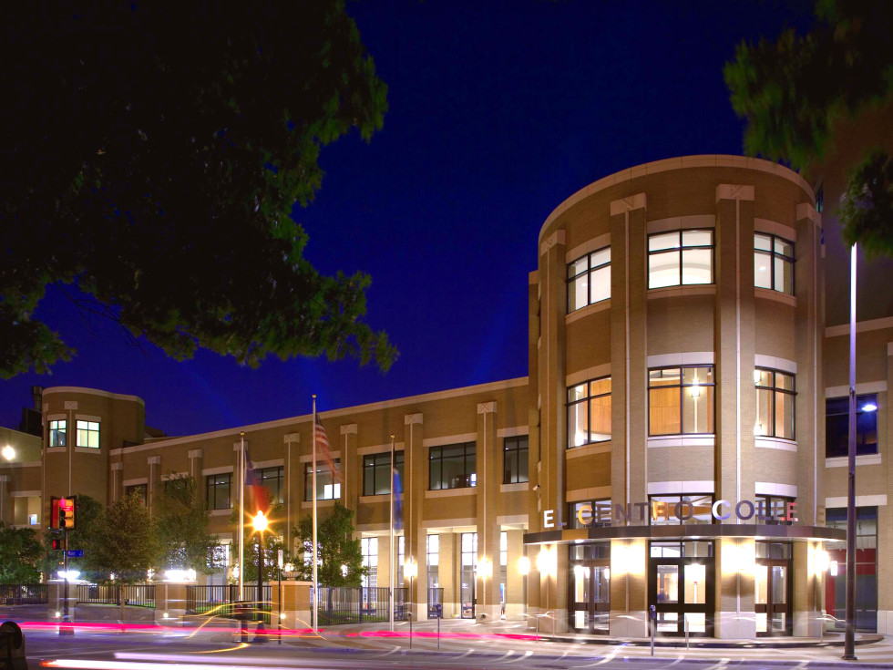
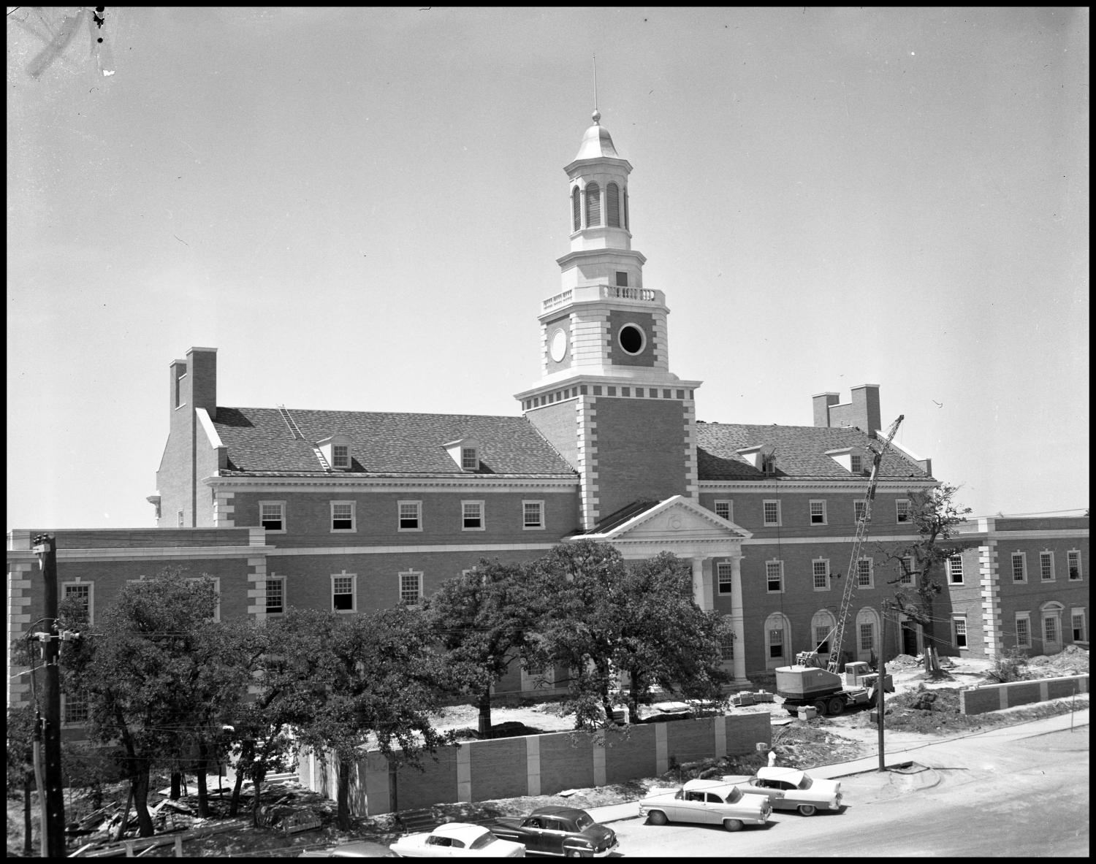
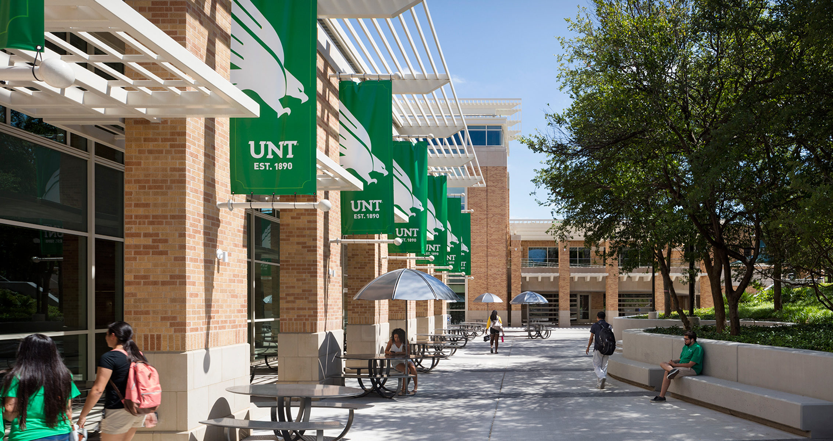
Why?
Notes:
Mirror Syndrome: Most change happens slow over time and it is not noticeable to the person living it. Dallas College El Centro Campus, TCU Amon Carter Stadium, University of North Texas new building and then the original Admin building being built.

Slide 14
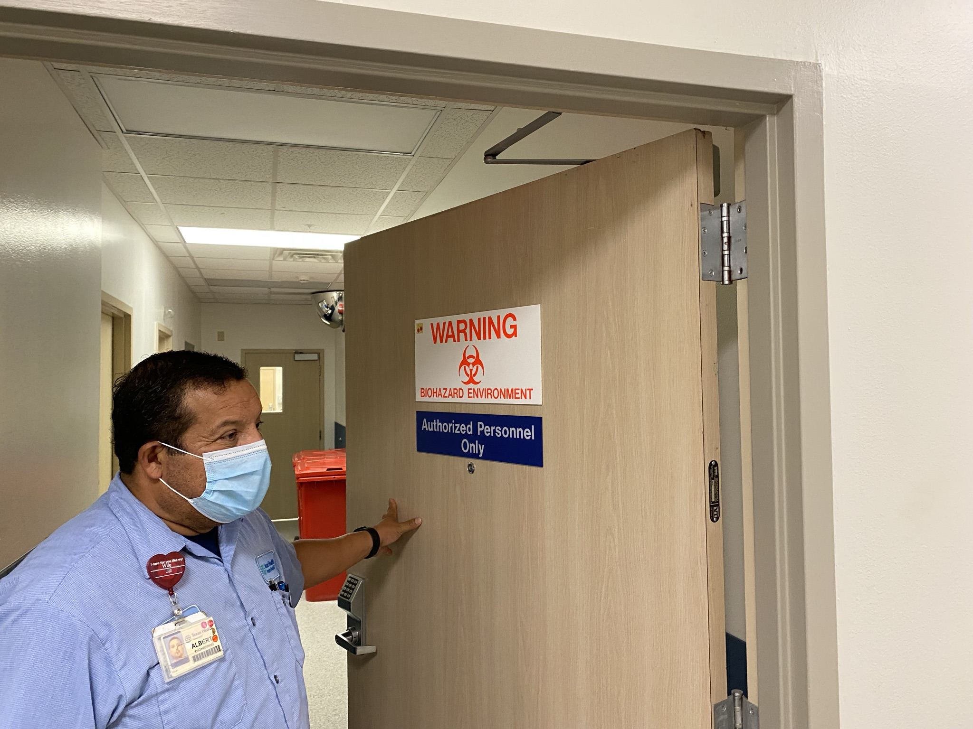
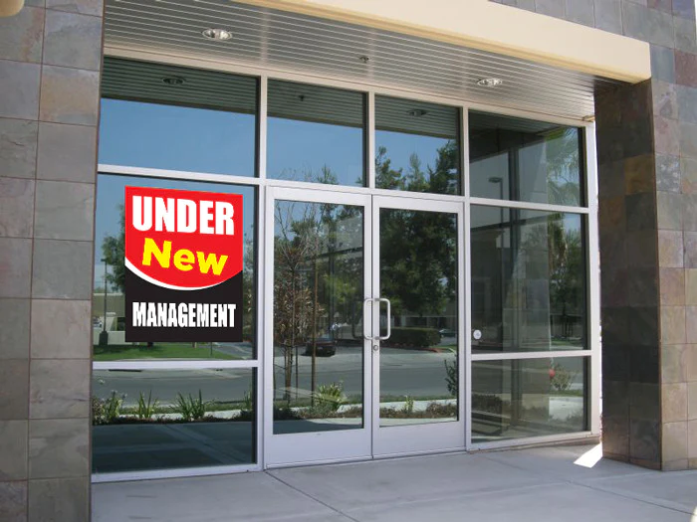
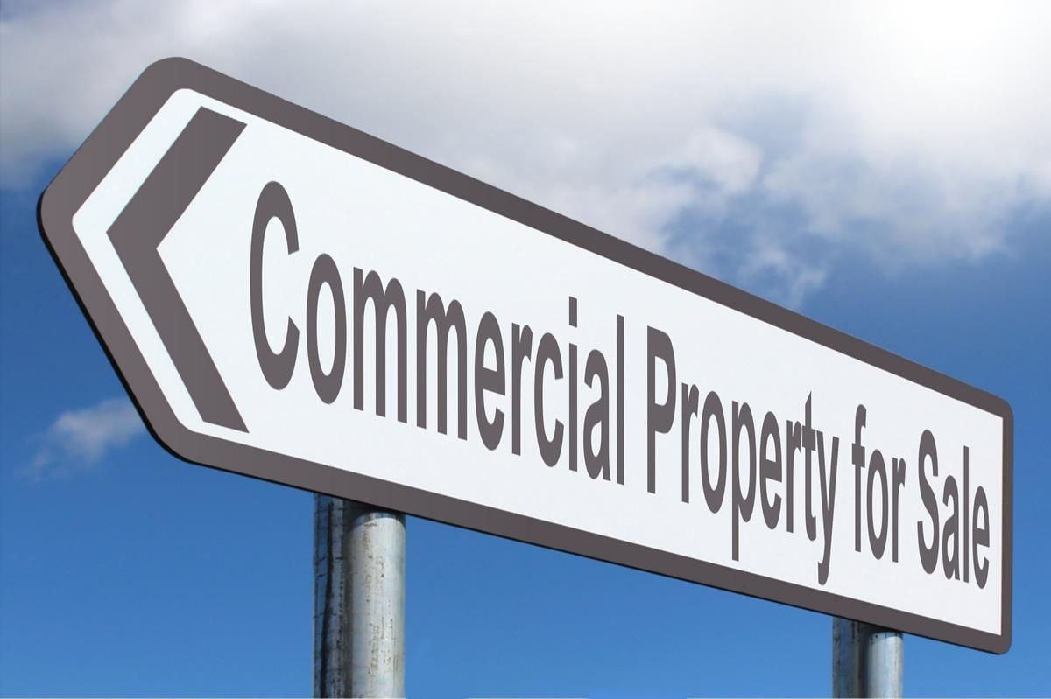
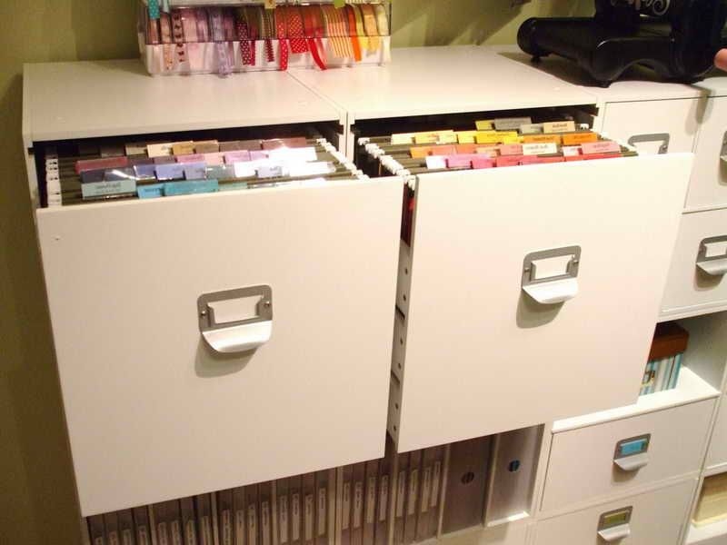
Lack of Continuity over Time.

Slide 15
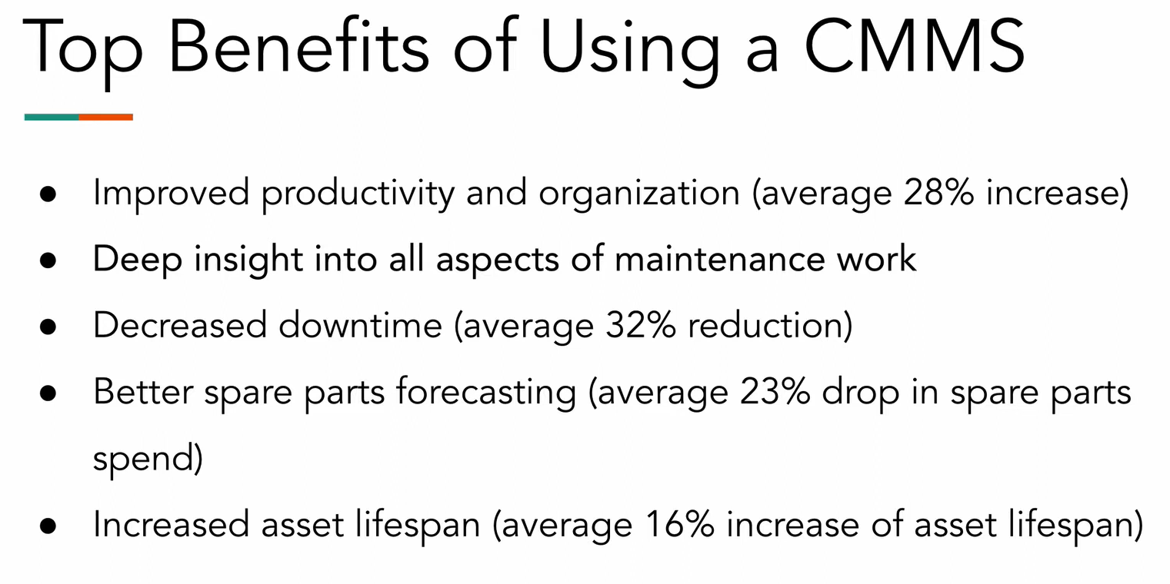
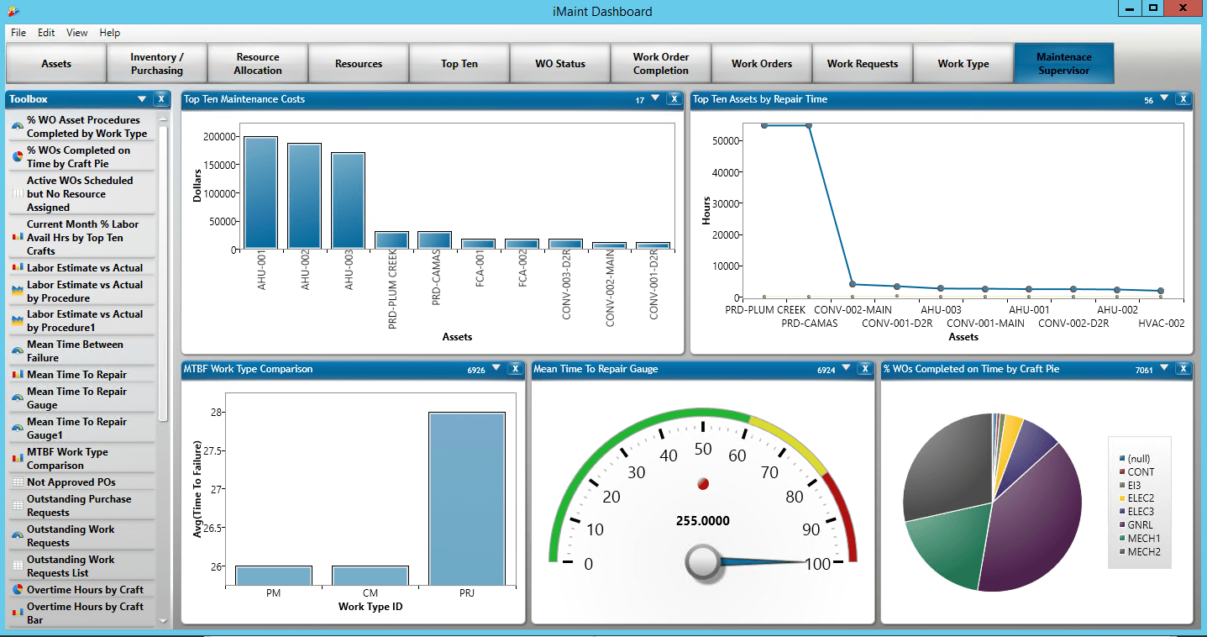
Grampa Leslie said: “A short pencil is better than a long memory."

Slide 16
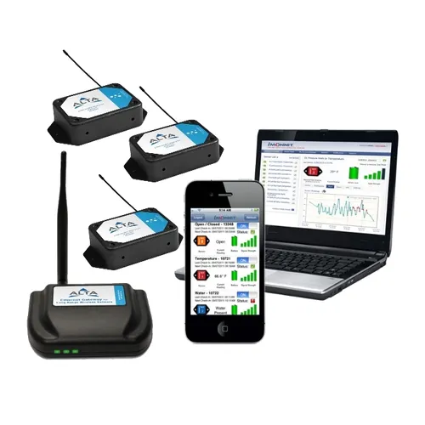
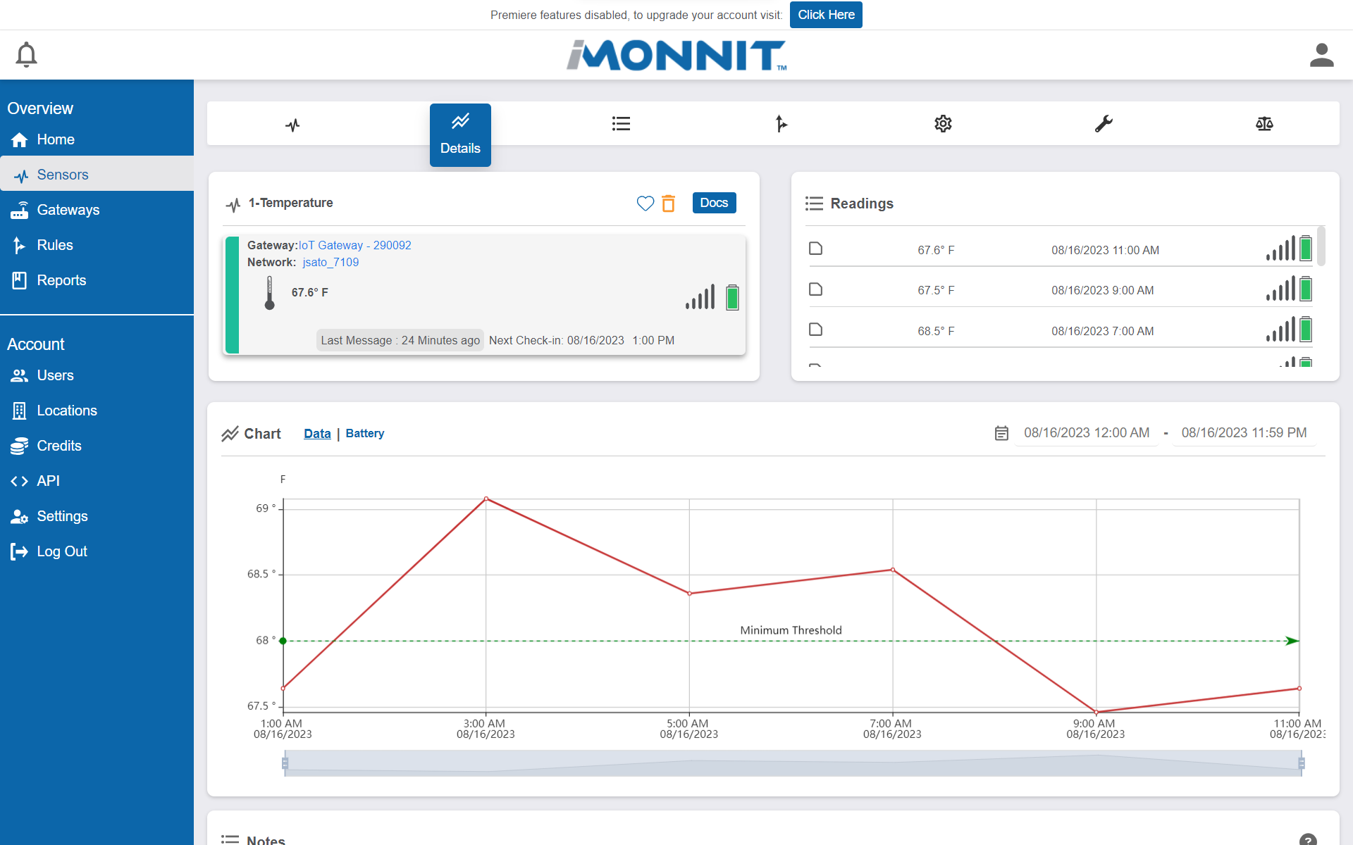
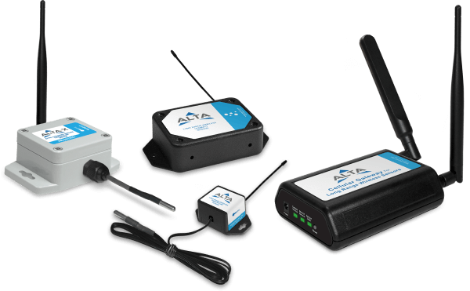
Dashboard and Sensors.

Slide 17
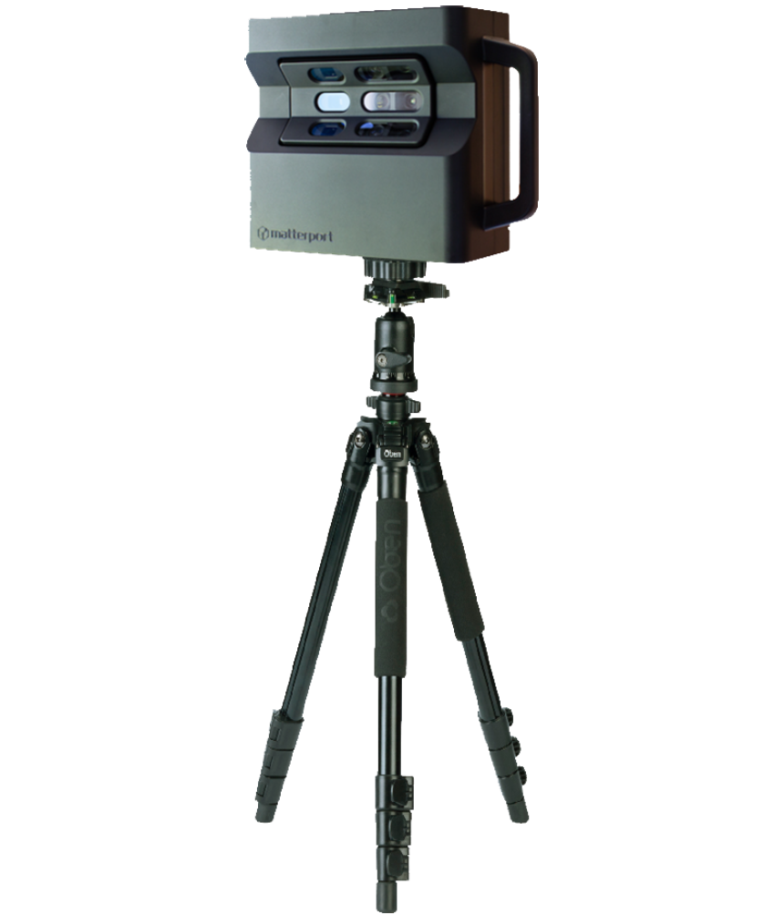
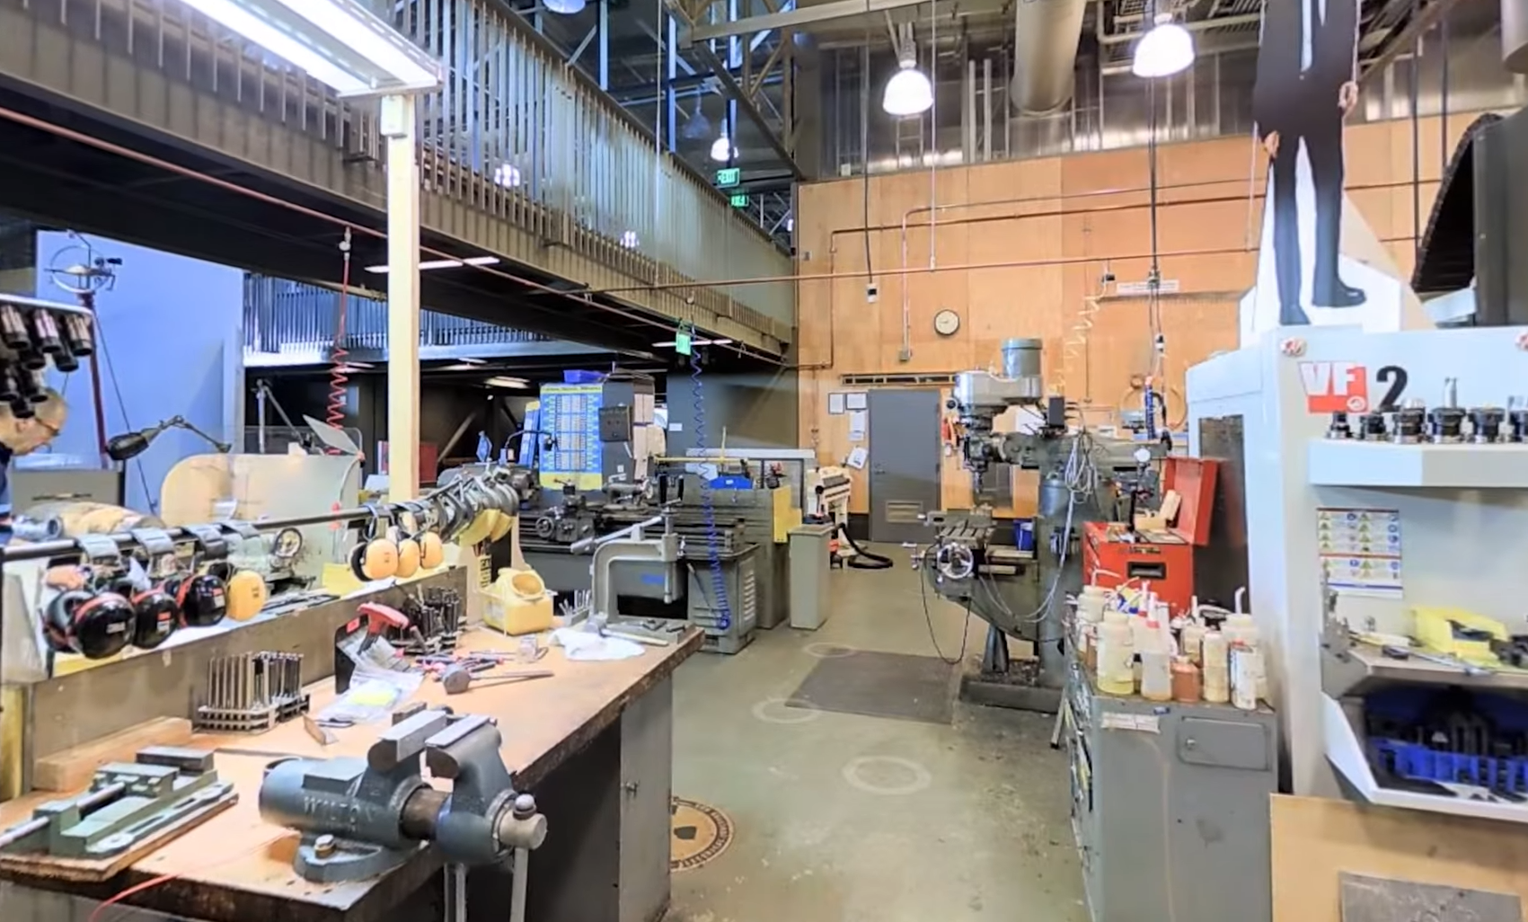
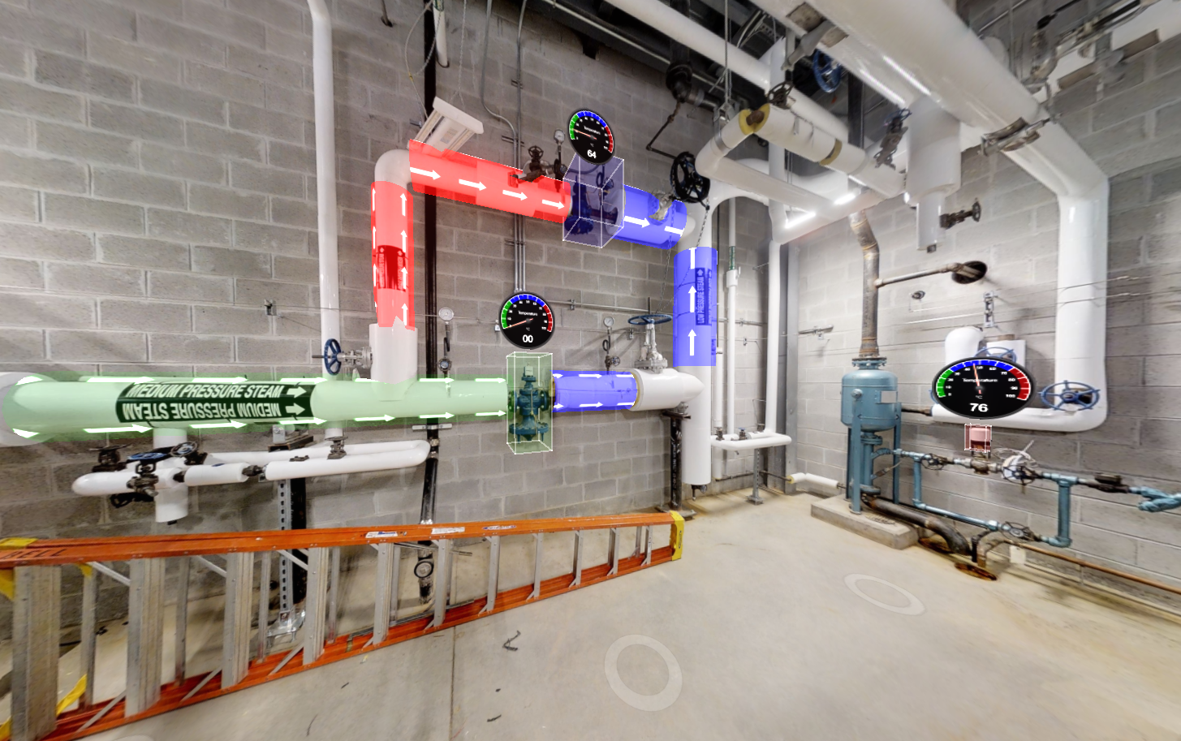
Capture and Communicate
Notes:
Matterport

Slide 18
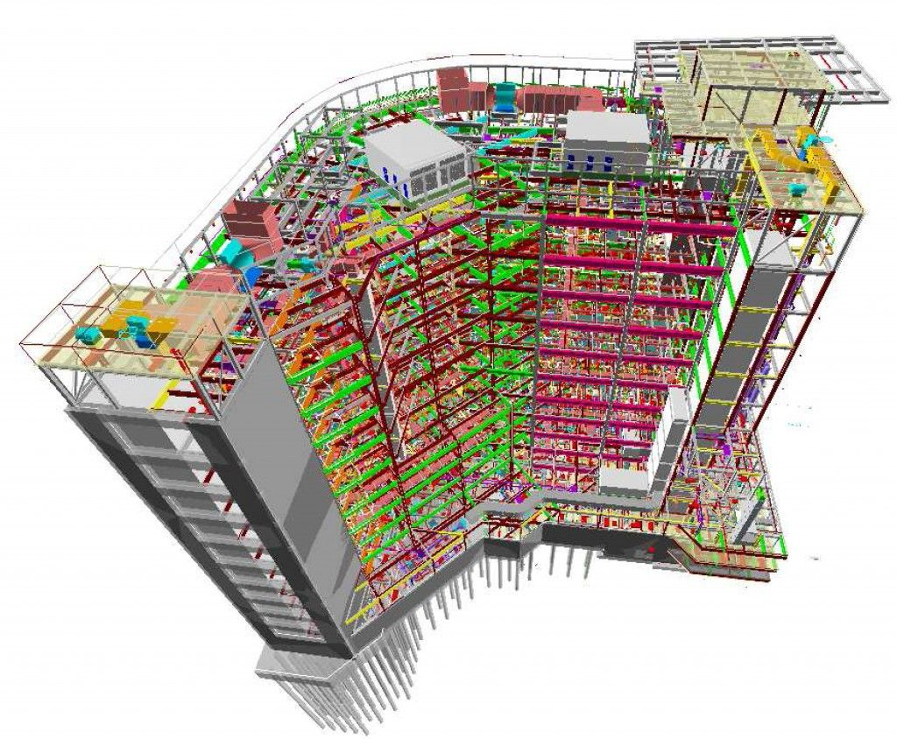
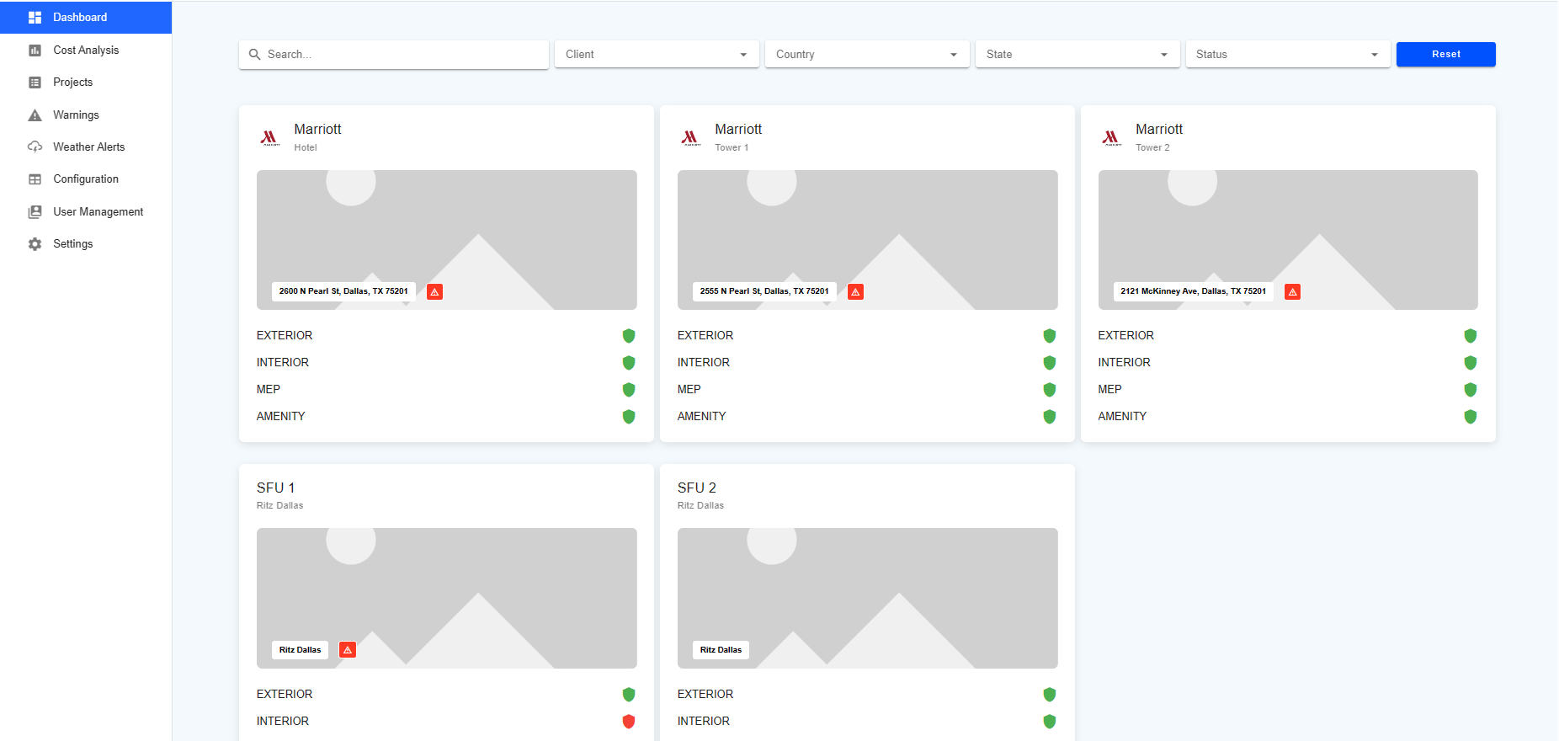
Yeddie said: “Forward Compatible, Scalable, and Readily Duplicate"
Notes:
Full readable BIM, Readability of PDFs is made possible when Optical Character Recognition (OCR) functionality is applied to files. OCR functionality ensures that text in a PDF file is searchable and readable by a screen reader.

Slide 19
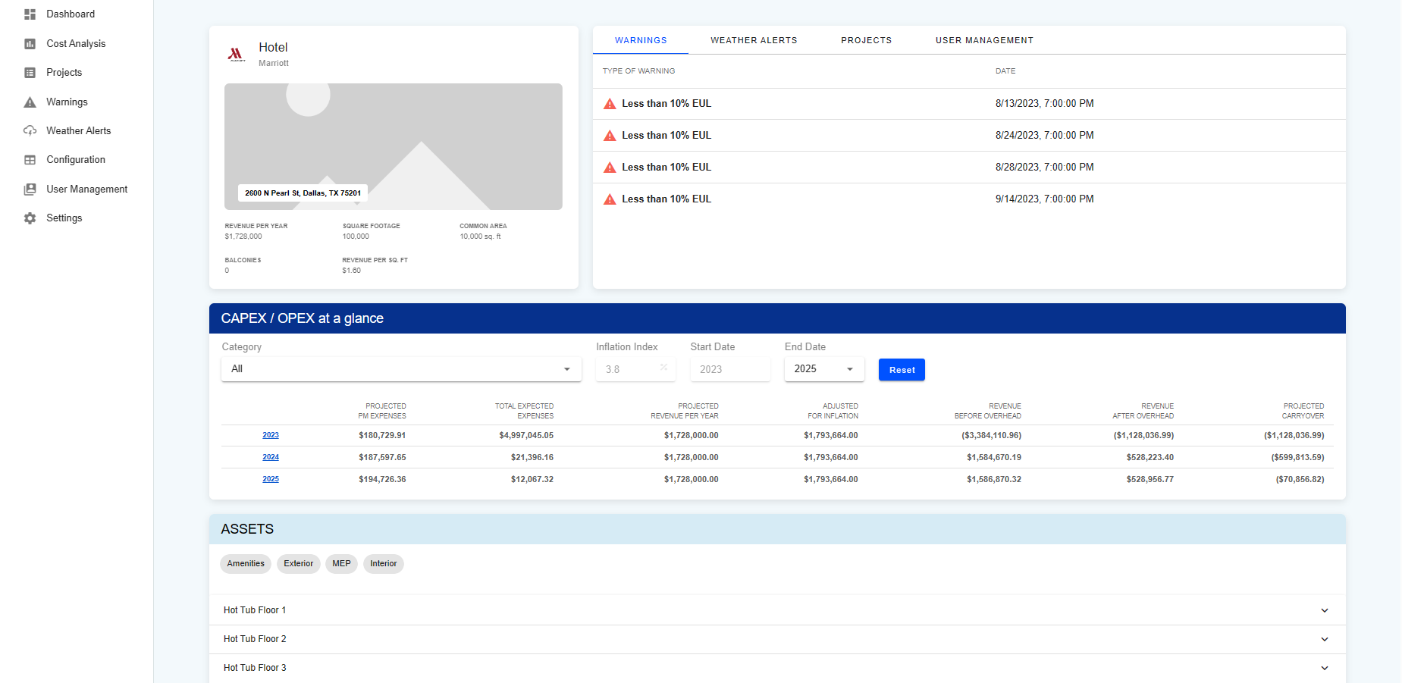
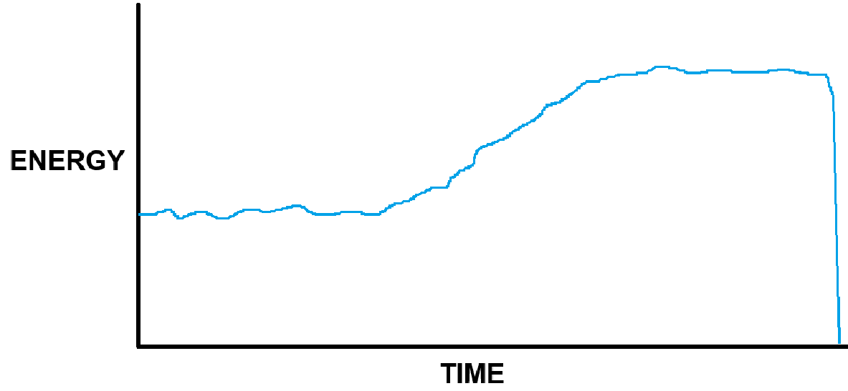
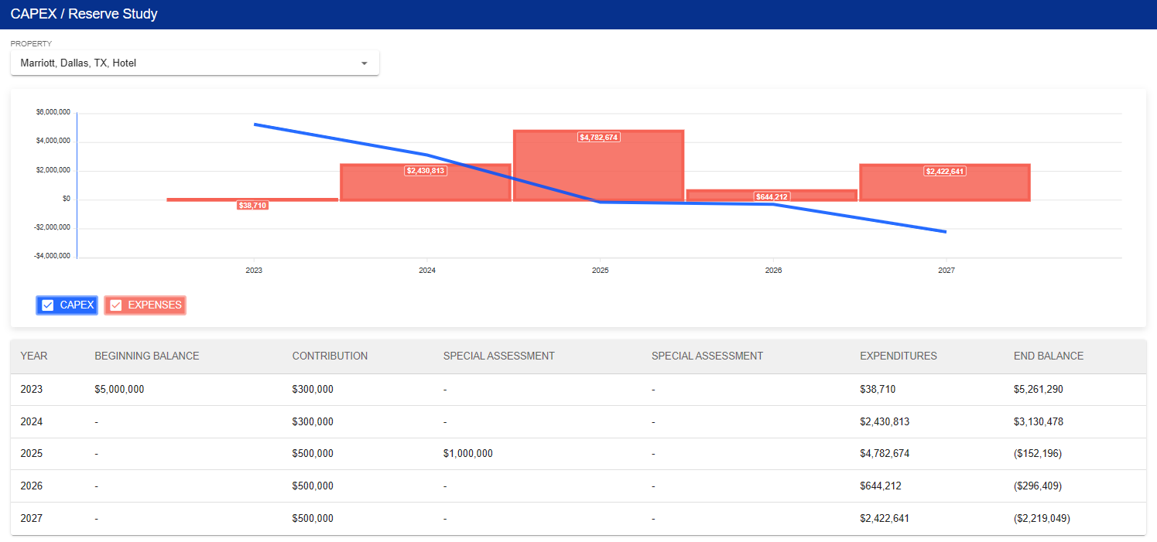
Living and Predictable.
E U L

Slide 20
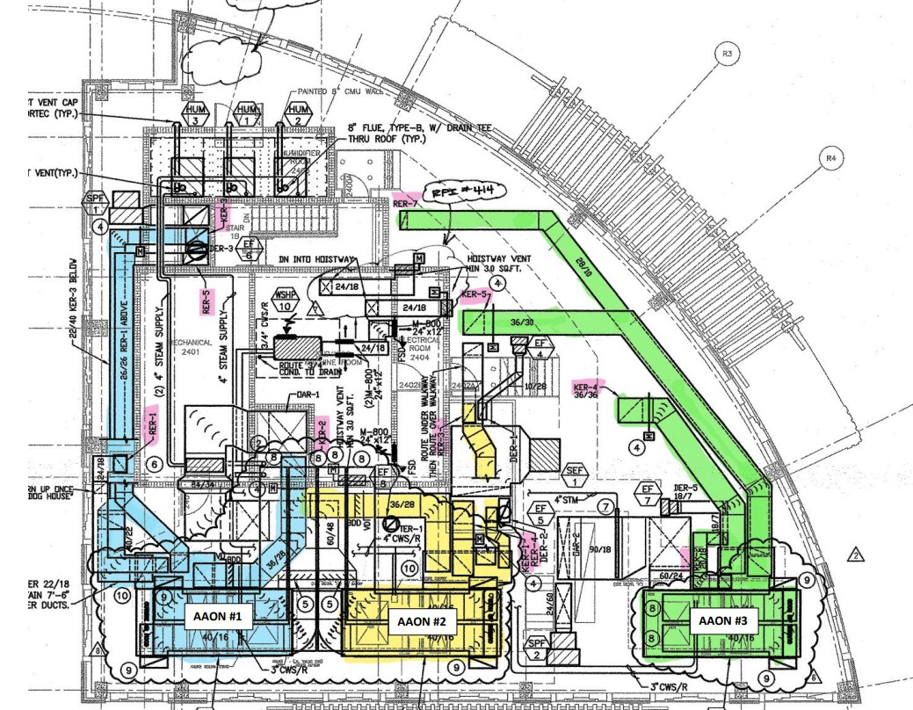
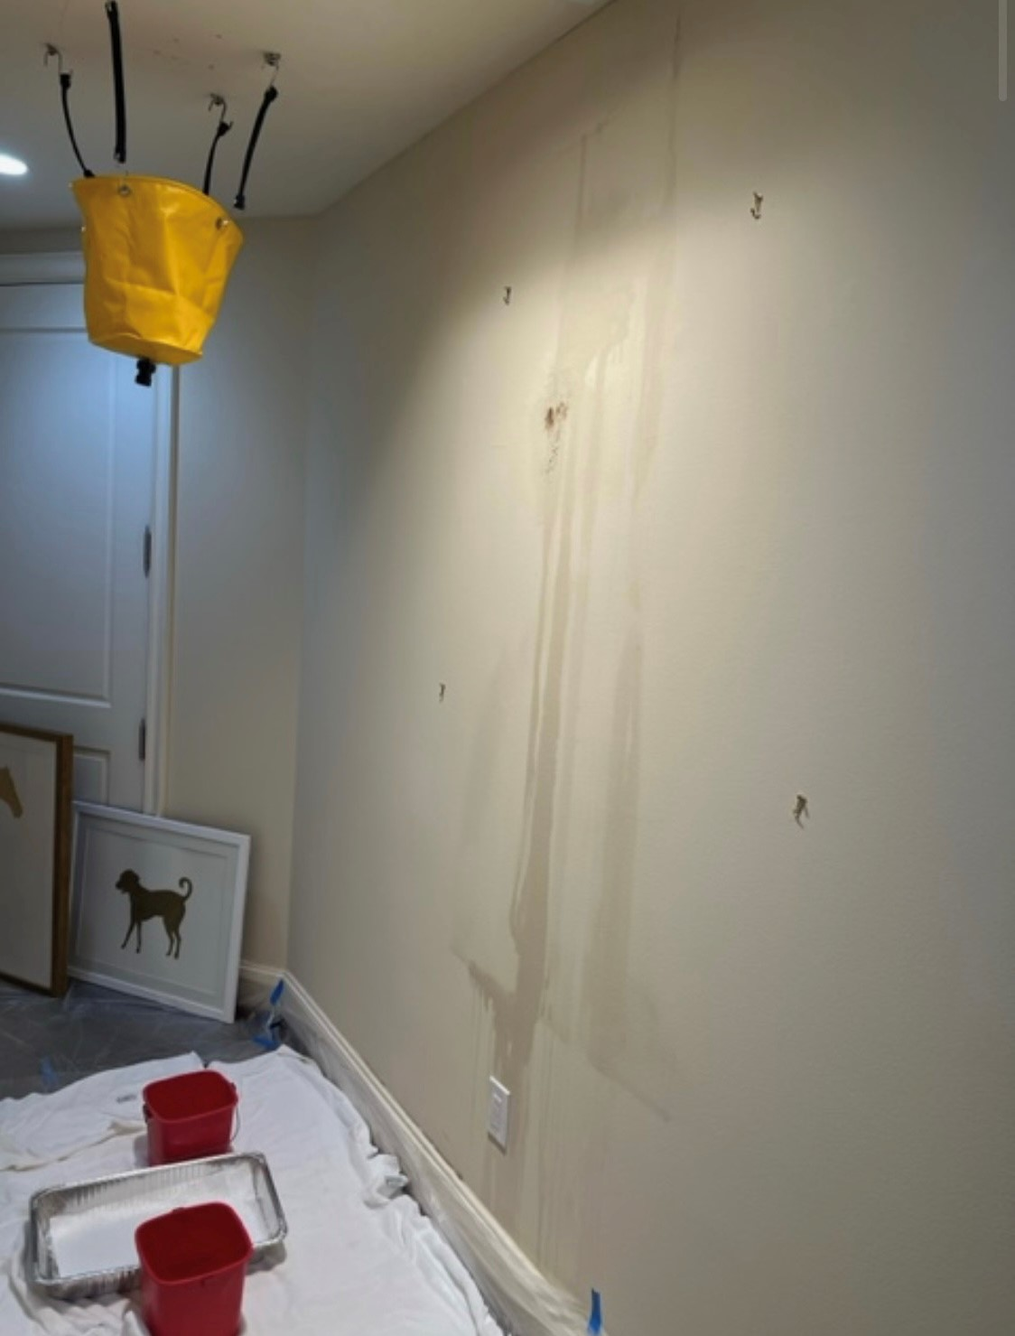
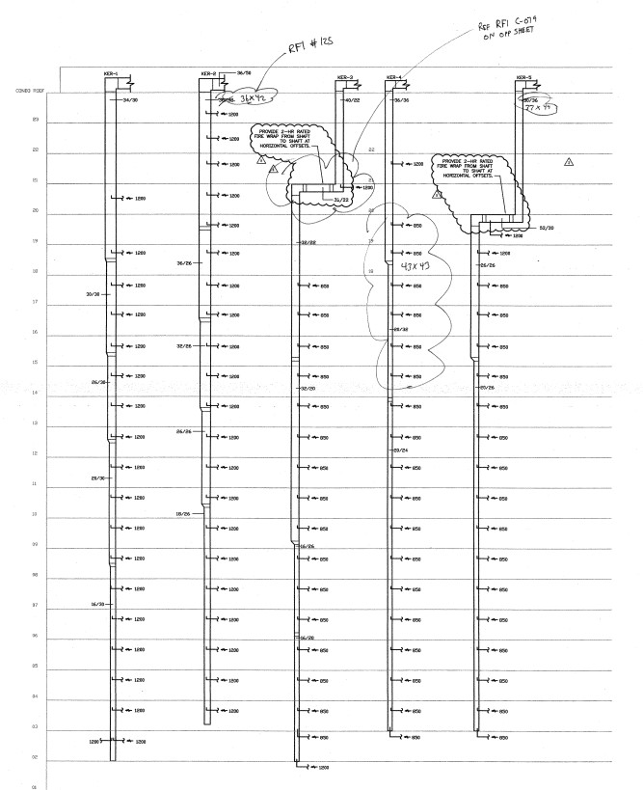
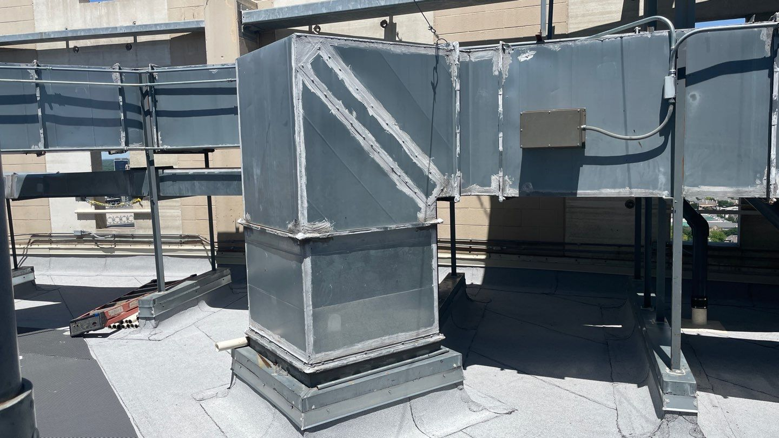
AI and Diagnostics.

Slide 21
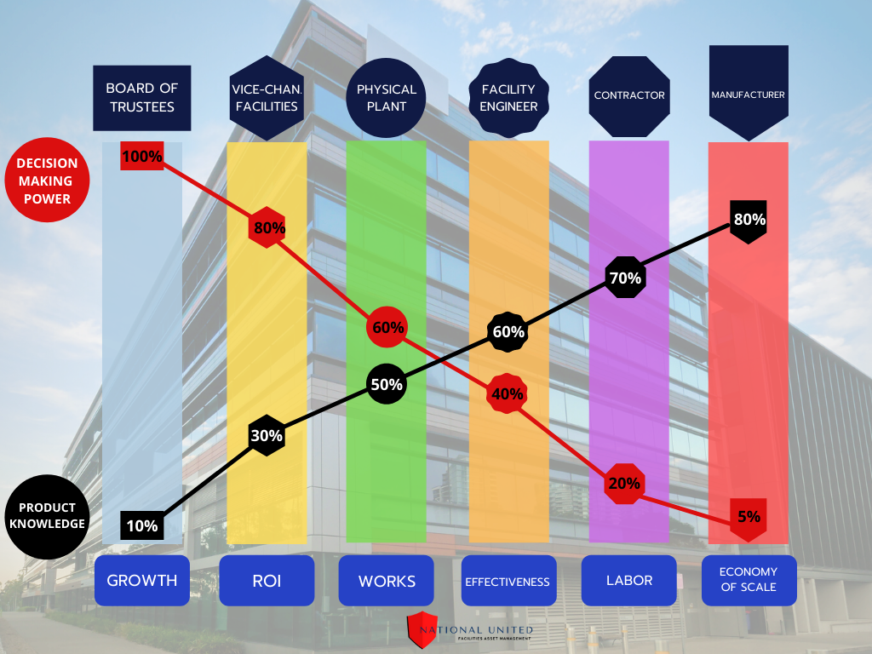
Power vs. Knowledge – Existing Buildings
Notes:
Power vs. Knowledge in graphic for Schools, Colleges, and Universities.

Slide 22
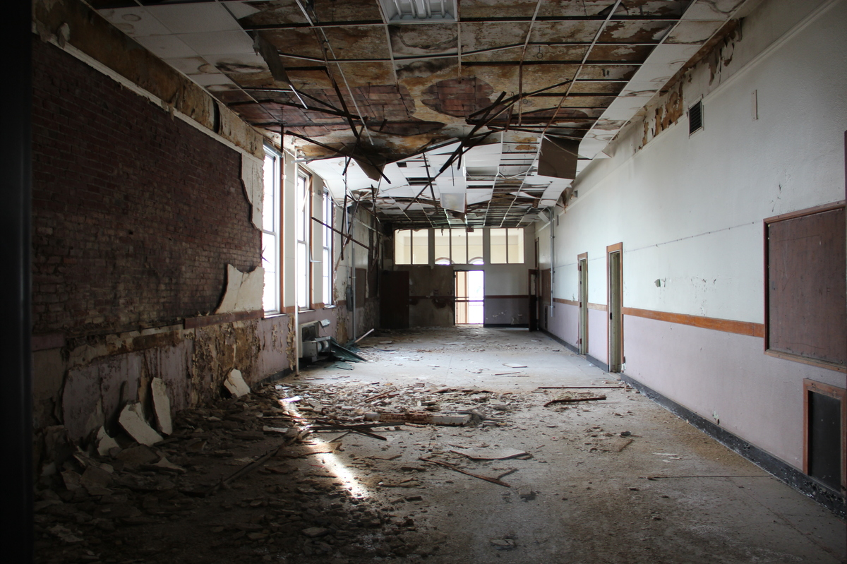
The Fatal Funnel:
Non-revenue generating space
Reduction in Maintenance Funds
Inefficient building and systems
Mold and sick building syndrome
Expensive emergency repairs
Devaluation of the property
Notes:
The two revenue sources are connected and when they start the downward spiral becomes the Fatale Funnel:
Non-revenue generating space
Mold and sick building syndrome
Expensive emergency repairs
Devaluation due to poor maintenance

Slide 23
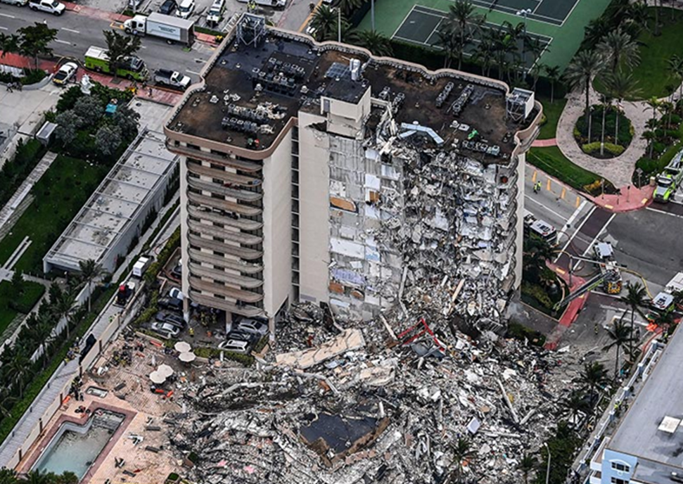
This is… preventable.

Slide 24
Thank You!!
nu-fam.com
Notes:
The unit is being sprayed with a sprinkler, but at one time it was enough!

