Slide 1
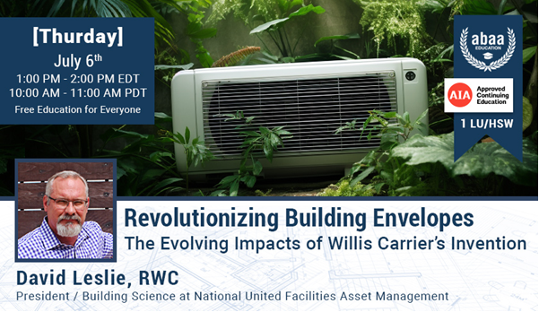
This presentation is protected by US and International Copyright laws. Reproduction, distribution, display and use of the presentation without written permission of the Provider is prohibited.
©2023, NUFAM, LLC.
Notes:
Intro:
David Leslie – President of National United Facilities Asset Management
David is a Registered Waterproofing Consultant with over 30 years of experience working with he Building Envelope
He is a published author, public speaker, expert witness and holder of multiple patent applications.
The primary purpose of a building is to keep the outside out and the inside in, but what we define as the outside and the inside has changed over time. The most significant change occurred at the turn of the 20th century when Willis Carrier invented air conditioning. That single invention changed not only where we live and work, but how we construct buildings.
Today we are going to study the impact of air conditioning on society and construction. We will then apply the Three Ps of Continuity to the business of constructing and managing buildings relative to keeping the outside out and the inside in.

Slide 2
Learning Objectives:
Explore how air conditioning changed where we live, work, and how we construct buildings.
Develop a better understanding of the building enclosure and the importance of keeping the outside out and the inside in.
Delve into the concept of the Three Ps of Continuity.
Illustrate how to apply the Three Ps of Continuity to the building enclosure and how it relates, to maximize the benefits of air conditioning and minimize the damage.
Notes:
Learning Objectives:
Explore how air conditioning changed where we live, work, and how we construct buildings.
Develop a better understanding of the building enclosure and the importance of keeping the outside out and the inside in.
Delve into the concept of the Three Ps of Continuity.
Illustrate how to apply the Three Ps of Continuity to the building enclosure and how it relates, to maximize the benefits of air conditioning and minimize the damage.

Slide 3
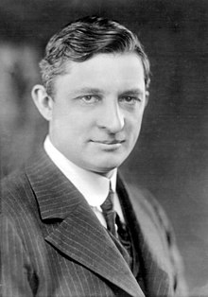
Willis Haviland Carrier
July 17, 1902, Carrier developed a system, in response to an air quality problem experienced at the Sackett-Wilhelms Lithographing & Publishing Company in Brooklyn, New York.
January 2, 1906, Carrier was granted U.S. Patent 808,897
Notes:
For the project, Willis Carrier submitted drawings for what became recognized as the world's first modern air conditioning system. It was so humid that summer that the paper grew and shrank, which resulted in poor quality images, because the color printing process involved running the same piece of paper up to four times, each with a different color ink.

Slide 4
What is Air Conditioning?
The 1902 installation marked the birth of air conditioning because of the addition of humidity control, which led to the recognition by authorities in the field that A/C must perform four basic functions:
Control Temperature
Control Humidity
Control Air Circulation and Ventilation
Cleanse the Air
Notes:
The four functions of necessary to be A/C:
Control Temperature
Control Humidity
Control Air Circulation and Ventilation
Cleanse the Air

Slide 5
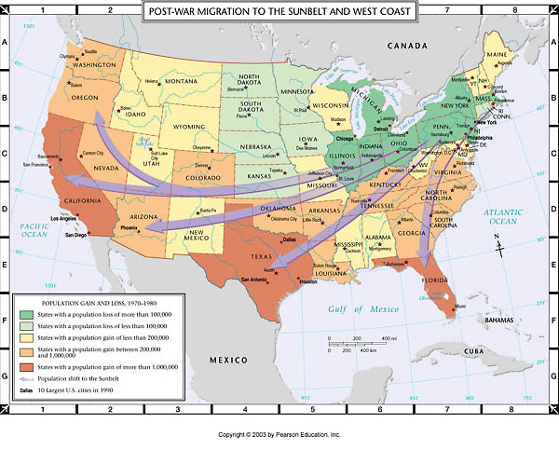
The Sunbelt Migration
Notes:
The primary purpose of a building is to shelter human activities and that is dictated by where the building is located. Many actives were not viable in the south prior to the invention of AC.

Slide 6
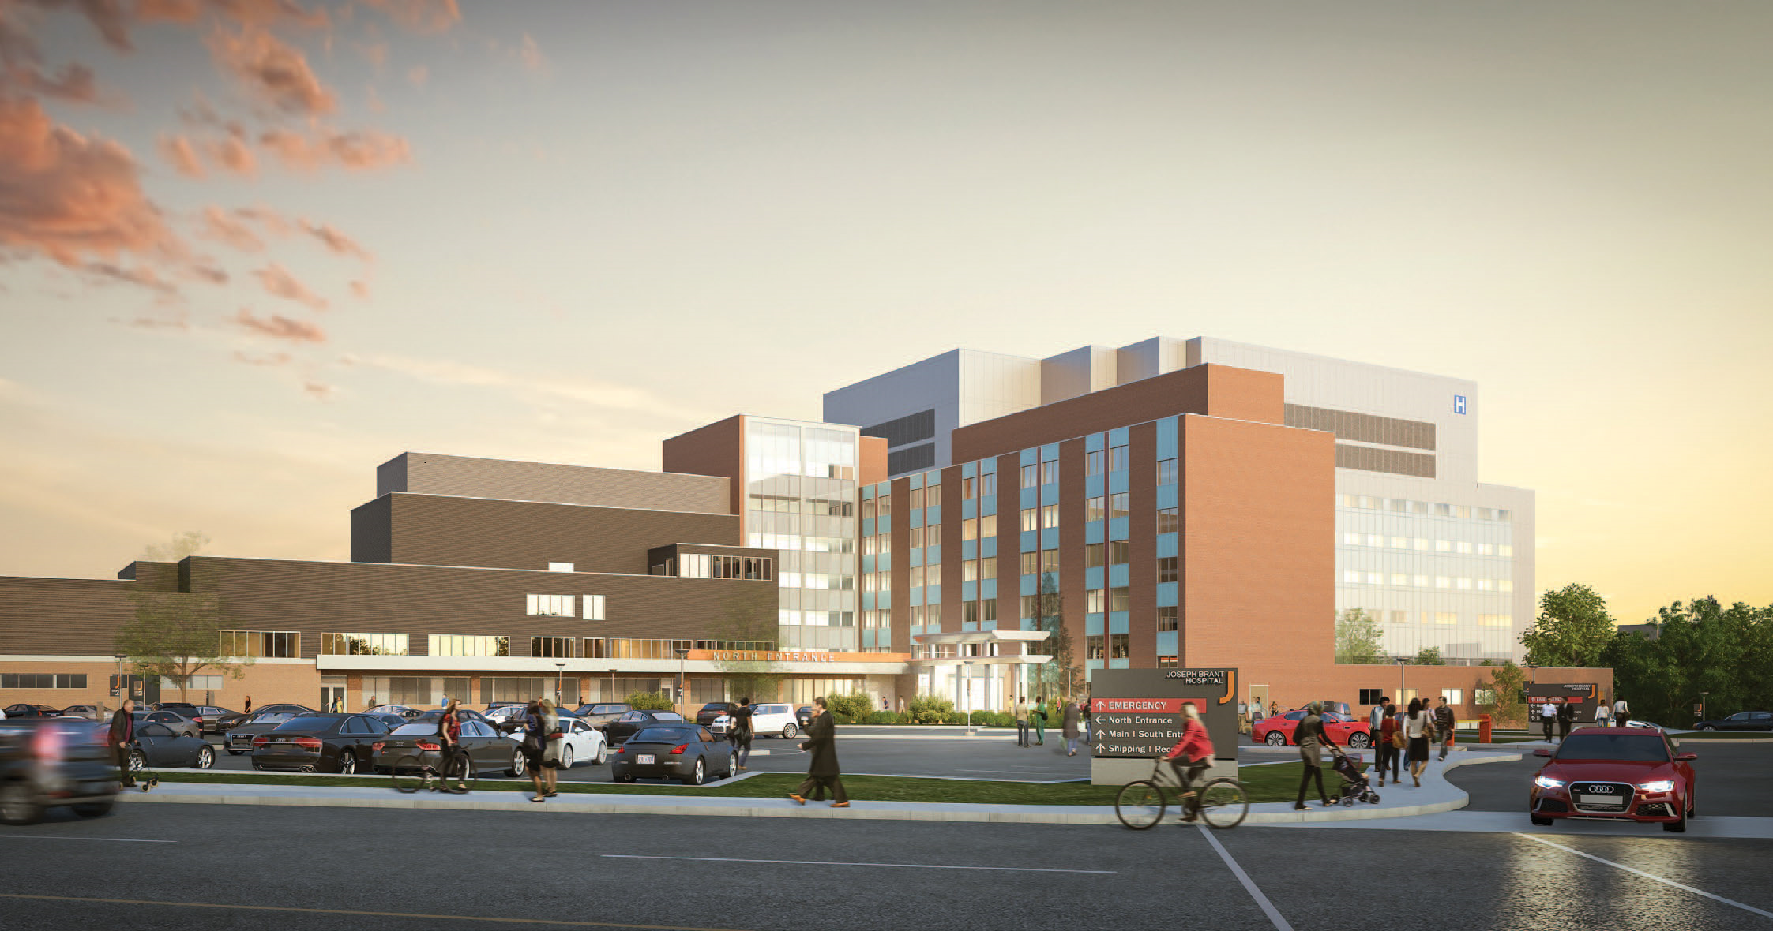
Shelter Human Activity…
Notes:
The primary purpose of a building is to shelter human activities.

Slide 7
Building:
Keeping the Outside Out!
And the Inside In!
Notes:
The Building Envelope is the part of the composition of a building that gives it the ability to meet its purpose which is: Keeping the outside environment out and the inside environment in to provide shelter.

Slide 8
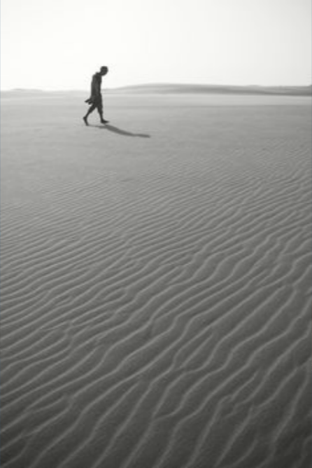
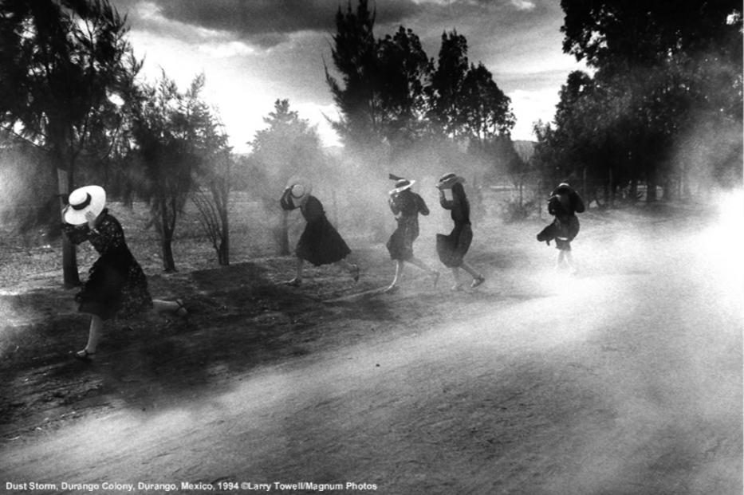
Radiation
Water
Air
Notes:
What is in the environment:
Air – Air is not the issue it is what comes with the air: dust, pollution, pathogens, and moisture.
Radiation – The main radiation with we deal with are UV and thermal. In Texas we keep the heat out. In Minnesota we keep the heat in.
Water – The most destructive element know to man.

Slide 9
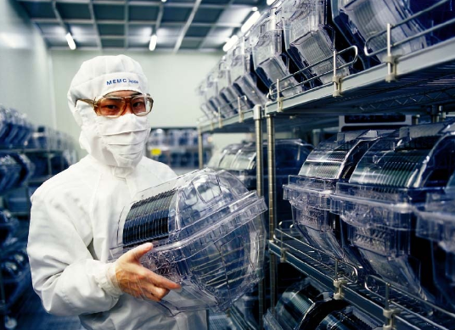
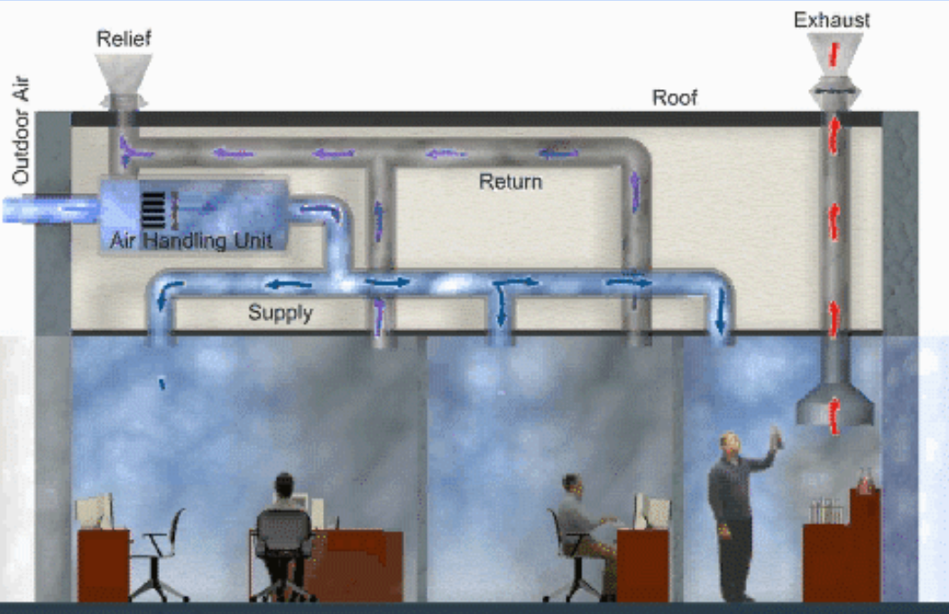
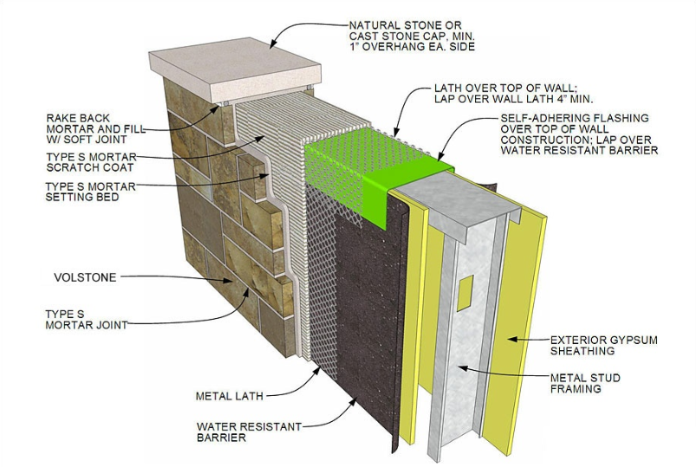
Expectation
Demand
Technology
Notes:
The difference between today's buildings and the buildings in the past:
Demands – We have greater demands on our buildings to shelter more sensitive actives like silicone wafer production.
Technology – We have the technology in the building material to construct buildings to meet our Demands and Expectations.
Expectations – We expect more performance from our buildings because we can control the inside environment with heat, air conditioning, and humidity.

Slide 10
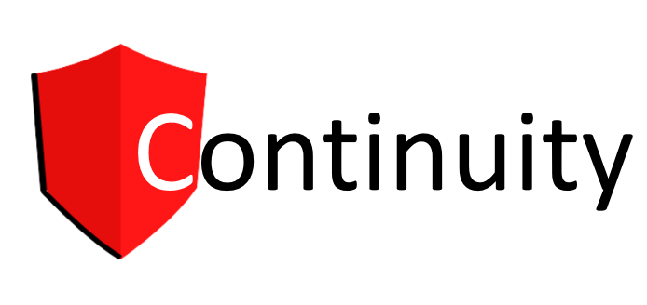
Notes:
Take-away from the presentation is the one word that is missing in our industry: Continuity

Slide 11
Shocking Truth:
80% of new construction litigation involves water intrusion!
Notes:
Considering that there are so many trades working on one building and few people know how to manage Terminations, Transitions, and Penetration, it is no wonder that 80% of litigation involves water intrusion. That is like say 8 out of 10 cars in the new car lot will not run!!

Slide 12
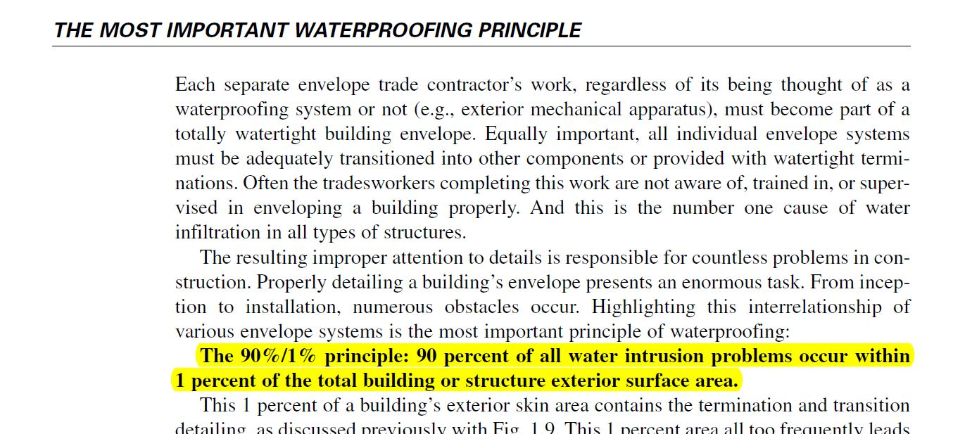
Michael T. Kubal –
Construction Waterproofing Handbook
Notes:
Michael was a waterproofer who was great a stopping leaks. For years, people said he needed to write a book and he did. In that book, he has two principle and the first and most important is the 90%/1% principle. 90% of all water intrusion comes from less than 1% of the building surface.

Slide 13
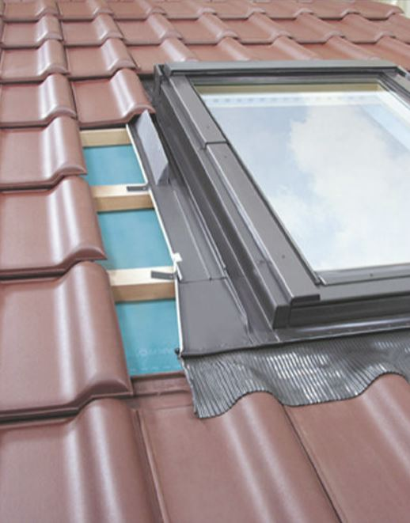
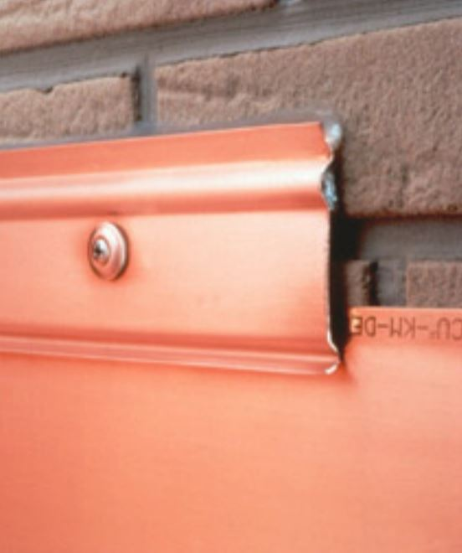
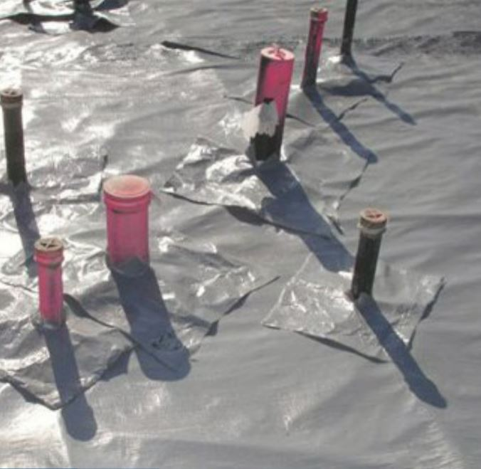
Transitions
Terminations
Penetrations
Notes:
The 1% of the building surface where 90% of leaks occur can be broken down to three places:
Terminations – the area with one system stops and another one starts. There is no through-flashing. So, a crack in the mortar joint will allow water past the termination bar. Is that a roof leak?
Transitions – are the system, but with different components. This is a roof, but it has a skylight. Does the clay tile, rubberized asphalt flashing, aluminum frame, and thermal pain glass expand and contract at the same rate? NO! In Texas during August, that roof will get to 170 degrees, but a thunderstorm could drop it to 70 degrees in minutes. Over time, the delta in thermal movement will causes this to leak.
Penetrations – anytime something passes through a system like an electrical line, a water pipe, or building support. This is a pre-applied waterproofing system that is installed 30 feet in the water-table. Do these flashing give you confidence?

Slide 14
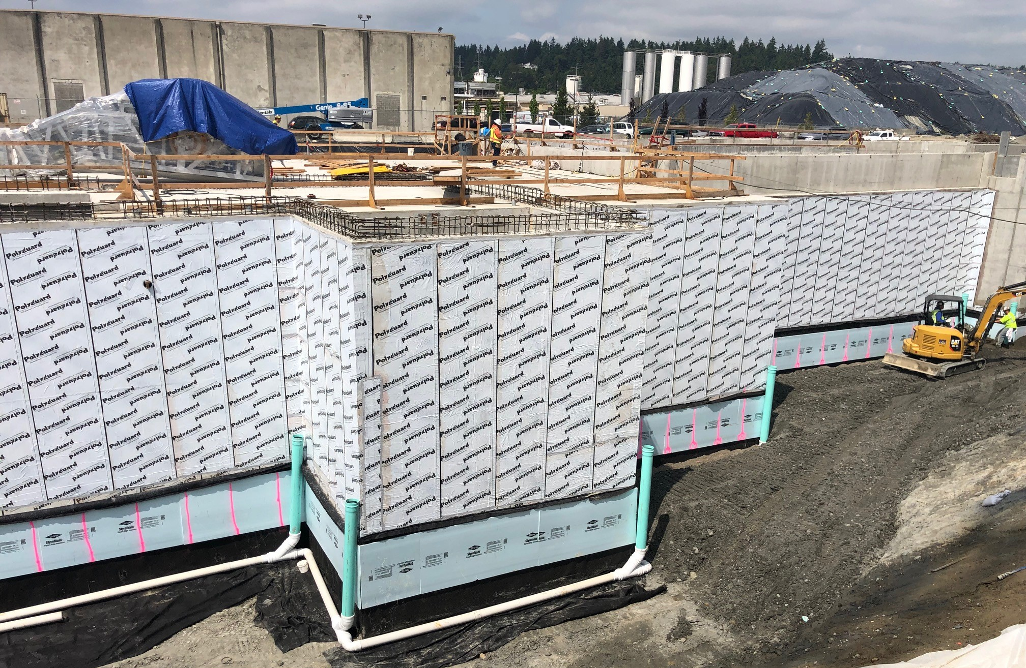
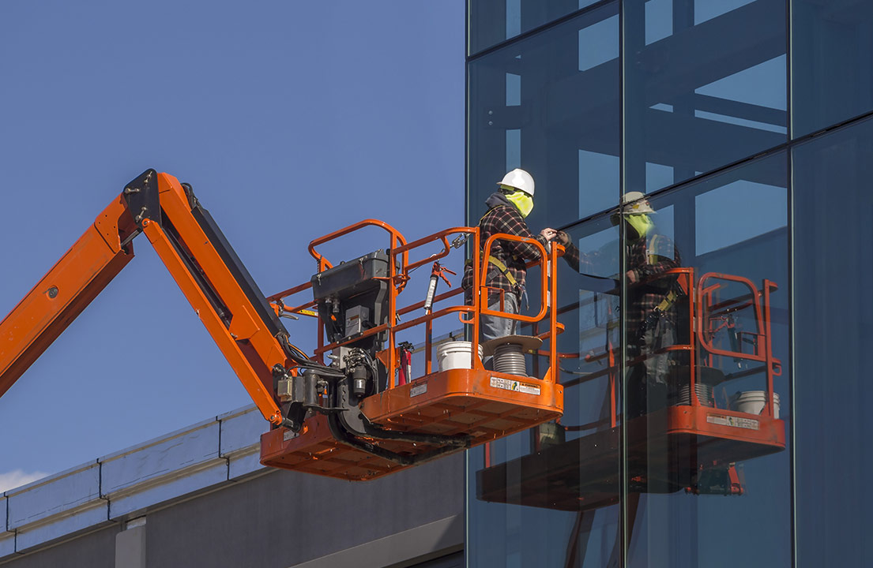
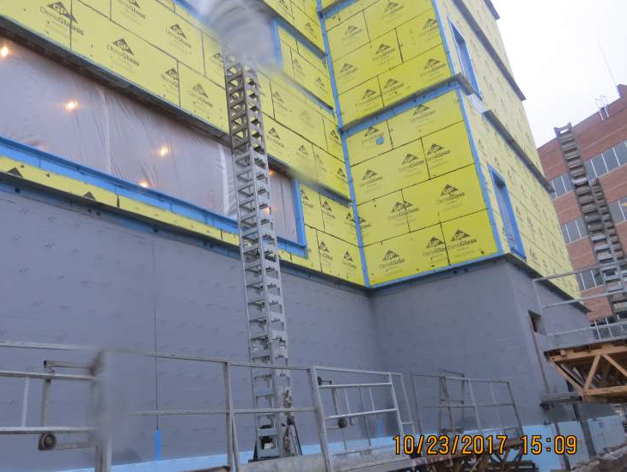
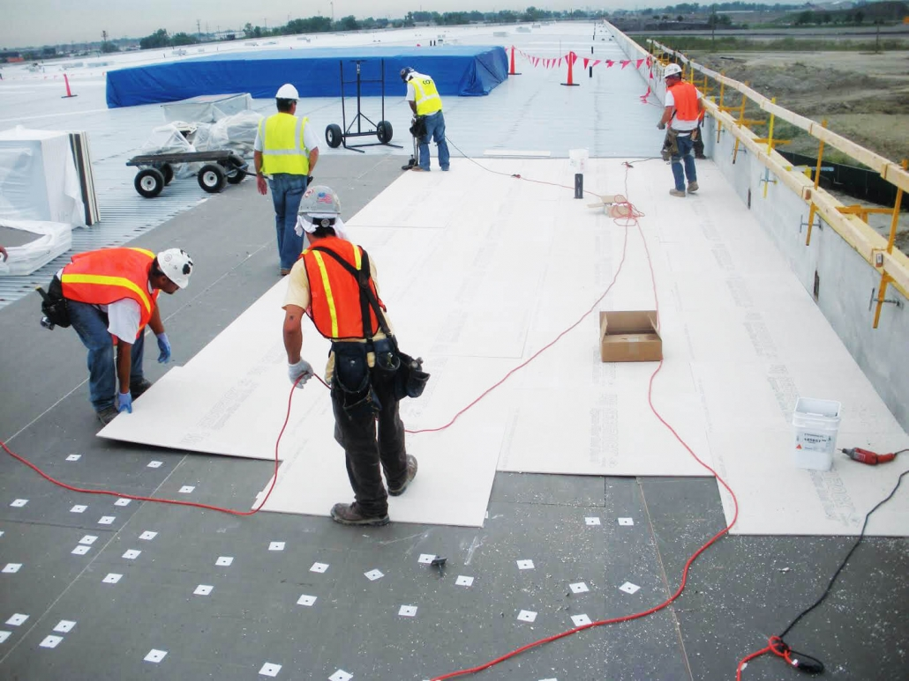
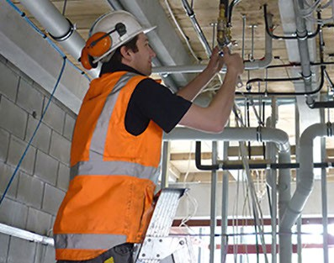
Notes:
We know that know the 90% of leaks occur in less than 1% of the building surface or in three places: Terminations, Transitions, and Penetrations. In construction today the waterproof, the air barrier installer, the glazer, and the roofer are all different contractors. So, the 1% being Terminations, Transitions, and Penetrations is where these installers systems meet, and no one takes ownership. Buildings are constructed and managed by different people at different times.

Slide 15
Power vs. Knowledge – New Buildings
Notes:
Power vs. Knowledge in graphic for New Construction.

Slide 16
Principle
Three Ps of Continuity:
Process
Property
CONTINUITY
Notes:
Continuity is the critical element to achieve success when managing any asset. To attain Continual Asset Optimizations, continuity must be applied to the Three Ps:

Slide 17
Principle:
The set of truths that apply to the subject being managed.
Notes:
Considering that there are so many trades working on one building and few people know how to manage Terminations, Transitions, and Penetration, it is no wonder that 80% of litigation involves water intrusion. That is like say 8 out of 10 cars in the new car lot will not run!!

Slide 18
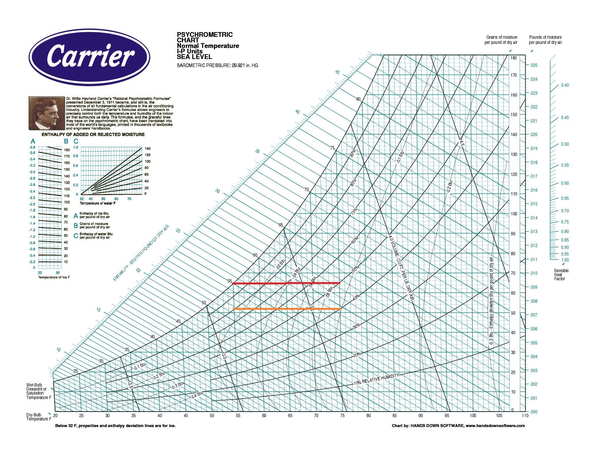
Psychrometric Scale:
Notes:
Carrier gave us the instruction to managing the interior climate of our building in 1911!!

Slide 19
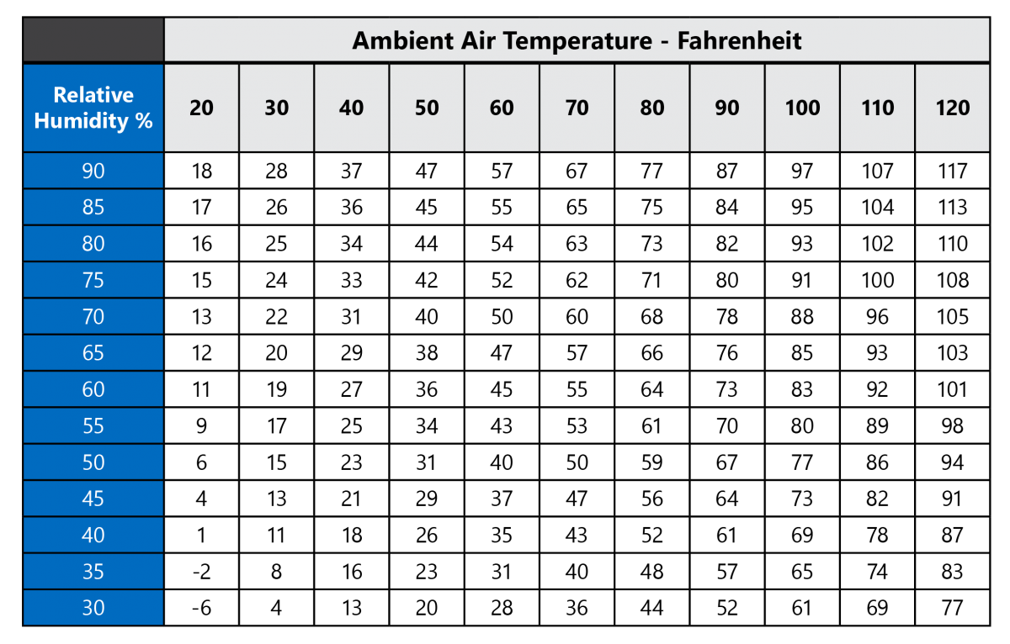
Simple Dew Point:
Notes:
Michael was a waterproofer who was great a stopping leaks. For years, people said he needed to write a book and he did. In that book, he has two principle and the first and most important is the 90%/1% principle. 90% of all water intrusion comes from less than 1% of the building surface.

Slide 20
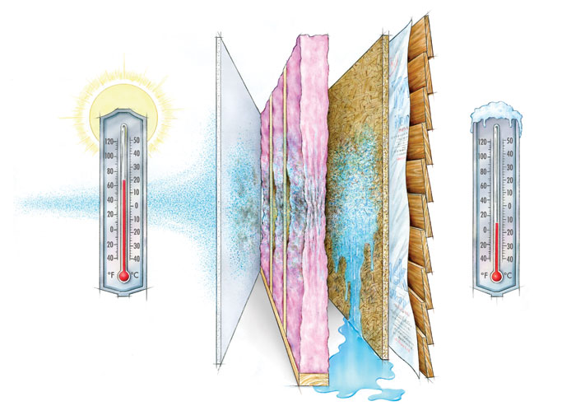
Direction that moisture travels:
Notes:
Michael was a waterproofer who was great a stopping leaks. For years, people said he needed to write a book and he did. In that book, he has two principle and the first and most important is the 90%/1% principle. 90% of all water intrusion comes from less than 1% of the building surface.

Slide 21
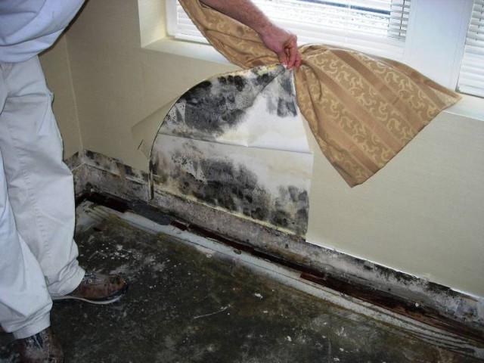
Not aligned with the Principle:
Notes:
Non-permeable vinyl wallpaper. Would it be a problem is the water didn’t get through in the first place?

Slide 22
Process:
The set of activities that apply to the subject being managed.
Notes:
Considering that there are so many trades working on one building and few people know how to manage Terminations, Transitions, and Penetration, it is no wonder that 80% of litigation involves water intrusion. That is like say 8 out of 10 cars in the new car lot will not run!!

Slide 23
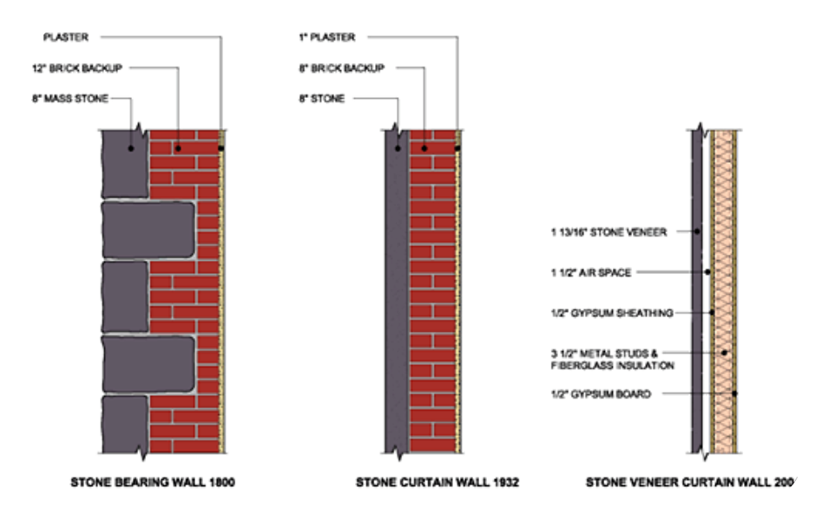
Notes:
Stone load bearing mass wall supports the floors. Stone curtain mass wall are supported by the floors and have no wall cavity. Stone veneer curtain walls are supported by the floors and have a wall cavity.

Slide 24
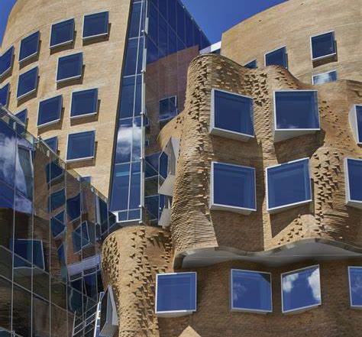
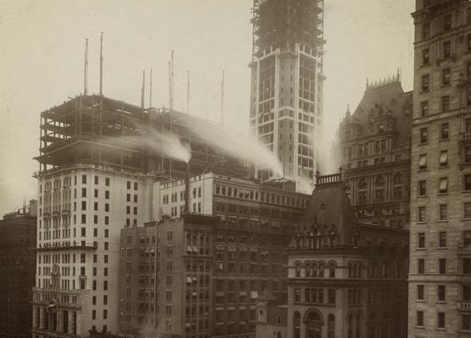
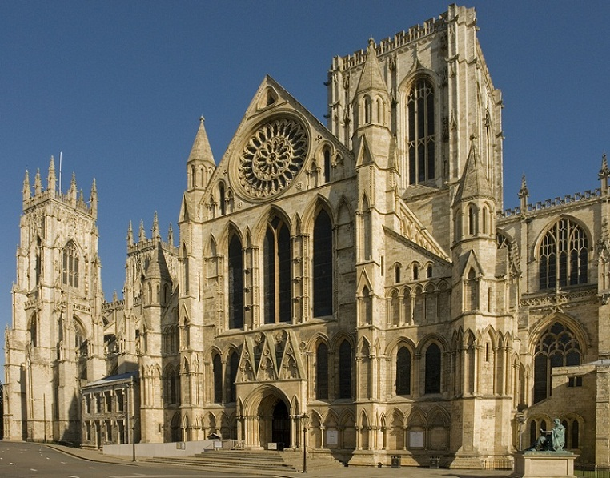
Notes:
Church has stone mass wall construction with multiple wythe of brick getting fewer moving upward where the wall support the floors. 20th Century buildings has mass curtain walls supported by the floors. Frank Gehry is brick veneer curtain wall with cavity and WRB supported by the floors.

Slide 25
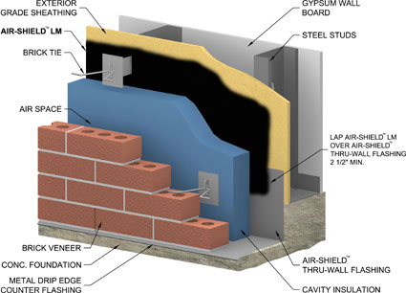
Notes:
Considering that there are so many trades working on one building and few people know how to manage Terminations, Transitions, and Penetration, it is no wonder that 80% of litigation involves water intrusion. That is like say 8 out of 10 cars in the new car lot will not run!!

Slide 26
Property:
The set of elements that apply to the subject being managed.
Notes:
Considering that there are so many trades working on one building and few people know how to manage Terminations, Transitions, and Penetration, it is no wonder that 80% of litigation involves water intrusion. That is like say 8 out of 10 cars in the new car lot will not run!!

Slide 27
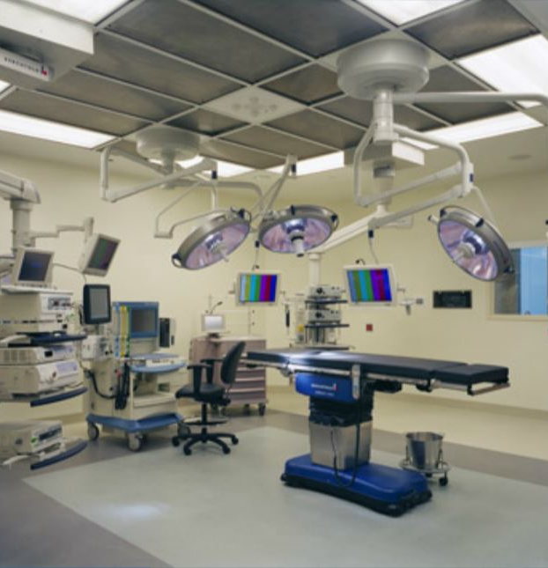
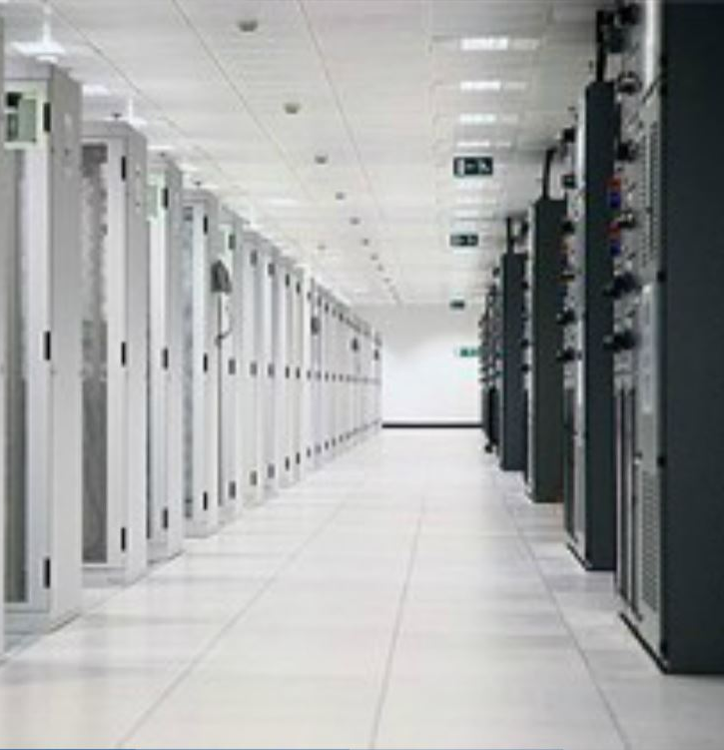
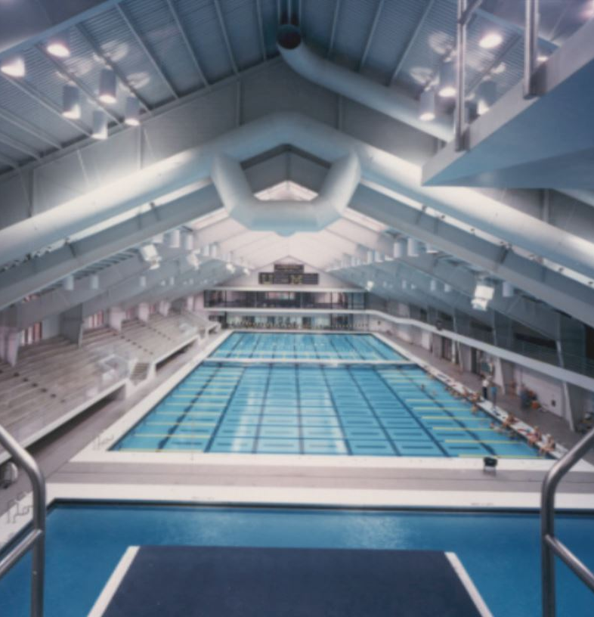
Where and How it is Usage
Notes:
What drives our building design is the use of the building relative to keeping the outside out and the inside in:
Natatorium – has high inside humidity.
Data Center – needs to be as cool as possible.
Operation Room – needs to have positively charged air pressure not to draw contaminates.

Slide 28
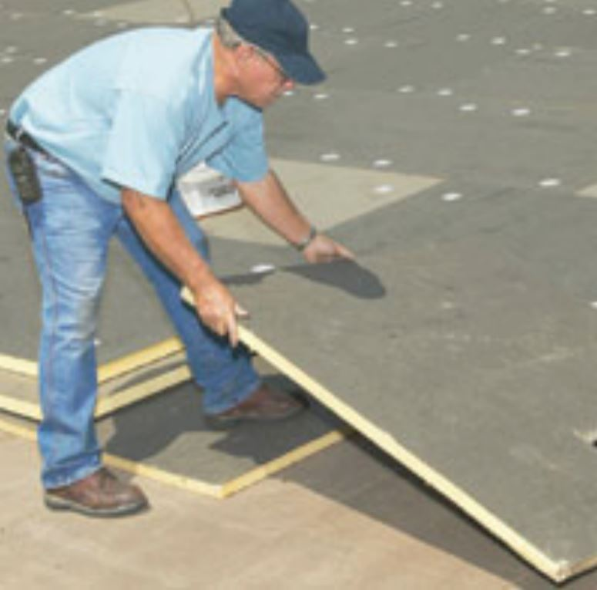
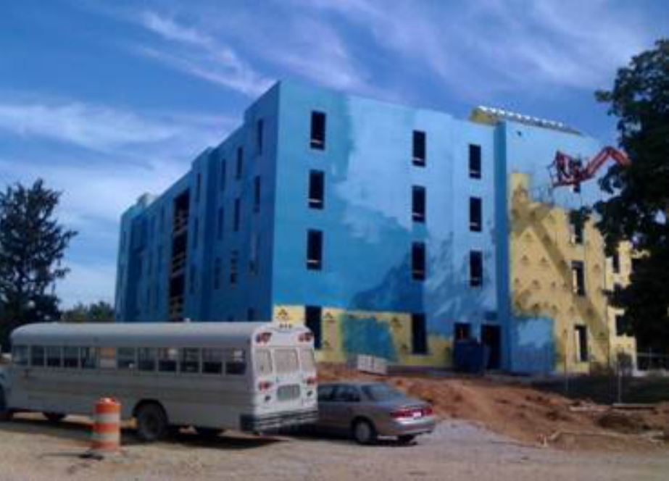
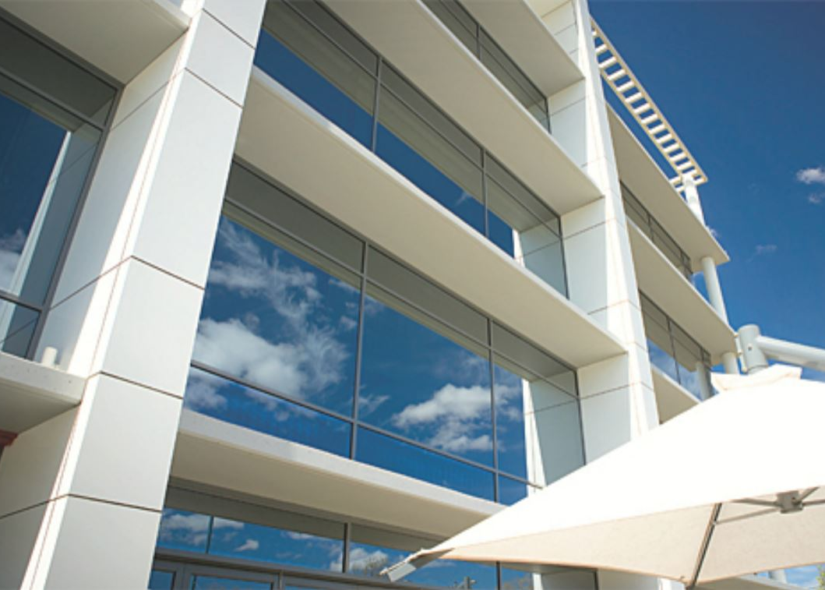
Composition
Notes:
We can construct our buildings with materials to meet our Usage.
Thermal pain glass windows
Insulation
Internal Air Barriers

Slide 29
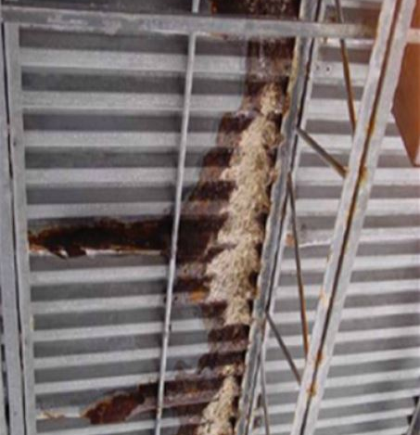
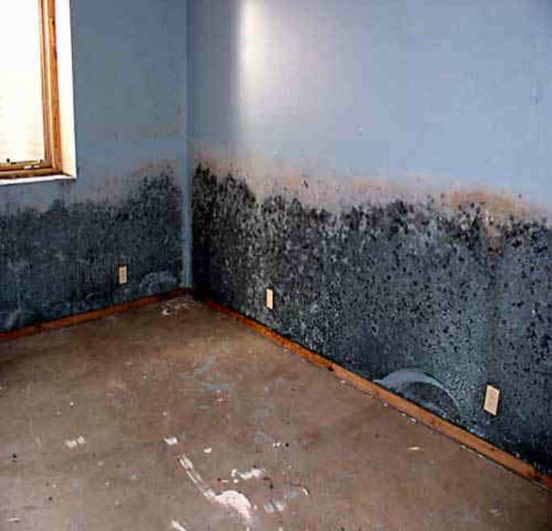
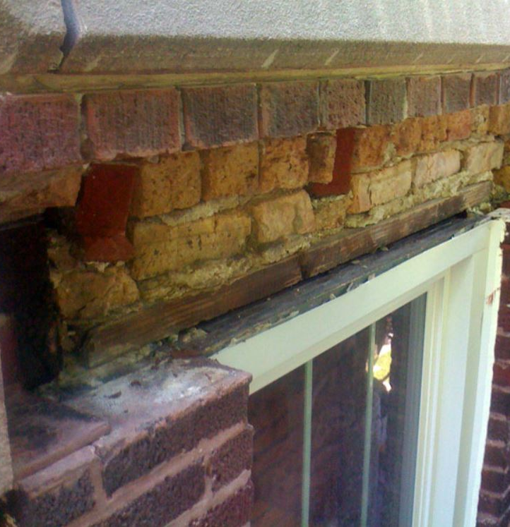
Lifecycle
Notes:
But the Lifecycle of the components affect the usage of the building over time.
Rusted lintels above window that had the weep holes sealed with caulk.
Rusted roof deck because of poorly maintained roof system.
Mold under vinyl wallpaper because fail sealant in the outside wall.

Slide 30
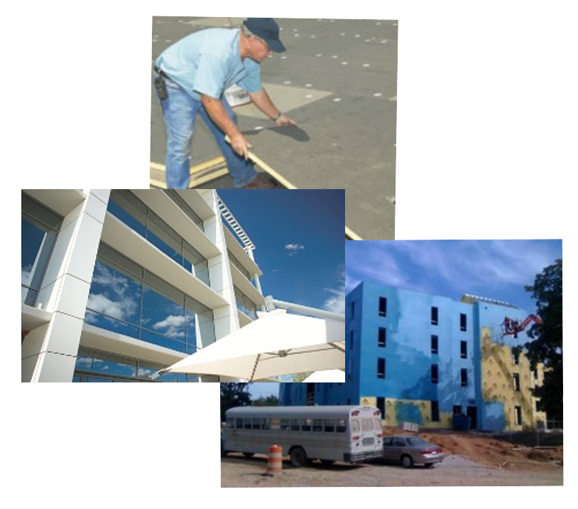
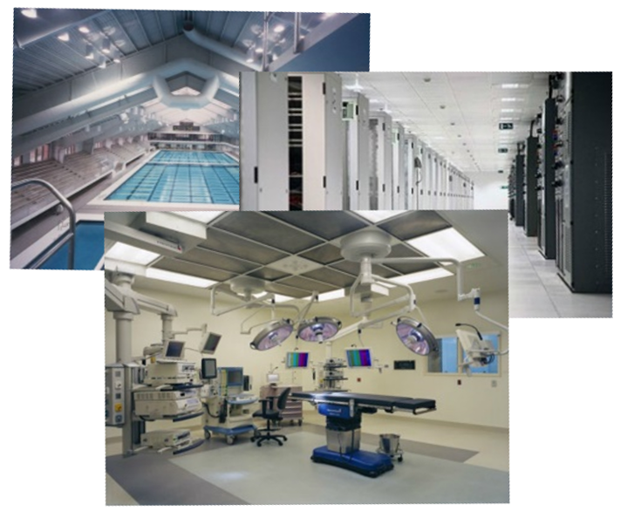
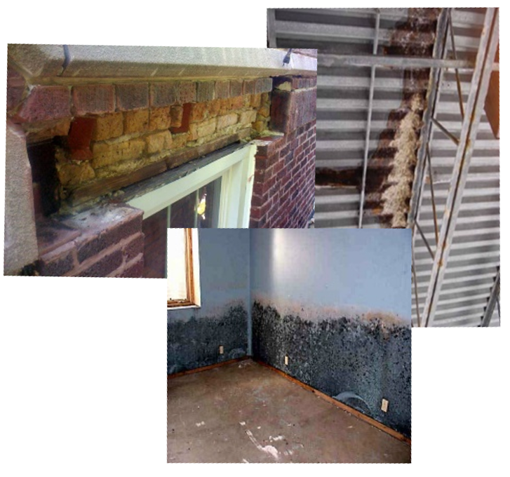
Composition
Usage
Lifecycle
Sustainability
Notes:
Usage, Composition, and Lifecycle work together to create Sustainability.

Slide 31
What does this mean for Existing Building?
Ownership
The building's purpose is shelter, but we build them for financial gain. If it loses its purpose, it loses its value both today and into the future.
Asset Manager
Managing a portfolio is about ROI, but timing is critical. If funds are not directed timely and appropriately, revenue is lost today, with equity being lost into the future.
Property Manager
A property is a mirror, but help is needed for a clear reflection. If the appropriate resources are not available now and for the long term, a property loses its luster.
Facility Engineer
The building is a calling, but the right tools make any job easier. If the job can’t be done efficiently, it typically can’t be done correctly.
What it Mean to your Team
Notes:
They must work together as well!! A sperate page showing how they are connected in the process which would be best done with a graphic.
Everyone love the white letters on the red logo!

Slide 32
What does this mean for Existing Building?
Board of Trustees
The building's purpose is shelter, but we build them for financial gain. If it loses its purpose, it loses its value both today and into the future.
Vice Chancellor of Facilities
Managing a campus is about ROI, but timing is critical. If funds are not directed timely and appropriately, revenue is lost today, with equity being lost into the future.
Physical Plant
The facilities are a mirror, but help is needed for a clear reflection. If the appropriate resources are not available now and for the long term, a things stop working.
Facility Engineer
The building is a calling, but the right tools make any job easier. If the job can’t be done efficiently, it typically can’t be done correctly.
What it Mean to your Team
Notes:
They must work together as well!! A sperate page showing how they are connected in the process which would be best done with a graphic.
Everyone love the white letters on the red logo!

Slide 33
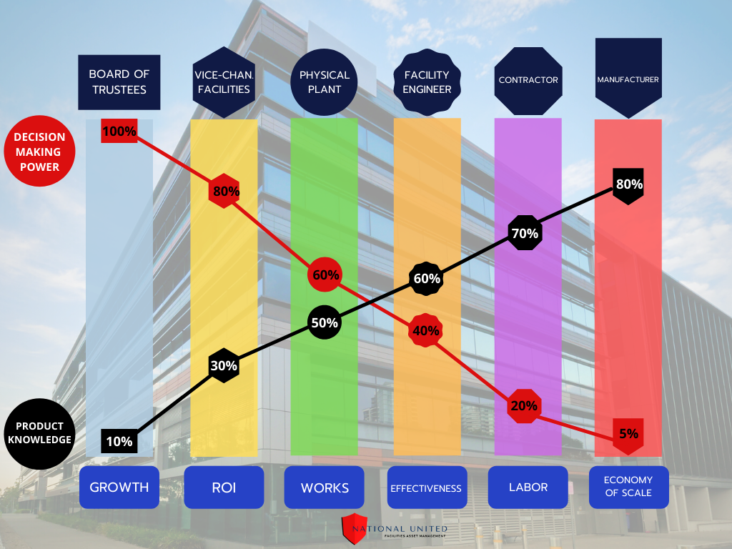
Power vs. Knowledge – Existing Buildings
Notes:
Power vs. Knowledge in graphic for Schools, Colleges, and Universities.

Slide 34
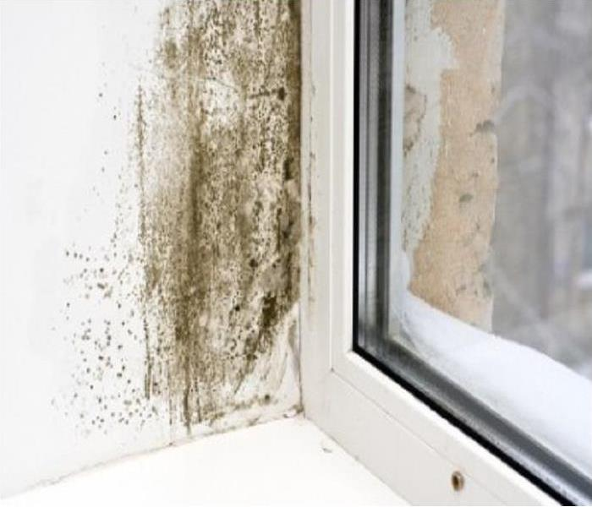
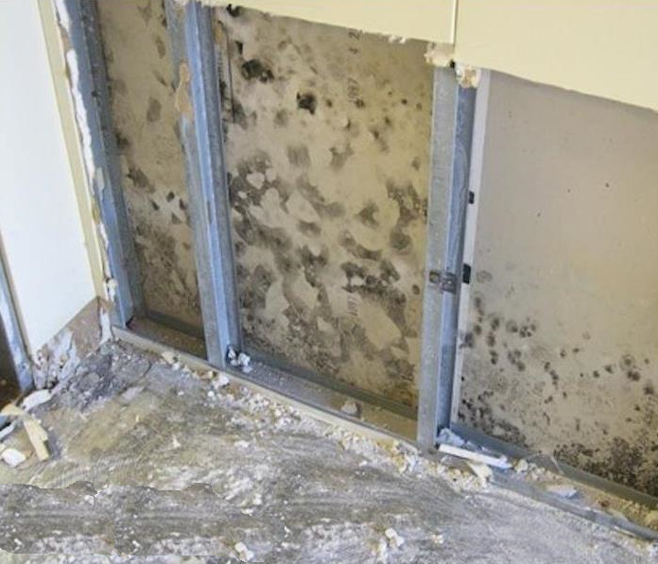
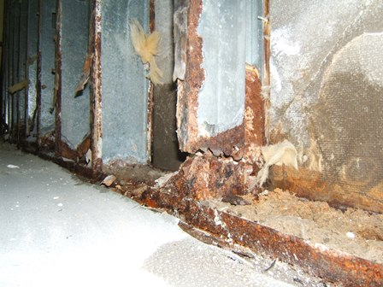
Vast majority of Intrusion…
is not puddles on the floor!
Notes:
Leaks start inside the structure before they appear in the living space as puddles.
Pic #1: mold behind the vinyl wallpaper.
Pic #2: mold in the stud-wall.
Pic #3: rusting of the steel studs and floor plate.

Slide 35
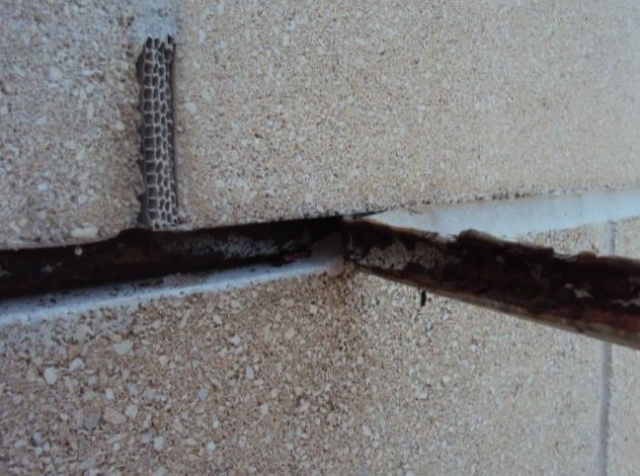
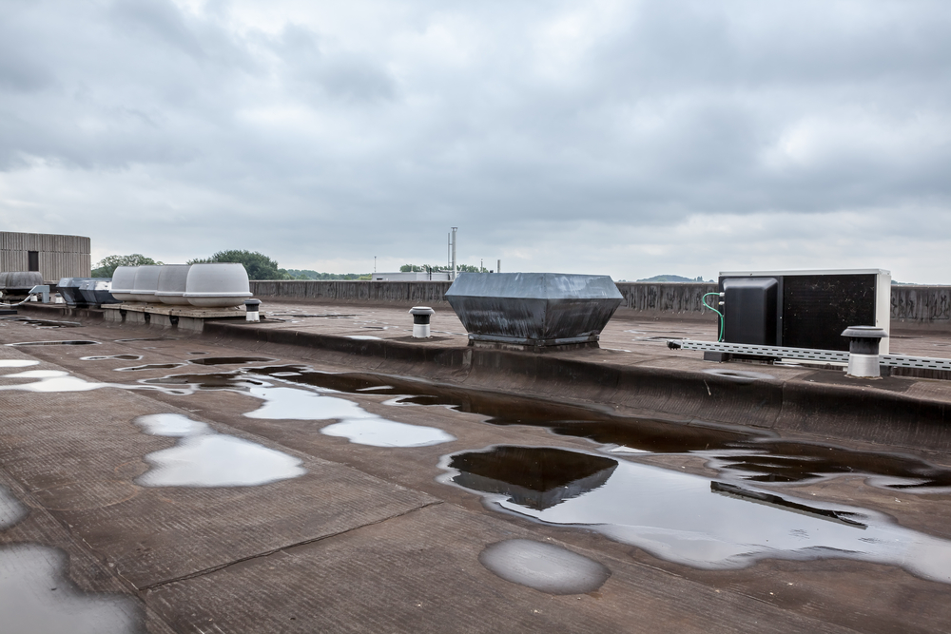
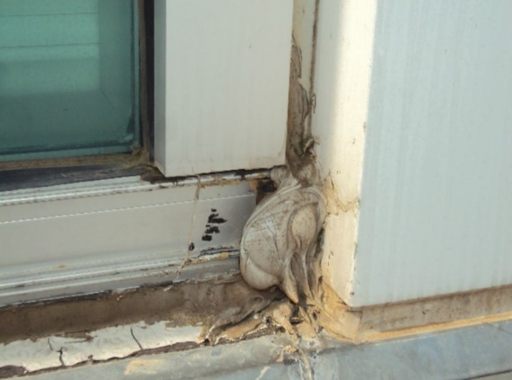
Yesterdays Building Envelope…
is not Today’s Building Envelope!
Notes:
Because it is a slow process, we forget that the Building Envelope which was originally designed and constructed into the building is not same Building Envelope we have today.
Sealed shelf angles will rust.
Sealants around window will need to be replaced.
Roofs require maintenance and eventual replacement.

Slide 36
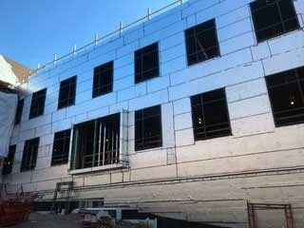
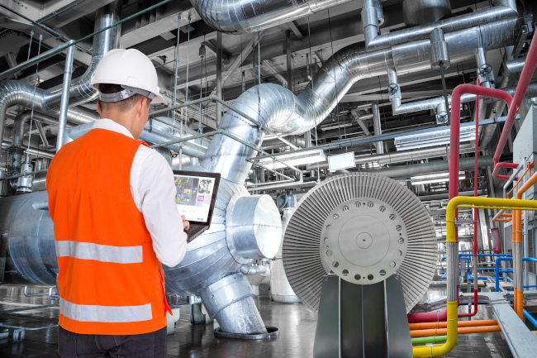
Tomorrow’s Building Envelope…
is the whole building!
Notes:
Tomorrow’s Building Envelope is a whole building approach because you cannot separate the Building Envelope for the internal climate controls. The two, relative to Usage, Composition, and Lifecycle, are intertwined and must work together for proper performance of the building.

Slide 37
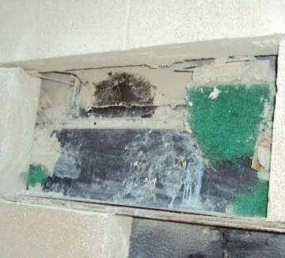
Building Enclosure leaks…
have hidden costs!
Notes:
When components of the Building Envelope are not maintained, the cost are often hidden and grow exponentially:
Through-wall flashing repair - $250 per linear foot and this building had 4,000 linear feet!
Climate Controls – Increased energy use, decreased ability to manage outside contaminants, and difficulty in managing humidity.
Loss of Living-Space – occupancy of the building decrease to poor internal environment, damage to equipment and inventory, and poor appearance.

Slide 38
The Fatal Funnel:
Non-revenue generating space
Reduction in Maintenance Funds
Inefficient building and systems
Mold and sick building syndrome
Expensive emergency repairs
Devaluation of the property
Notes:
The two revenue sources are connected and when they start the downward spiral becomes the Fatale Funnel:
Non-revenue generating space
Mold and sick building syndrome
Expensive emergency repairs
Devaluation due to poor maintenance

Slide 39
This is… preventable.
Notes:
Surfside Condo FL

Slide 40
David Leslie, RWC
President
www.nu-fam.com
dl@nu-fam.com
469-449-3393

